Slide 1
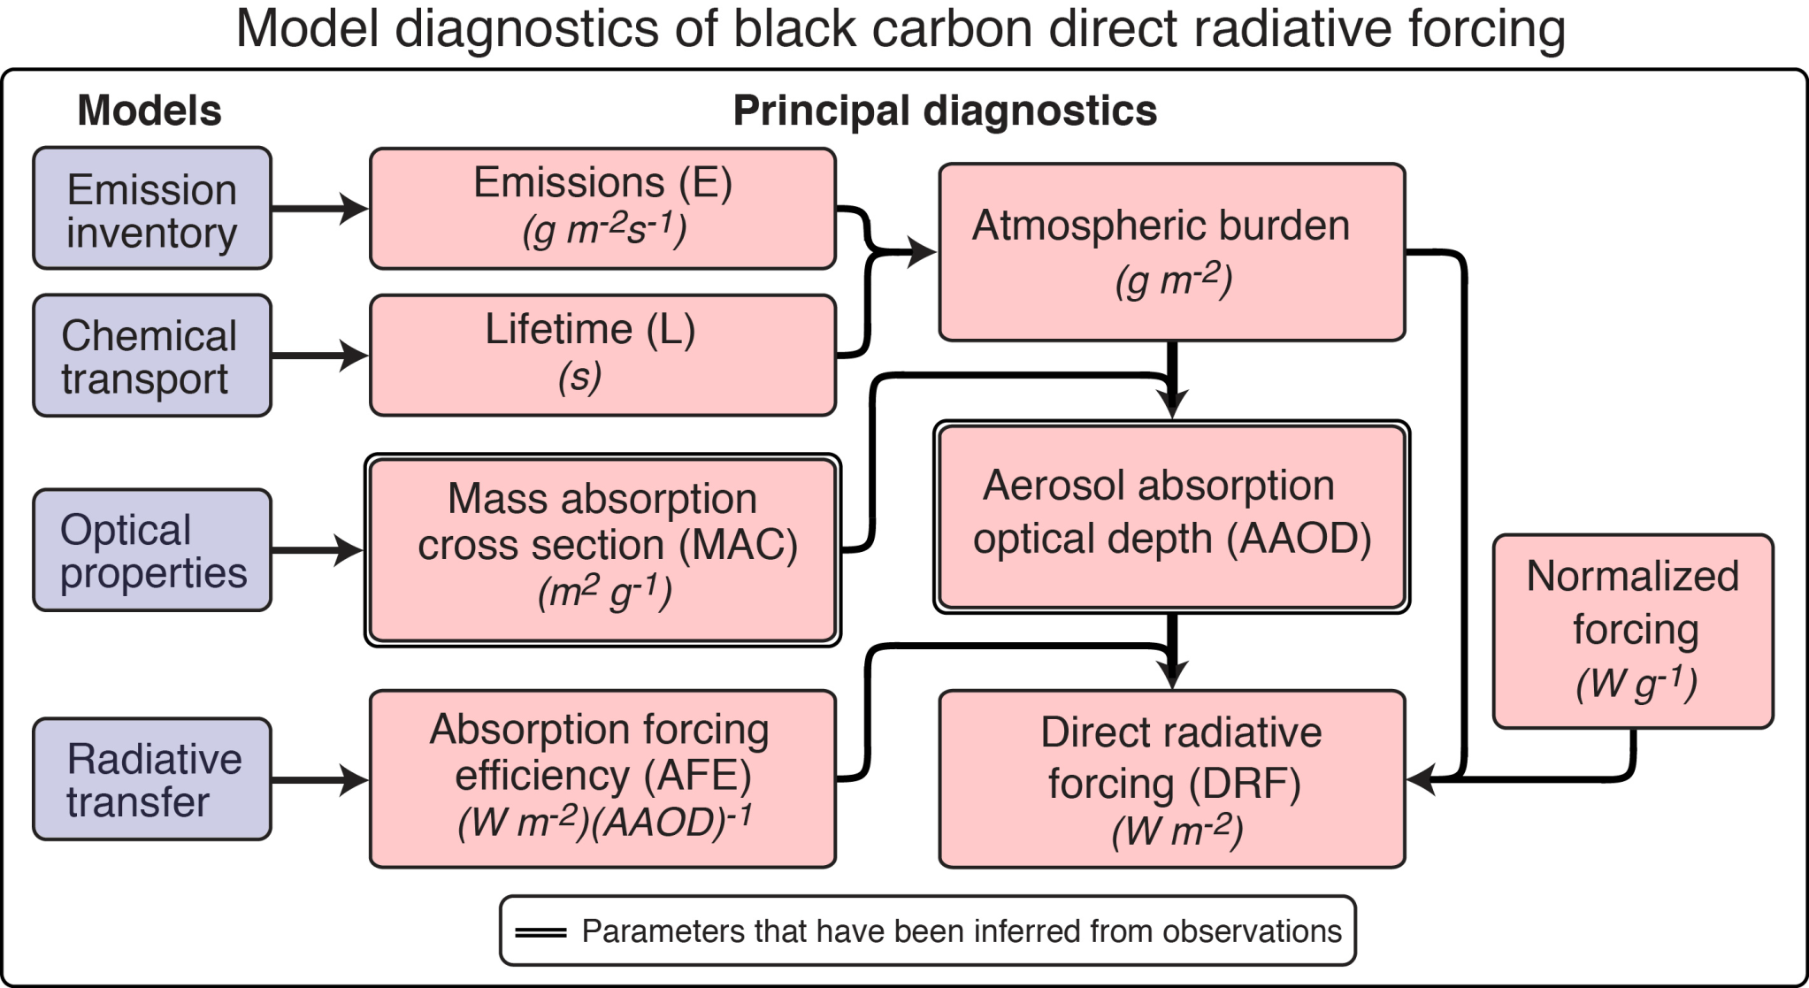
Notes:
Vertical distribution, which is usually poorly modeled, also plays important roles in defining lifetime and MAC

Slide 2
Direct Radiative forcing
BC-RDF=E ×L ×MAC_{BC} ×AFE
Black-carbon cloud effects:
semi-direct effect
indirect effects
Notes:
Insufficient scientific knowledge
Best estimate: non-linear response to emission and burden, scaling
modeled forcing to the new emission rates or forcing is used
Uncertainty: model diversity rather than true uncertainty propagation due to lack of understanding for accurate internal mechanism

Slide 3
Factors ——interconnected, even negatively related
BC-DRF=BC-AAOD ×AFE
(BC-AAOD=E ×L ×MAC_{BC} )
Observation of BC-AAOD is used as constraints to correct modeled atmospheric abundance
Narrow down real RF variation:
smaller than the product of diversity estimated by multiplying the minima and maxima of the four factors

