Slide 1
CO₂ sources and sinks in China as seen from the global atmosphere
Frédéric Chevallier
Laboratoire des Sciences du Climat et de l’Environnement
Gif-sur-Yvette
France

Slide 2
Outline
Method
33-yr global atmospheric inversion
The net carbon budget of China

Slide 3
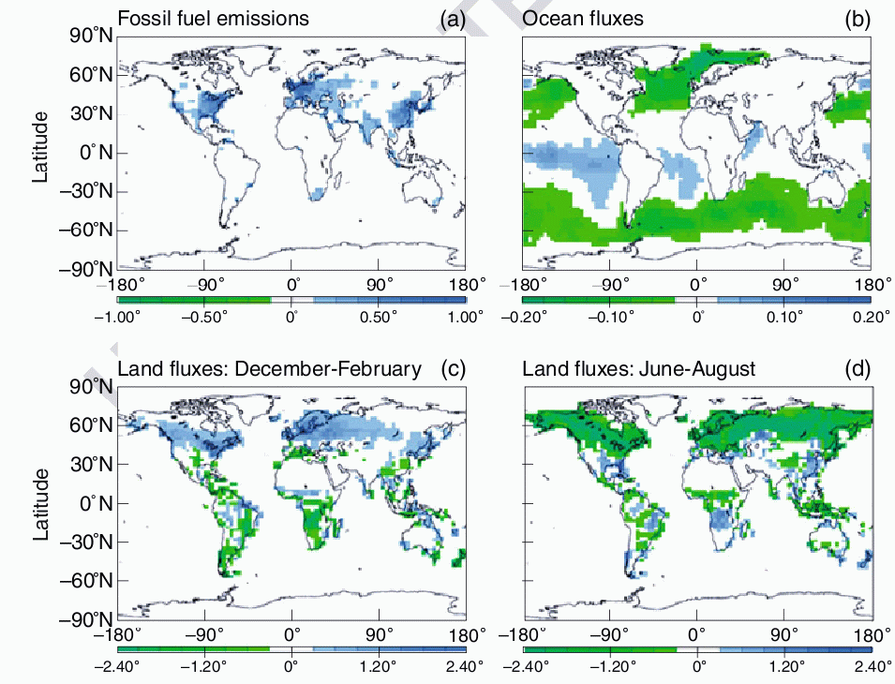
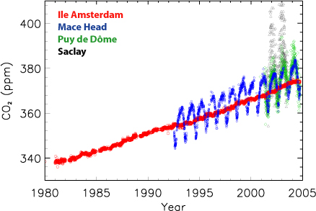
Global CO₂ flux estimation
Non-reversible atmospheric mixing
Need a statistical approach to revert the sign of time

Slide 4
Principles of a full-fledged flux inversion
Probabilistic approach
Observations of [CO₂] p(y|x)
Prior information about the surface fluxes p(x)
Bayes’ theorem
Case of Gaussian PDFs
Posterior PDF defined by
Some of the algebra can be simulated with Monte Carlo
Most likely state of the surface fluxes x also minimizes

Slide 5
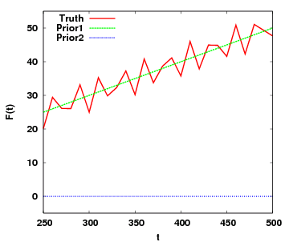
Analytical? Ensemble? Variational?
Flux inversion starts from some prior knowledge
It actually computes flux increments
The structure of the flux increments stems from the structure of the errors of the prior fluxes rather than from the structure of the fluxes themselves
A posterior using a weakly informative prior may be of worse quality than a good prior
Simple example:
Prior1 needs denser observations than Prior2 because it is more informative

Slide 6
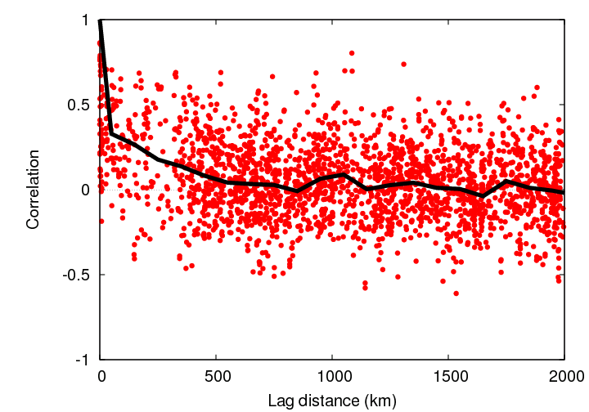
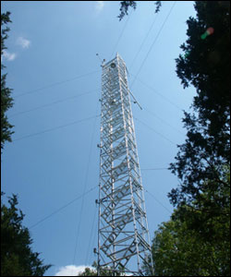
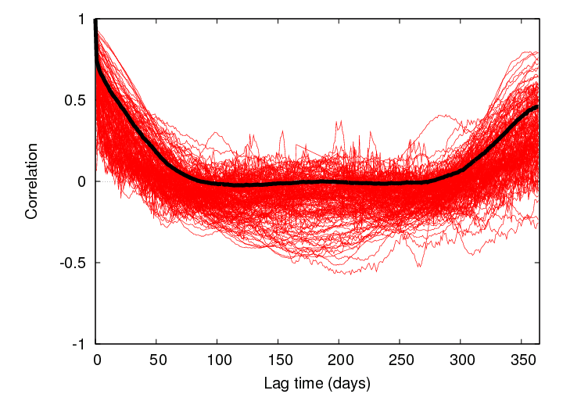
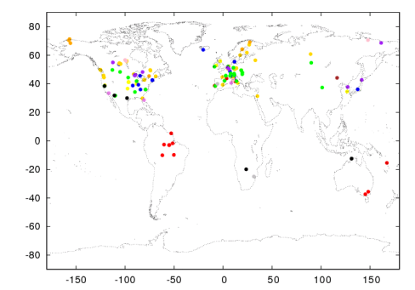
Structure of the prior CO₂ flux errors
Use daily-mean eddy-covariance flux measurements to assign the error statistics of the prior fluxes
Results:
Small spatial correlations
Large temporal correlations
Chevallier et al. (2012)

Slide 7
Structure of the prior CO₂ flux errors
Use daily-mean eddy-covariance flux measurements to assign the error statistics of the prior fluxes
Results:
Small spatial correlations
Large temporal correlations
The small spatial correlations hamper the use of ensemble formulations like EnKF because of the curse of dimensionality

Slide 8
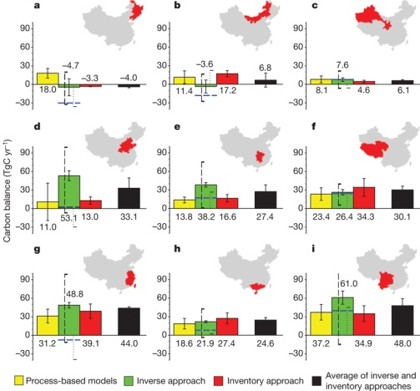
Analytical approach
Piao et al. (2009) with an inversion system from Peylin et al. (2005)
Global inversion with a focus over China
Grid-point inversion system exploiting monthly averages of observations (“large” control vector, “small” observation vector)
Mean budget of Chinese terrestrial ecosystems of 0.35±0.33 GtC/yr

Slide 9
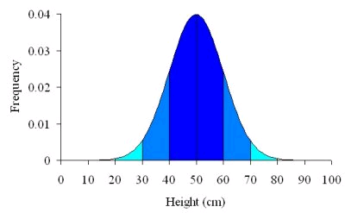
Hybrid approach
Variational approach for high-resolution information
Weekly grid point fluxes (3.75x2.5 deg² global)
or hourly fluxes at ~ 10 – 100 km² regional
Ensemble approach for coarse resolution information
Mean variance of the flux errors over long periods of time

Slide 10
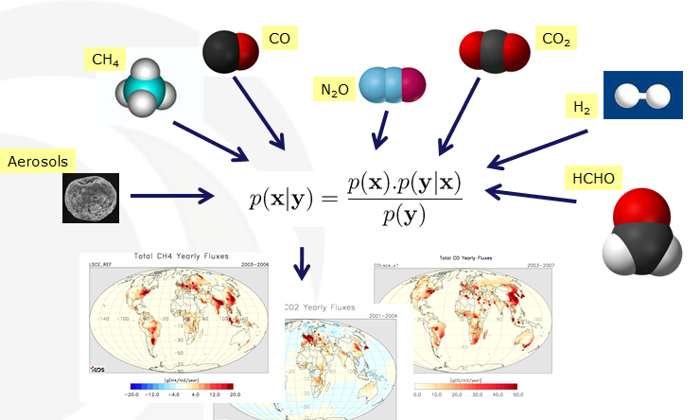
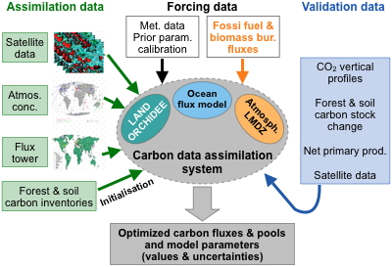
One equation fits all
PYVAR modular framework

Slide 11
Computational performance
Tedious adjoint coding
Both variational systems and transport models usually exhibit limited scalable parallelism
Large effort for PYVAR
33-yr CO₂ global inversion now runs in a week
Global 3.75x2.5 deg²
Weekly day/night
7,000,000 variables to infer

Slide 12
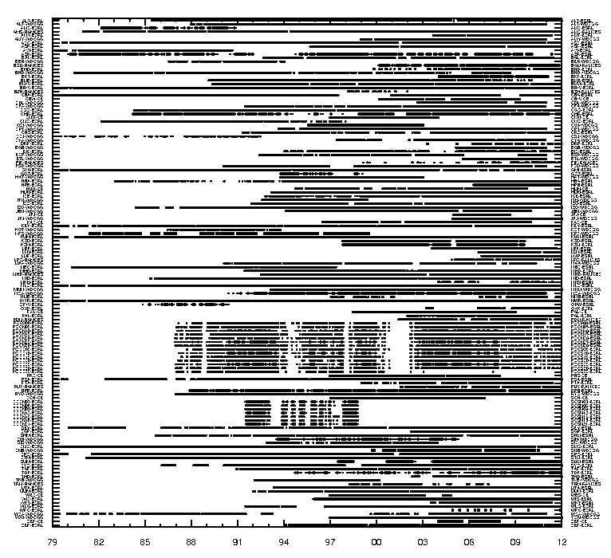
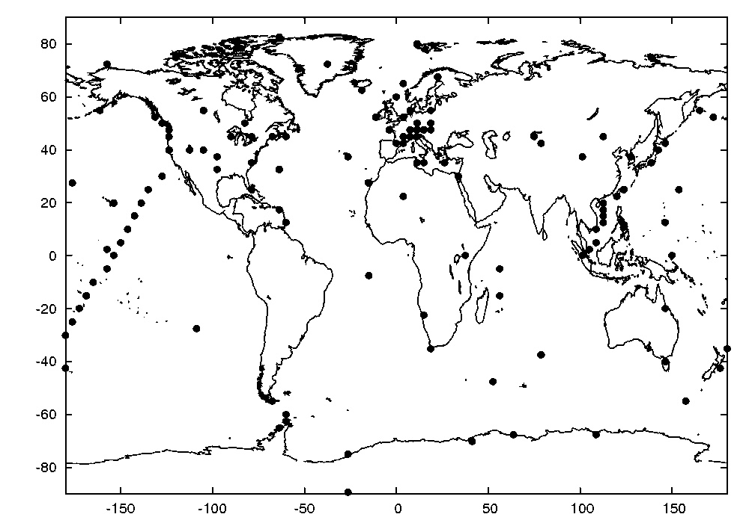
Assimilated data for 1979-2011
Dry air mole fraction of CO₂ from 136 surface stations
NOAA, WDCGG, CarboEurope, RAMCES databases
Each station record spans at least 5 years
Irregular time-space distribution
1979
2012

Slide 13
Prior fluxes
Annual anthropogenic emissions from EDGAR.4.2 and CDIAC
Climatological monthly ocean fluxes (Takahashi et al. 2008)
Climatological monthly biomass burning emissions (taken as the 1997-2010 mean of GFED3)
Climatological 3-hourly biosphere-atmosphere fluxes taken as the 1989-2010 mean of a simulation of ORCHIDEE, v1.9.5.2.
Interannual variations from fossil fuel emissions only
1979
2012

Slide 14
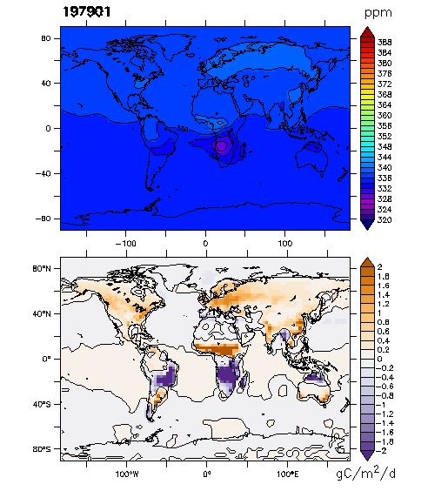
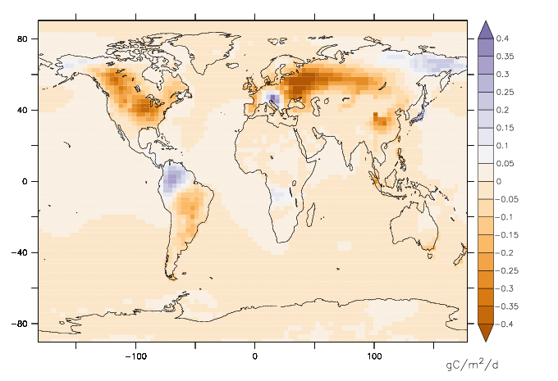
Monthly flux maps
XCO₂
1979-2011
3-hourly available as well
Mean inversion increments
Surface fluxes

Slide 15
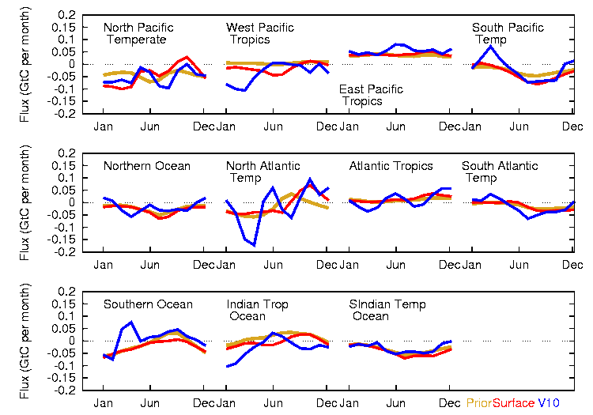
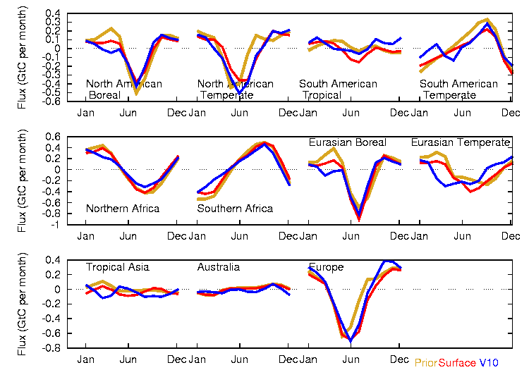
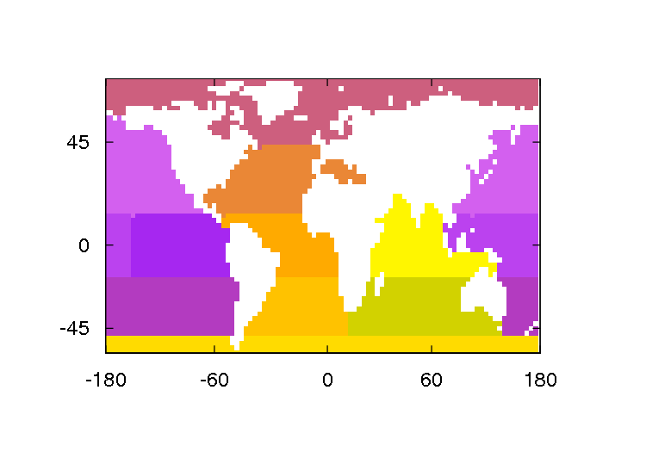
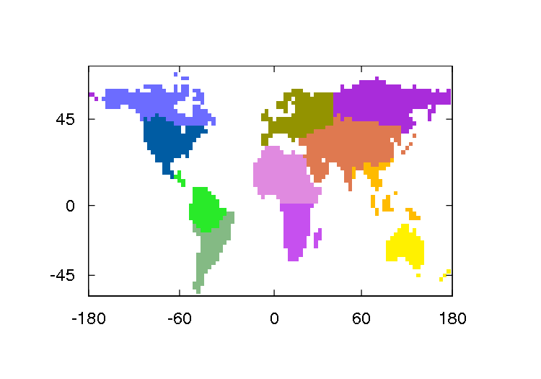
Seasonal cycles of natural fluxes
2009, TransCom3 regions, v11 vs. v10 (Chevallier et al. 2011)
Fossil fuel from EDGAR.4.2 and CDIAC
Prior
V11
V10

Slide 16
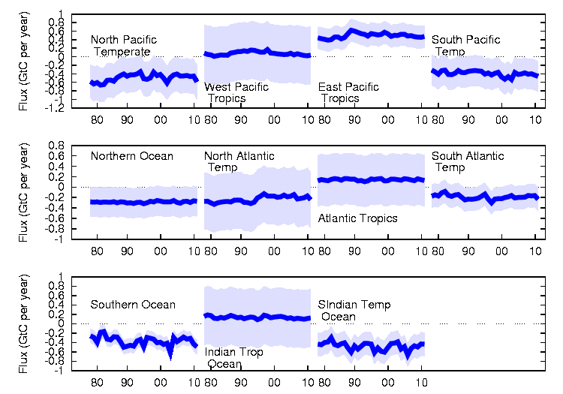
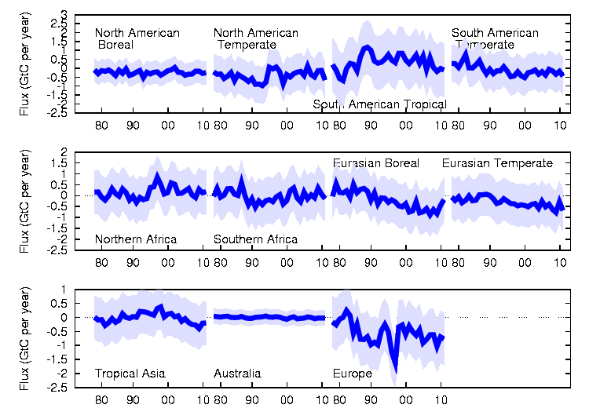
1979-2011 annual natural budgets
TransCom3 regions
Fossil fuel from EDGAR.4.2 and CDIAC

Slide 17
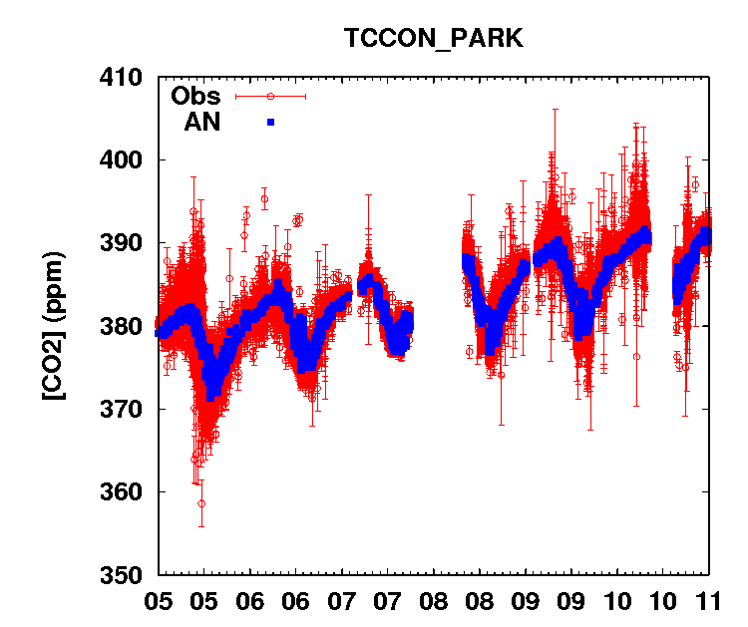
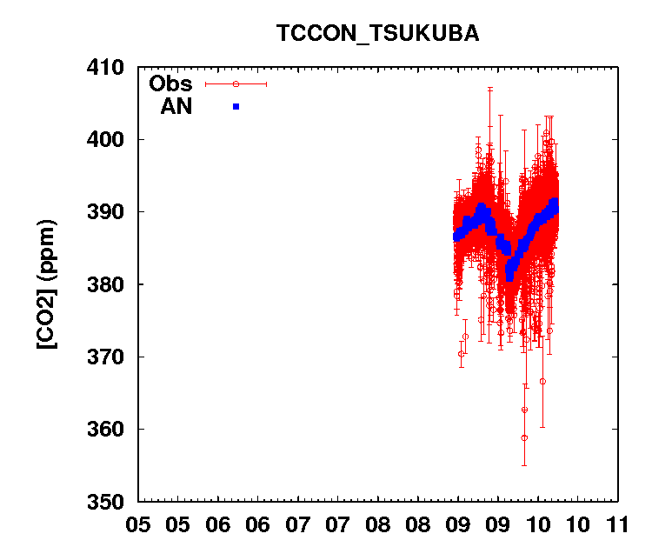
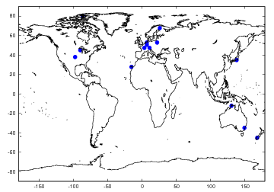
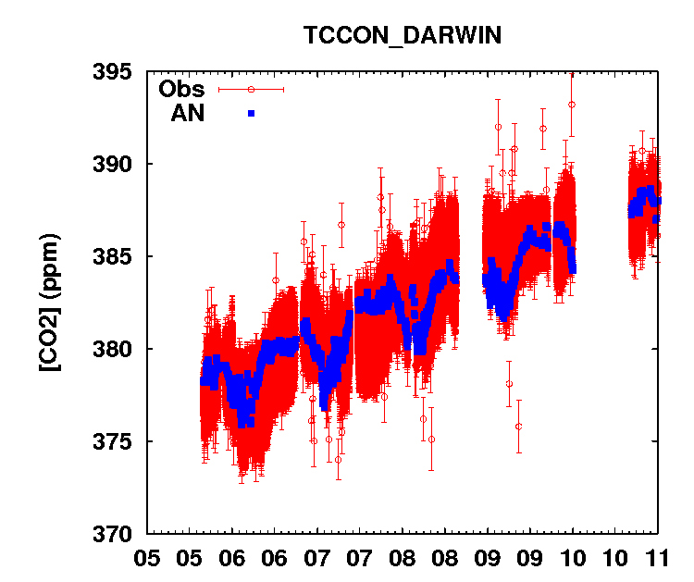
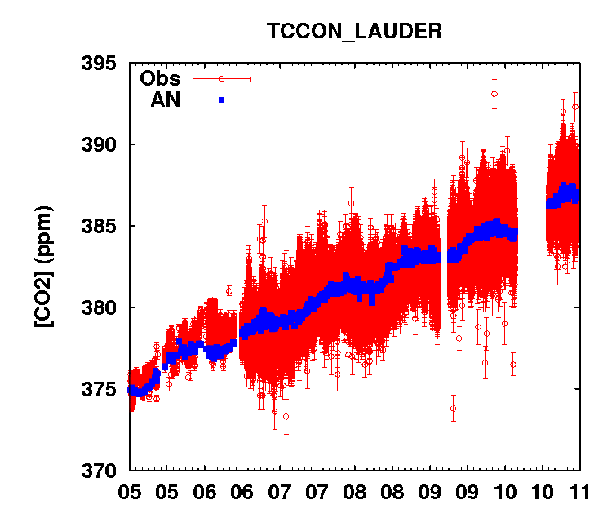
Comparison with total column measurements from TCCON
14 TCCON stations

Slide 18
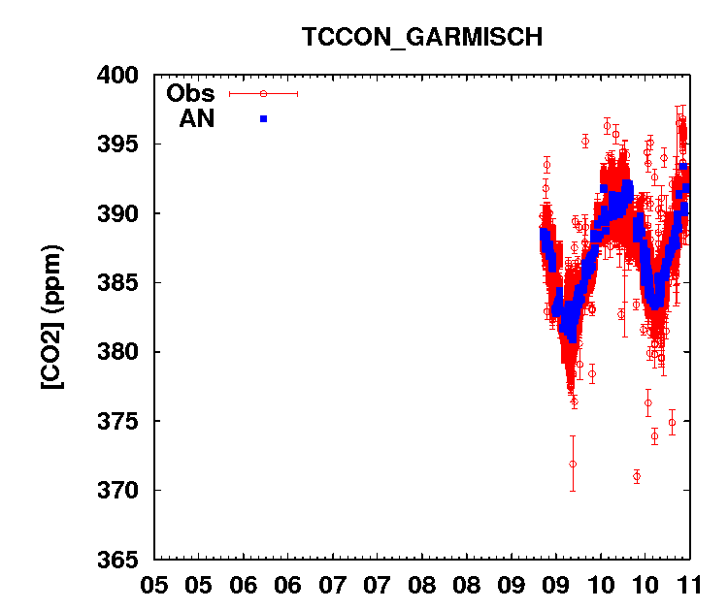
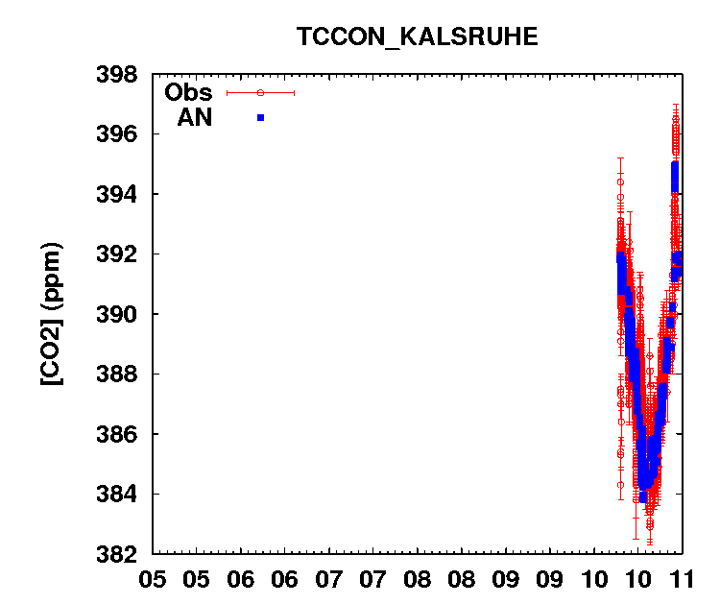
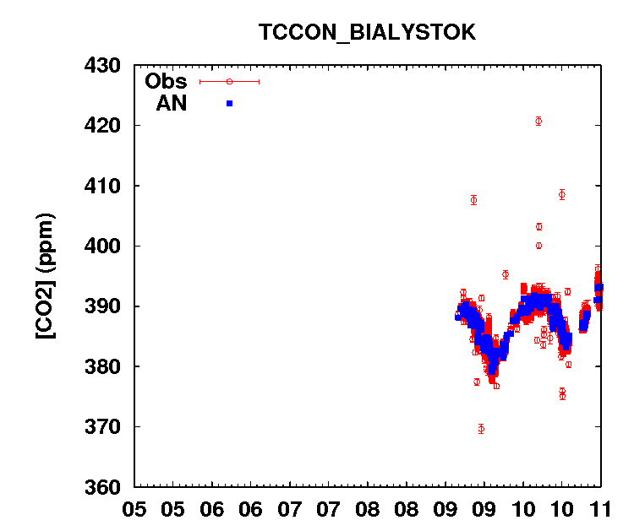
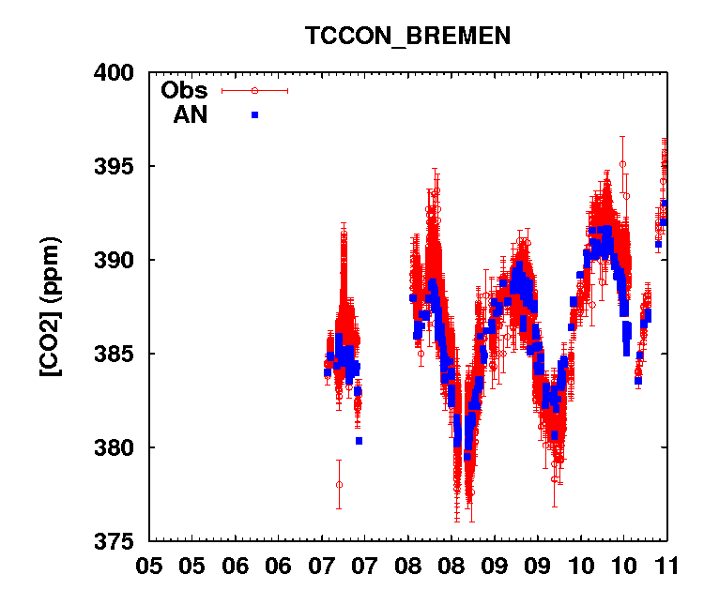
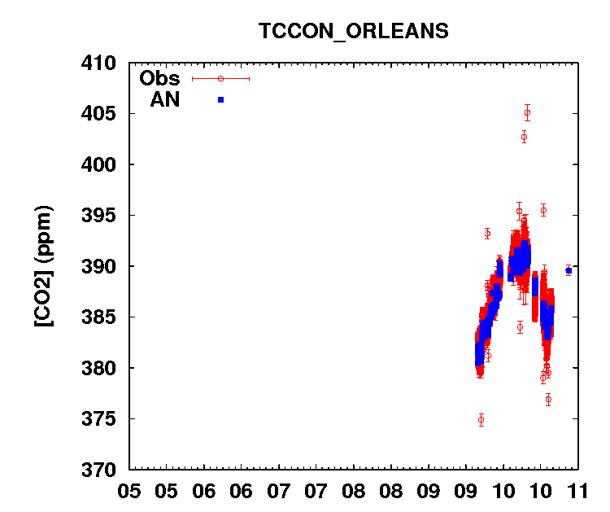
Comparison with total column measurements from TCCON

Slide 19
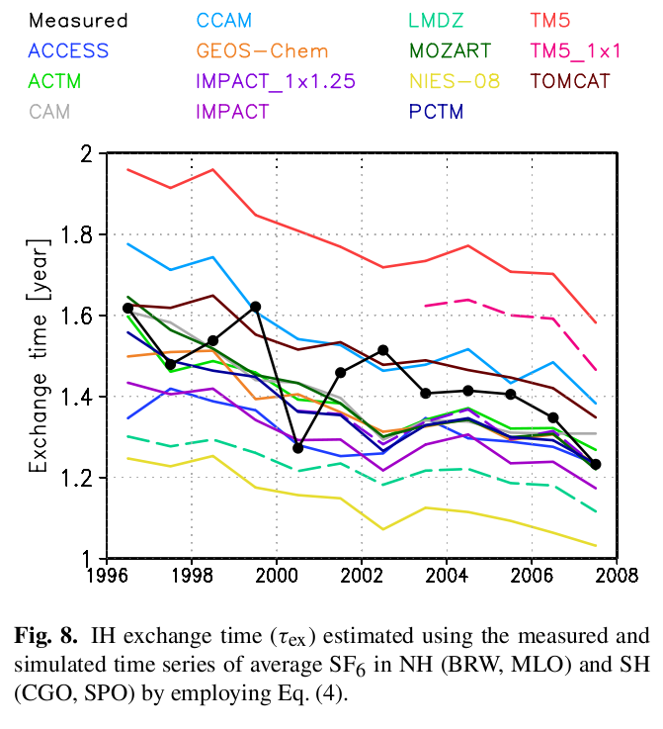
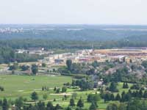
Limitations
Transport model systematic errors
Accounting for subgrid scale variability around measurement stations
GIF station (RAMCES)
Patra et al. (2011)

Slide 20
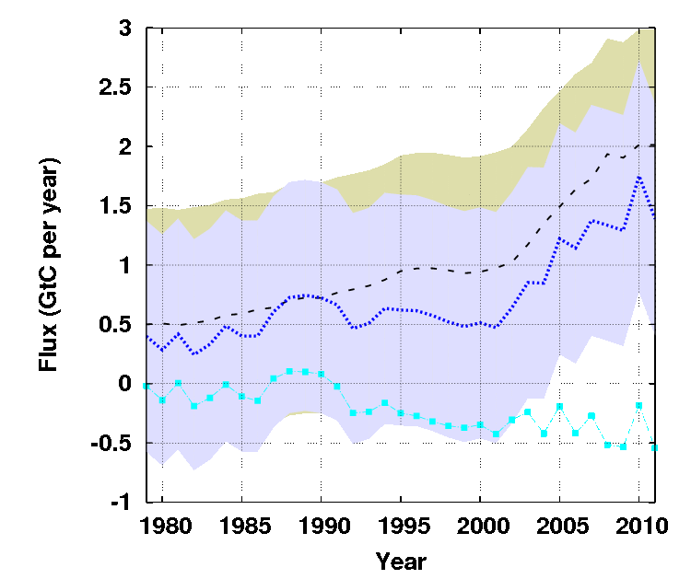
Carbon budget of China
~110 LMDZ pixels
The inversion has a mean NEE of -0.21GtC/yr varying by 0.18 GtC/yr (s.d.) from year to year, driven by measurements only
Trend of ~ -0.05GtC/yr in the 90s, stable before and after
Large uncertainty (~1GtC/yr s.d., but not up to date): overestimated?

Slide 21
Carbon budget of China
~110 LMDZ pixels
The inversion has a mean NEE of -0.21GtC/yr varying by 0.18 GtC/yr (s.d.) from year to year, driven by measurements only
Trend of ~ -0.05GtC/yr in the 90s, stable before and after
Large uncertainty (~1GtC/yr s.d., but not up to date): overestimated?
1996-2005
This study: -0.32±1.0 GtC/yr
Piao et al.: -0.35±0.33 GtC/yr
Same transport model (LMDZ), but with versions ~ 5 yrs apart
Different observation selection and processing
Different statistical models

Slide 22
Prospects
Update error estimates, possibly revise them
Update fossil fuel maps (Wang et al.)
Use Chinese stations
Zoom transport model over Asia
Improved physics
Regional analysis

