Slide 1
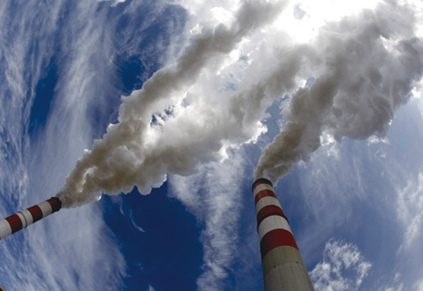
Global Inequality of CO2 Emission A study based on Gini coefficient
Yu Zhang
Environmental Science
PKU
Notes:
Good afternoon pro., im another student of Pro. Li. And I’m going to give you a short report of XXXX
Gini coefficient is widely use concept in economics to quantify the gap between the wealth and poor, so we want to use this index, which is generally understood and easy to calculate, to indicated the global inequality of CO2 emission

Slide 2
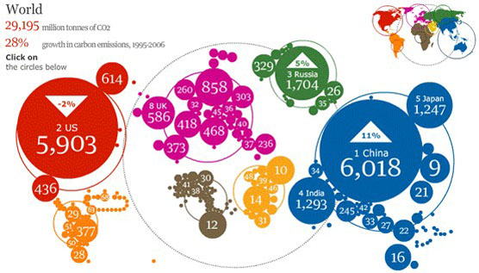
Global FF-CO2 emission
Fossil fuel accounts for more than 80% in energy use worldwide
More than 30Pg(Peta-gram) CO2 in 2010
Limited main emission countries
How much the inequality are
Notes:
The number may be not so accurate because this the not the latest data, but we can still have a general understanding that which countries contributes most for global CO2 emission growth
It’s a truth that there are inequality of CO2 emission--some country has a large emission while some not, we want to figure out, how much the inequality are?

Slide 3
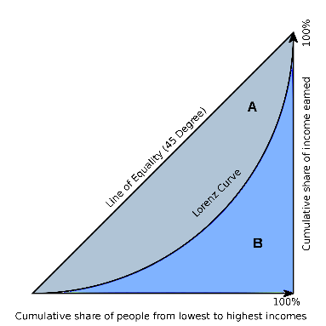
Gini Coefficient & Lorenz Curve
Gini coefficient
Represent income distribution of a nation's residents
How much proportion of income is unequal
Based on Lorenz Curve
Lorenz Curve
A graphical representation of the cumulative distribution function of the empirical probability distribution of wealth
Horizontal axis is percent of people and the vertical axis is the percent of income those people receive
Always start and end at the same places, where 0% of people make 0% of the country's income and 100% of people make 100% of the total income.
Perfect equality (45 degree) & completely inequality
Gini coefficient= A/(A+B)
Notes:
Horizontal axis is percent of people and the vertical axis is the percent of income those people receive. (to make it easier)

Slide 4
Application of Gini coefficient to CO2 emission
201 countries; 60 years (1950-2010)
X axis, cumulative share of population/land area in increasing order of per capital/unit land area CO2 emission
Y axis, cumulative share of CO2 emission or CO2 cumulative emission
cumulative share of
CO2 emission
cumulative share of
CO2 emission
cumulative share of historical accumulated CO2 emission
Cumulative share of population
Cumulative share of land area
cumulative share of historical accumulated CO2 emission
Cumulative share of population
Cumulative share of land area
Notes:
In this study, we are going to draw 4 figures and each one of them shows how the Gini coefficient changes from 1950 to 2010. (increasing? Constant? Or decreasing? So we can figure out how the inequality change with time)
And for each given year, we need 4 Lorenz Curve to calculate its Gini coefficient
We will divide the 4 curves into 2 parts, one is based on the population (so the X axis is the cumulative share of population), another is based on land area.
And inside each part, the Y axis will be the one-year CO2 emission or historical accumulated CO2 emission

Slide 5
Gini coefficient based on population
Notes:
So this is the first figure we will get in the end, we can see the Gini coefficient decreased with a lot of fluctuation from 0.75 to about 0.5 in the past 60 years, actually it’s goog thing to see the global emission is tend to be equal but this coefficient is still high
The next step we need know is which country or which countries contribute to this decrease?

Slide 6
Which countries contribute to decrease
Notes:
Although china has a sharp increase in emission while America’s emission has fallen by half,
These countries emission still accounts for 70% of the global emission
It seems that all of those countries make a contribution to the global inequality of CO2 emission

Slide 7
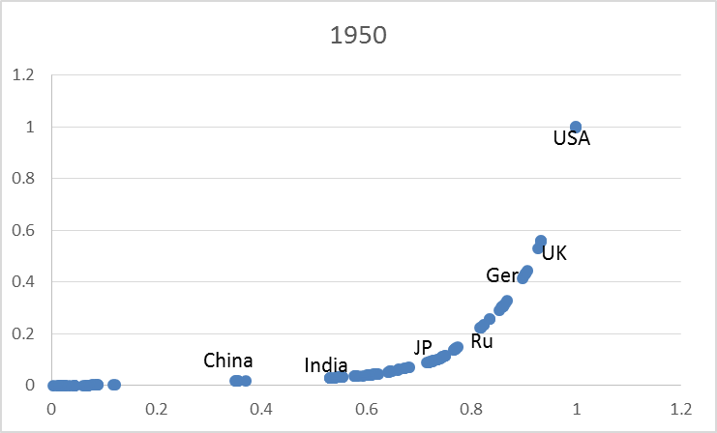
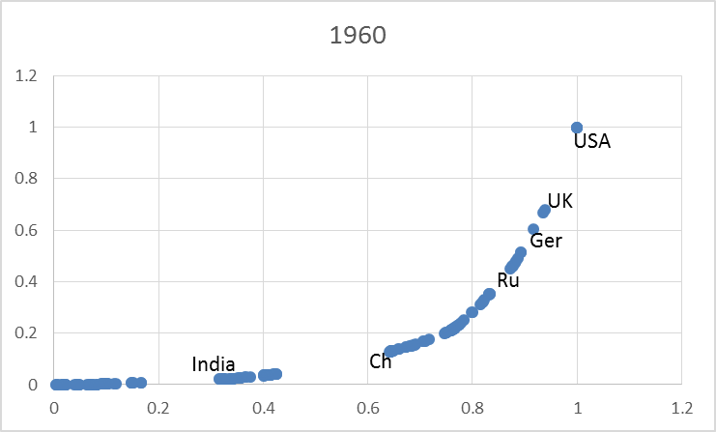
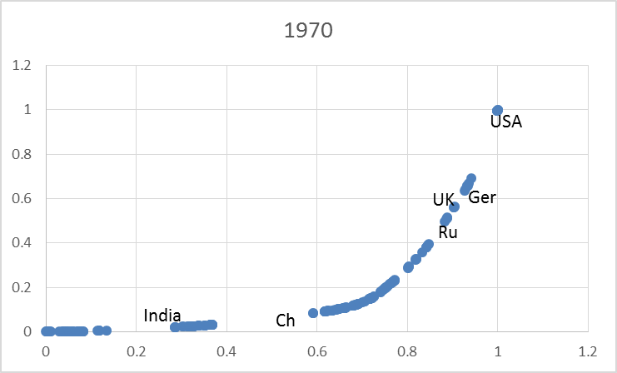
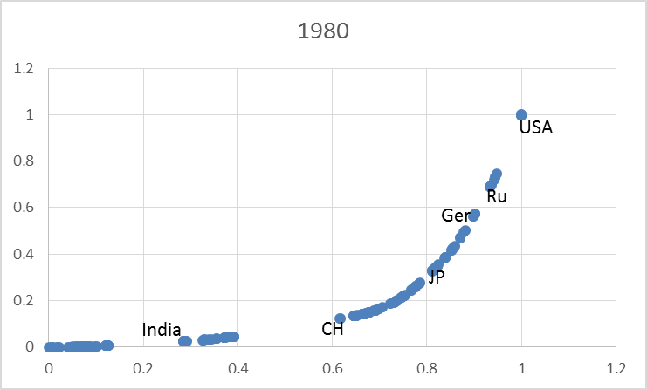
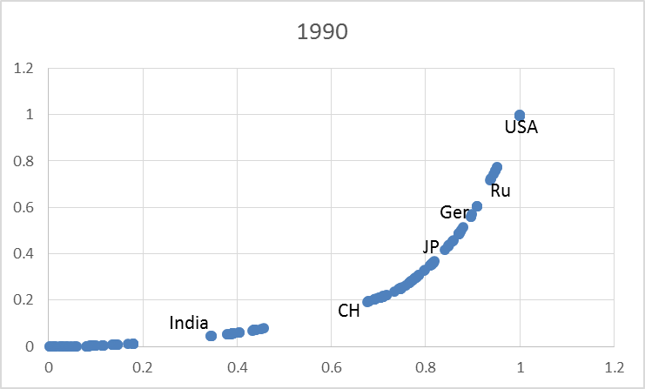
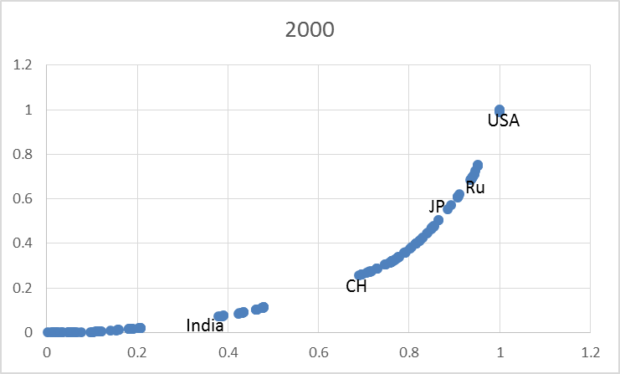
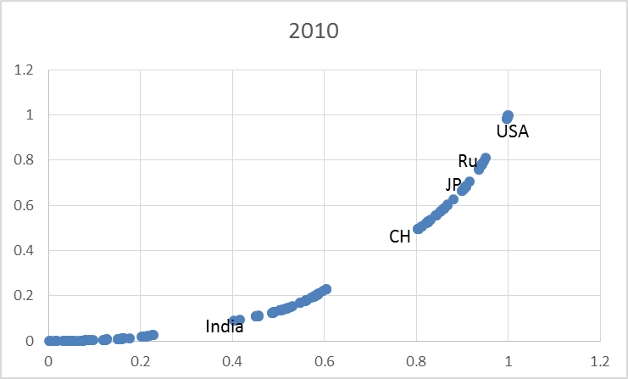
Which countries contribute to decrease
Lorenz curves based on population
0.50 8.7% | 2.54 44.0% | 0.08 1.4% | 0.51 8.9% | 0.42 7.3% | 0.10 1.8% | 0.06 1.2%
0.49 1.6% | 5.43 17.3% | 8.28 26.4% | 0.74 2.4% | 1.74 5.5% | 1.17 3.7% | 2.00 6.4%
unit: Pg time: 1950 ➔ 2010
60%
96%
Notes:
This slid presents every ten years’ Lorenz curves based on population. It’s easy for us to see, these countries (xxxxx), which are at the turn point of curves, can decide what the curve will look like. So we can narrow down our target countries from 10 to these 6 ones.
In this table, this is the emission data in 1950 and this is in 2010. although American’s emission has doubled, it’s emission proportion has dropped by 60% (from 44% in 1950 to 17.3% in 2010).
Situation is not same for china, its’ emission has increased by 10 times (from 80Tg to nearly 9000 Tg) and the proportion has also increased by 96%

Slide 8
Which countries contribute to decrease
Notes:
Now we put all the Lorenz curve together
Although india has a 6.4% proportion of global emission, it locates in the left side of the curves, and countries such as japan, Russian, American, british, Germany, is on the right-up side, they have a small influence on the difference among each curve.
But china does not, we can see from the picture, (china, china, china, china…), so china is the main reason to make the Lorenz curve keep going up, resulting a smaller area of this part.
As the gini coefficient is the area ratio of this part and this part, so it decreases.

Slide 9
Factor affecting Gini coefficient
Per capital CO2 emission: Country VS. World
C > W: Emission (up), Gini (up); otherwise;
C < W: Emission (up), Gini (down); otherwise
Notes:
After knowing China is the main country to lower the Gini coefficient, we want to know how it can do so?
As we know, the X axis is ordered by per capital emission (small to large), so we can start out by per capital CO2 emission.
We find that if…..then….if…then. It’s quiet easy to understand, assuming I’m the china emission, I’m lower than world average, when I am going up, what I am doing is make myself more access to standardized situation because the completely fair situation is everyone has the same per capital emission.
So let’s see china’s line, it increases quickly here, it decreases quickly there. It goes up constantly here, it goes down constantly there
When it exceed world average here, it keeps going up there.

Slide 10
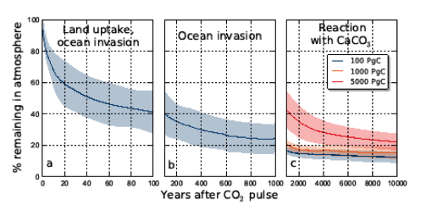
Historical accumulated CO2 emission since 1750
Why historical emission data?
Fossil fuel has been widely used since the industry revolution
Long life-time in atmosphere (CO2, more than 120 years)
Total amount VS. current amount
So, historical emission can provide a more objective representation on a given country’s historical responsibility

Slide 11
Comparison between one-year and historical emission
Notes:
UK, the first country taking a industry revolution, has a strong emission since 1750. although it has took many measures to reduce emission, the proportion of each year for historical data is still higher than corresponding one-year data.
China, on the other hand, has emitted lots CO2 in the past decades, but it didn’t use fossil fuel in a large scale until 1900s, so its proportion in this chart is much less then this chart.

Slide 12
Lorenz curves of historical emission (population)
Emission offset effect
Emission reduction will be offsetted by previous large emission
Emission break-out will be offsetted by previous low emission
Notes:
This is another Lorenz curves series of historical emission, this is what we have seen before. The distance-difference between each curve is not as obvious as the former one.
The emission reduction for countries like USA, UK, Germany has been partly offsetted by their previous large emission; while the emission break-out for china, India has been naturalized by their previous low emission.

Slide 13
Factor affecting historical accumulated Gini coefficient
Notes:
We have discussed the relationship between per capital one-year emission and Gini coefficient.
However, this relationship is not suitable for this part, because historical accumulated emission always means the line will keep going up, so we move on to the growth rate of per capital historical emission, which will have a more reasonable and objective reflection on how it affluence Gini coefficient.
We can see all the countries’ line tend to be close to the line of World average value. It’s reasonable that the more these lines are closer, the smaller the Gini coefficinent is, that can explain why Gini coefficient keeps going down.

Slide 14
Gini coefficient based on population
 | MAX | MIN | Decease rate
Gini (historical) | 0.778 | 0.648 | 0.022/10 years
Gini (one year) | 0.740 | 0.500 | 0.040/10 years
Slow decrease: a large base emission amount in last century
Less fluctuation: emission offset effect
Notes:
The historical accumulated Gini coefficient decrease moderately with less fluctuation
Decrease rate is only haft of the one-year Gini coefficient
The slow decrease is mainly because there has been a large amount emission from 1750
The less fluctuation is mainly because the emission offset effect

Slide 15
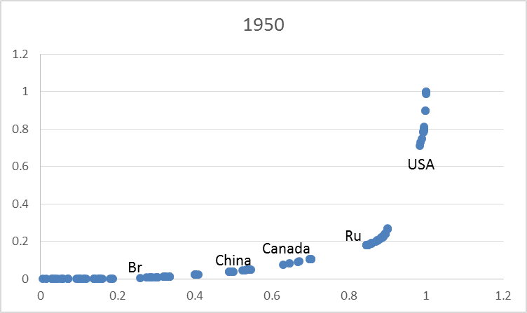
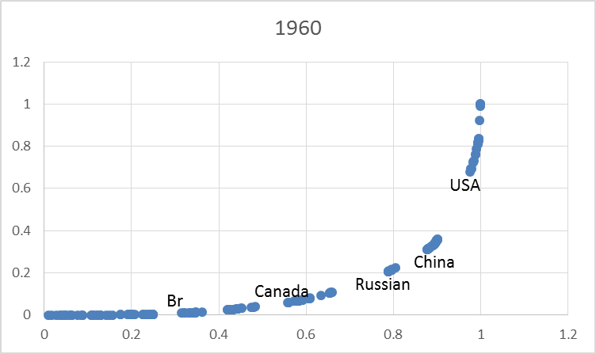
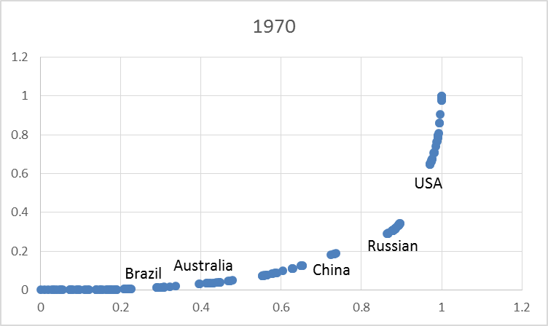
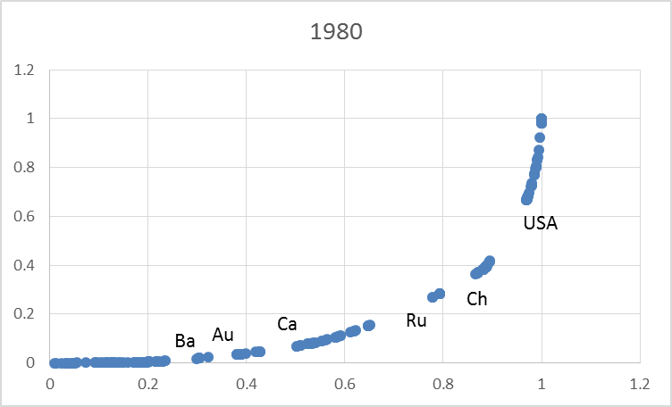
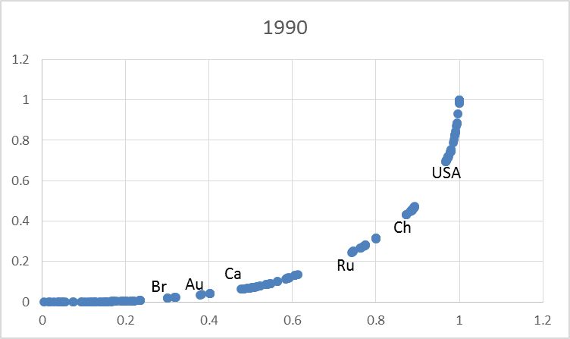
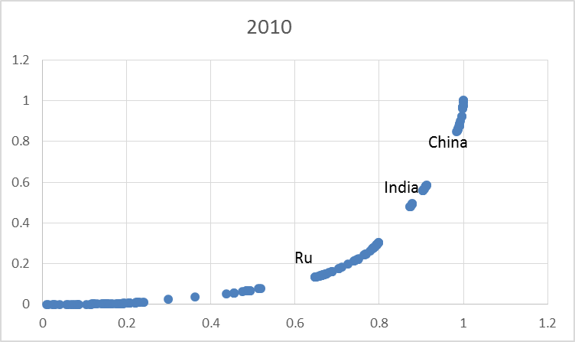
Gini coefficient of one-year emission (Land area)
Which countries can shape the curve?
Country with large population
Country with large land area
Notes:
Now we are moving on to the lad area part, again we can see this picture.

Slide 16
Lorenz curves of one-year emission (land area)
Notes:
Less difference between each curve compared with population study，because there is only one variable.
Again we can see the Lorenz curves of historical emission are more regular(the position of each one is a little higher than another), but for one-year emission, some of the curves are overlapped.

Slide 17
Gini coefficient based on land area
 | MAX | MIN | Decrease rate
Gini (historical) | 0.845 | 0.678 | 0.028/10 years
Gini (one year) | 0.790 | 0.656 | 0.022/10 years
A relative constant decline rate
Notes:
The same as the gini coefficient based on population, we can get 2 curves indicating how the Gini coefficient changed with time

Slide 18
Result & Conculusoin
Fluctuation: one-year line > historical accumulated line; population line > land area line
Gradient
One-year emission shows a relative low inequality due to a small Gini coefficient in 2010
There still are at least about 50% CO2 emitted unequally
Gini coefficient of one-year part has a potential to rise after 2010 due to
a high growth rate of CO2 emission for developing countries (China, India, Russian)
relative low growth rate of population
more industry activities with economic recovery
The vertical distance between population line and land line are increasing
Constant land area VS. growing population
17.8% 32.0%
21.0% 17.9%

Slide 19
The End
Thanks for your attention
Comments are welcomed

