Slide 1
The impact of SO₂ emission from China on Japan
Environmental Science / Chen Gu
May 13, 2014
Notes:
Good afternoon ,everyone. I am very happy to give my presentation here. My name is Chen Gu ,and my major is environmental science. The presentation I’ll show to you here is The impact of SO₂ (sulfur dioxide)emission from China on Japan .

Slide 2
CONTENTS
Model
Data
Method
Result
Notes:
My presentation contains four parts, the Model, Data, Method and final Result.

Slide 3
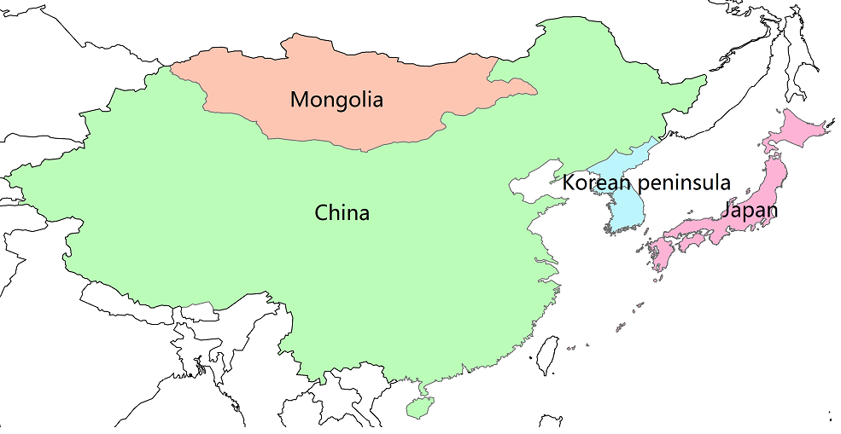
East Asia
Notes:
The picture showed here is the map of East Asia. It’s a brief overview of our work base.

Slide 4
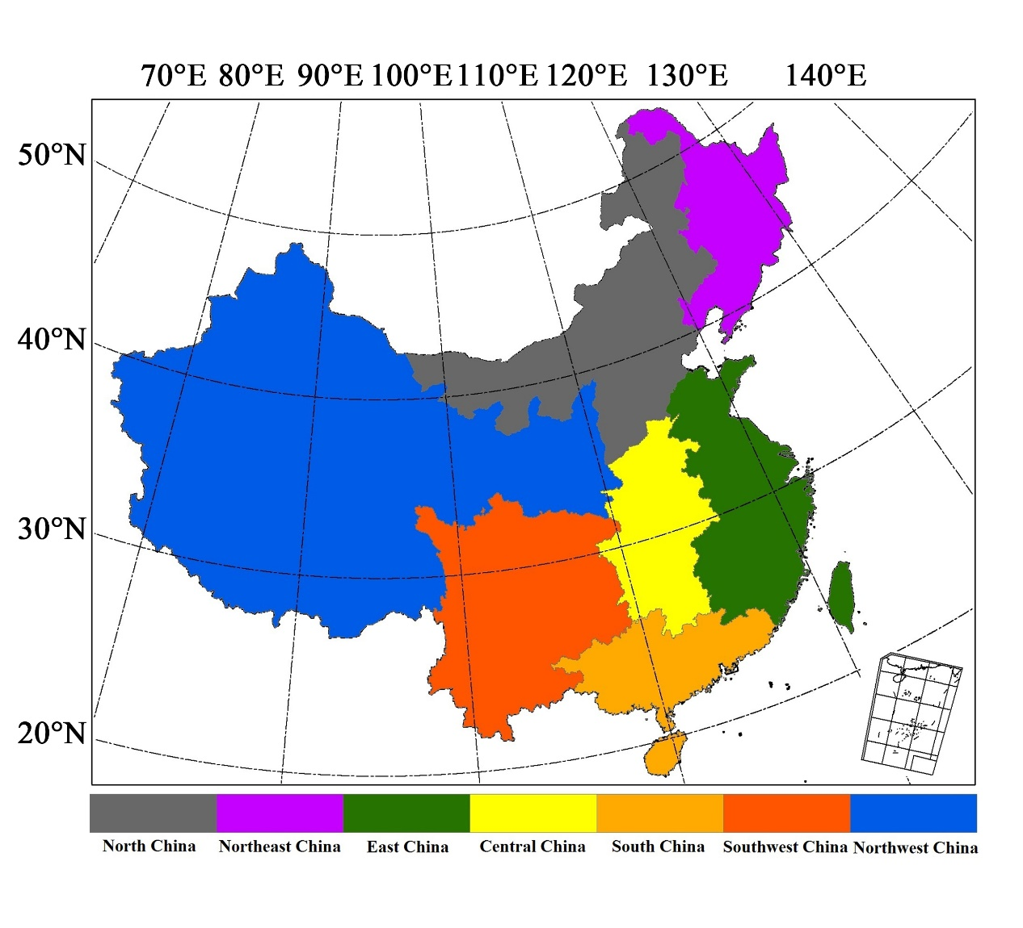
Sub-regions of China
Fig. 1. Seven sub-regions of China
Notes:
In order to easy comprehension and comparison, we divide China area into 7 sub-regions as showed in figure 1. These sub-regions are the North, Northeast, East, Central, South, Southwest and Northwest China.

Slide 5
Model
three-dimensional， regional-scale， CTM
horizontal resolution （24km × 24 km）
CanMETOP
12 vertical layers (1.5m, 3.9m, 10m, 100m, 350m, 700m, 1200m, 2000m, 3000m, 5000m ,7000m)
Ma J, Daggupaty SM, Harner T, Li Y (2003) Impacts of lindane usage in the Canadian prairies on the Great Lakes ecosystem – 1: coupled atmospheric transport model and modeled concentrations in air and soil. Environ Sci Technol 37:3774–3781
Notes:
In this study ,we use Canadian model. CanMETOP is a three-dimensional regional-scale atmospheric chemical transport models.
This model has a horizontal resolution of 24km × 24 km and
12 vertical layers (centered at 1.5, 3.9, 10, 100, 350, 700, 1200, 2000, 3000, 5000 and 7000m, representatively) .
we can get more information from this paper.
Canadian Model for Environmental Transport of Organochlorine Pesticides

Slide 6
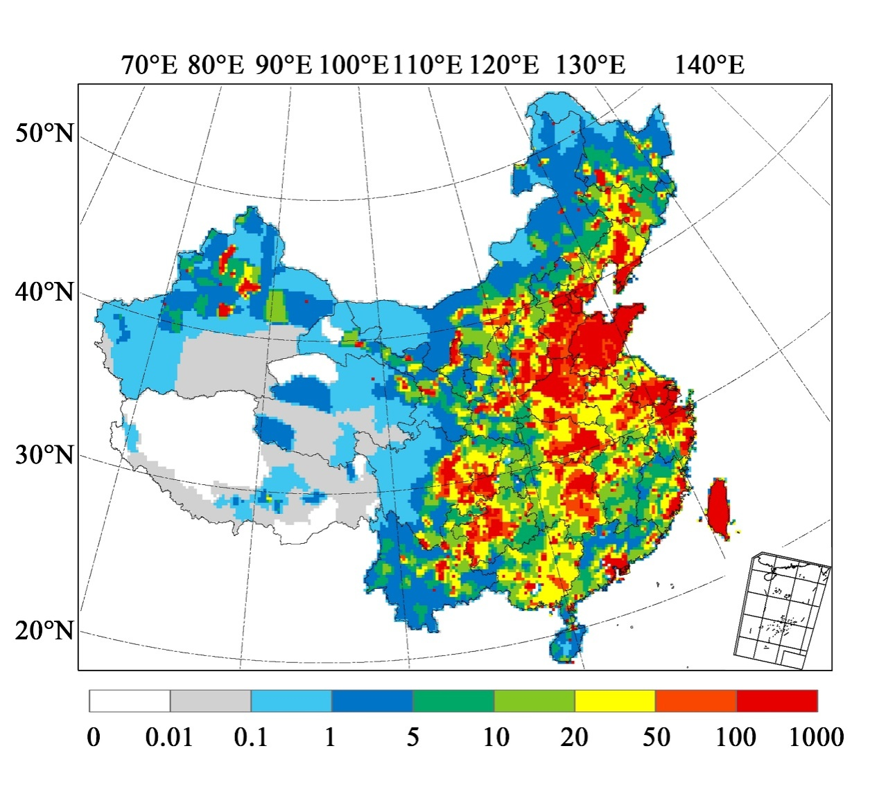
1.PKU-SO2-China
2.INTEX-B for Japan/Mongolia/Korea
Data
1
Emission data
2
Validation data
Fig. 2. SO₂ Emission in China (2007，mg km⁻² s⁻¹)
Notes:
Turning to the next part. The Data is comprised of Emission data and Validation data . Emission data includes the SO2 emission
Of china in 2007 and the INTEX-B for Japan ,Mongolia and Korea .we scaled this emission data to keep consistent with China.

Slide 7
Data
1
Emission data
2
Validation data
Fig. 3. Modeled and observed annual mean SO₂ concentration at 18 monitoring sites of EANET
Notes:
CanMETOP was run with this compiled emission inventory. The results were extracted for comparison with observation data at 18 monitoring sites of Acid Deposition Monitoring Network in East Asia (EANET).The SO₂ annual mean concentration at 18 monitoring sites of EANET was Modeled and observed. From this figure, we can find the balance between modeled and observed data.For annual average, more than two-thirds sites were closed to 1:1 line.

Slide 8
Method
The influence of A₀ to B =
Residual
Notes:
We used the Residual method to calculate. The equation is here, and the final results is the most important part in my presentation today.

Slide 9
Result
1
column concentration
2
ground concentration(<100m)
3
deposition
Notes:
The first part is about the column concentration. Here we see, to study the impact of SO₂ emissions from China on Japan, the annual mean columns of SO₂ were significantly different over space. The North and East China were the high emission area. The Japan SO₂ influence caused by inner emission was much bigger than China emission. The impacts of Mongolia and Korea were almost invisible.

Slide 10
Result
1
column concentration
Notes:
On the contrary, the influence of Sulfate column concentration from China to Japan is much bigger than the influence caused by Japan itself. The conclusion is that, the impact from China on Japan is mainly through Sulfate column concentration .

Slide 11
Result
1
column concentration
2
ground concentration(<100m)
3
deposition
Notes:
Then, let’s talk about the SO₂ ground concentration.
We can see clearly that the influence from itself is much bigger than from China. So, We can ignore the impact of China.

Slide 12
Result
2
ground concentration(<100m)
Notes:
On the other hand, the influence of Sulfate ground concentration from China on Japan was the main reason.
We can also find that the impact of ground concentration is much less than column concentration .

Slide 13
Result
1
column concentration
2
ground concentration(<100m)
3
deposition
Notes:
Thirdly, this chart was about the sulfur deposition. From the annual mean data, the SO₂ emissions from China on Japan were also varied significantly over space. The high emissions were in North and East China. The sulfur deposition from Japan itself is more serious than from China. The impact of Mongolia and Korea can be ignored.

Slide 14
Result
3
deposition
Notes:
This is Sulfur dry deposition . We can see that the influence from Japan itself is much bigger than from China. so, We can ignore the impact of Sulfur dry deposition from China.

Slide 15
Result
3
deposition
Notes:
Finally, although the influence of Sulfur wet deposition from China is much bigger than from Japan itself ,the impact of wet deposition is still much less than Japan own Sulfur dry deposition .

Slide 16
Conclusion
1. The impact is mainly through sulfate column concentration.
2. the impact of ground concentration is much less.
3. The impact mainly come from North China and East China.
4. The impact is mainly through sulfur wet deposition.
Notes:
The last slide is a brief summary of my presentation.
The first part showed that the impact of SO₂ emission from China on Japan is mainly due to Sulfate column, Which was proved to be less important than ground concentration in part 2. The third part introduced the mainly impact came from the North and East China. And finally, the impact of deposition from China to Japan is mainly through Sulfur wet deposition.

Slide 17
THANK YOU
Author Chen Gu
Email pkugchen@pku.edu.cn
Department of Environmental Science
School of Urban and Environmental Sciences
Peking University
Notes:
That’s all ,thank you for your attention.

