Slide 1
Understand & Assess DARF model uncertainty:
Traditional way of uncertainty assessment:
Multi-model “diversity” in direct aerosol radiative forcing (DARF)
Gap between model-based & observation-based uncertainty :
Model underestimate
Improvement:
Understanding: Uncertainties in sub-model
Alternative approach: derive DARF from other modelled parameters
Notes:
Traditionally, simulated multi-model “diversity” in direct aerosol radiative forcing estimates is often perceived as a measure of the uncertainty on global scales
However, the spread of model-based uncertainty estimates are generally lower than observation-based uncertainty. Also, the traditional practice convolutes all the processes together. And it is impossible to attribute uncertainty to specific process.
Recent researches isolate uncertainties in sub-models and come up with a new method to calculate total uncertainty.

Slide 2
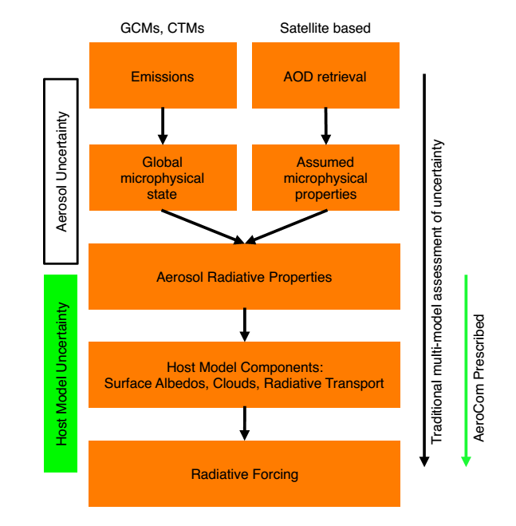
Significant uncertainties in sub-model
Isolate host model uncertainty from aerosol uncertainty
Great diversity in host model parameters,
global mean inter-model RSD:
surface albedos (4%) and cloud fraction(9%)
Consistent improvement of the physics underlying host model components
Uncertainties in other processes
Stier et al., ACP, 2013
Notes:
For example Stier isolate host model uncertainty from aerosol uncertainty and explore diversity of surface albedos, cloud fraction and radiative transport on total deviation.
Obviously, consistent improvement of the physics processes underlying host model components and also other processes: emission, microphysical state and aerosol optical properties will narrow the uncertainty.

Slide 3
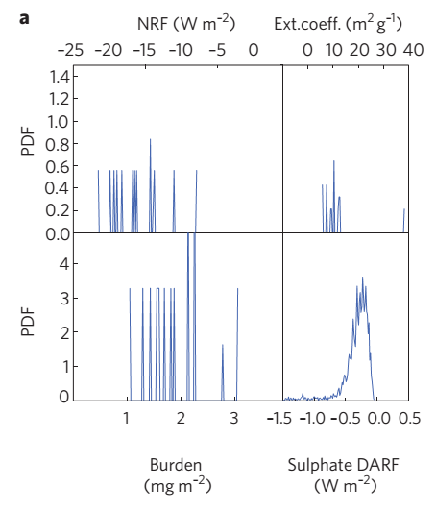
Derive DARF from other modelled parameters
Monte Carlo Technique
$$DARF=\frac{\overline{DARF}}{\overline{AOD}}×\frac{\overline{AOD}}{\overline{Bd}}×\overline{Bd}$$
$$=NRF×ext.coff×\overline{Bd}$$
Significantly larger uncertainty range:
close to observation-based uncertainty estimates
Further work:
statistical emulation vs. physical process
observation constrain
Samset et al., Nature, 2014
Notes:
Samset calculate DARF uncertainty by decompose DARF into forcing normalized to aerosol optical depth, extinction coefficient and the burden. Then collected a large number of combinations of the three parameters from the model sample to construct probability density functions (PDF) and perform Monte Carlo calculation. This method result in a much wider uncertainty range and is close to observation-based uncertainty estimates.
However, it replaces physical process with simple factorial assumptions. Furthermore, the role of uncertainty in emissions, the aerosol anthropogenic fraction and modelled vertical distributions are parameters cannot be included in the present method with available data. Also further work is needed to constrain model simulation results through observations.

