Slide 1
Attribution of the effect of anthropogenic climate change on the carbon cycle
Thomas Gasser
(tgasser@lsce.ipsl.fr)
SOFIE Spring School
PKU; May 15, 2014
Acknowledgements:
Philippe Ciais (LSCE)

Slide 2
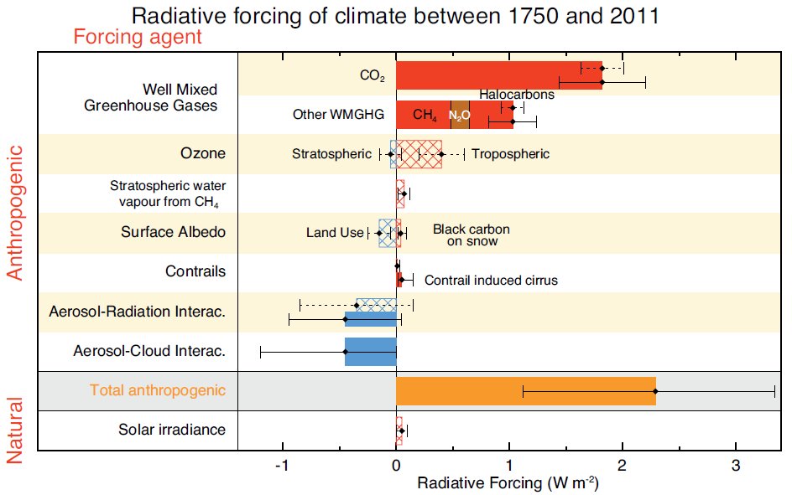
1. Attribution of anthropogenic RF
to radiatively active species
IPCC AR5, WG1 Chap. 8

Slide 3
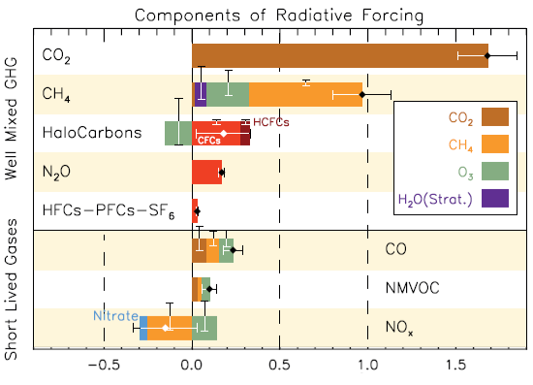
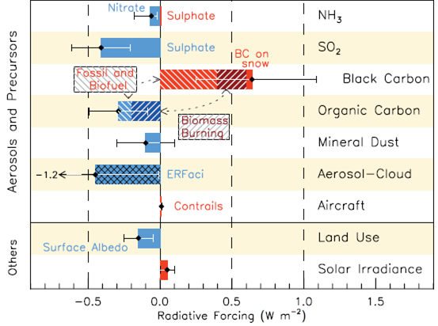
1. Attribution of anthropogenic RF
to anthropogenic emissions
Greenhouse gases: some (esp. CH4) do impact the atmospheric chemistry;
otherwise they are all attributed to themselves.
Ozone precursors: are not GHGs but they impact atmospheric chemistry (CH4 and O3).
Aerosols: part of the atmospheric chemistry but not fully attributed.
IPCC AR5, WG1 Chap. 8

Slide 4
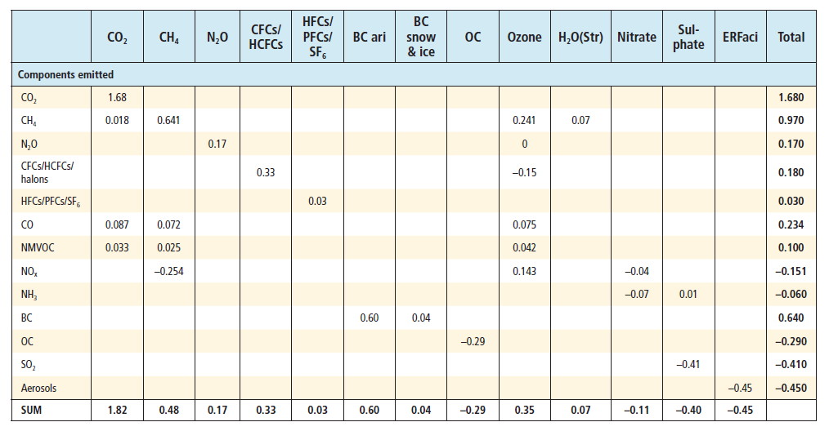
1. Attribution of anthropogenic RF
Table of cross-attribution
Cross-effects only occur through atmospheric chemistry.
Coupling through biogeochemical cycles are ignored.
IPCC AR5, WG1 Chap. 8

Slide 5
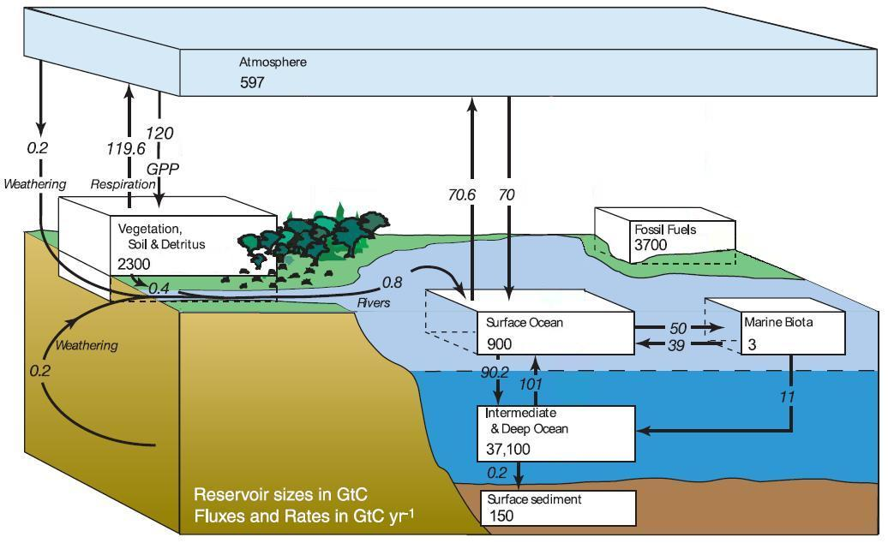
2. Causality of the carbon-cycle
A preindustrial steady-state…
IPCC AR4, WG1 Chap. 7

Slide 6
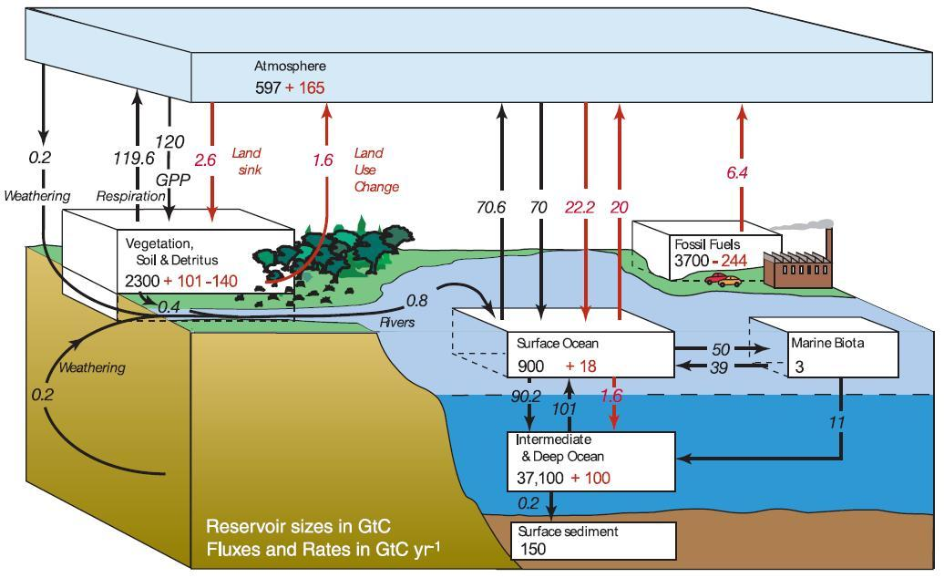
2. Causality of the carbon-cycle
A preindustrial steady-state disturbed by anthropogenic activities
IPCC AR4, WG1 Chap. 7

Slide 7
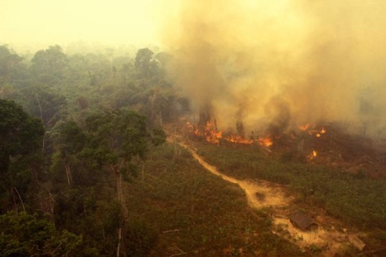
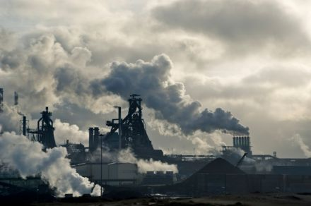
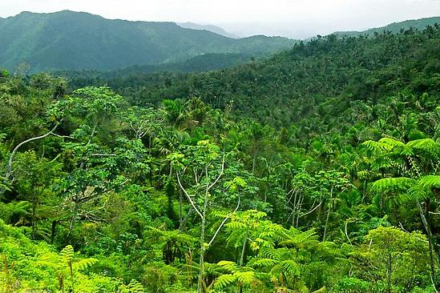
2. Causality of the carbon-cycle
Global anthropogenic carbon equation
0.8 ± 0.5 GtC/yr
Land-Use Change
4.3 ± 0.1 GtC/yr
Atmosphere
45%
+
2.6 ± 0.5 GtC/yr
Ocean
27%
8.6 ± 0.4 GtC/yr
Fossil Fuels
2,6 ± 0.8 GtC/yr
(residue) Land
27%

Slide 8
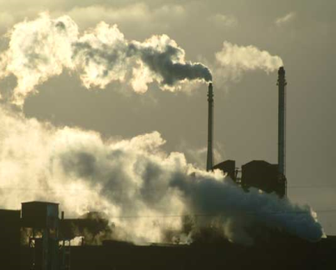
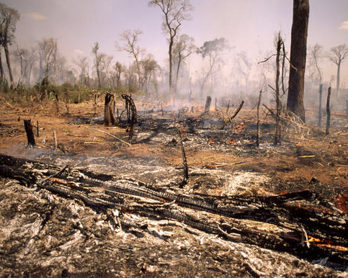
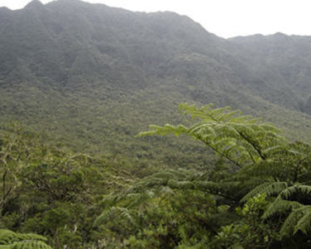
2. Causality of the carbon-cycle
First order causality

Slide 9
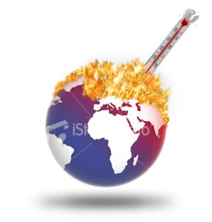
2. Causality of the carbon-cycle
Second order causality
all non-CO2 species and effects
CO2

Slide 10
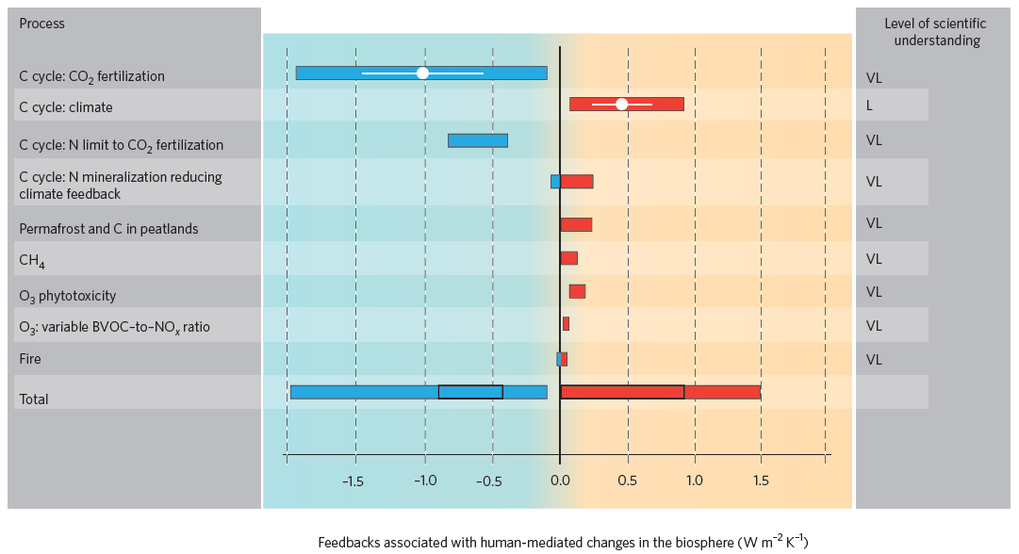
2. Causality of the carbon-cycle
Third order causality…
Arneth et al., 2010; NGeo

Slide 11
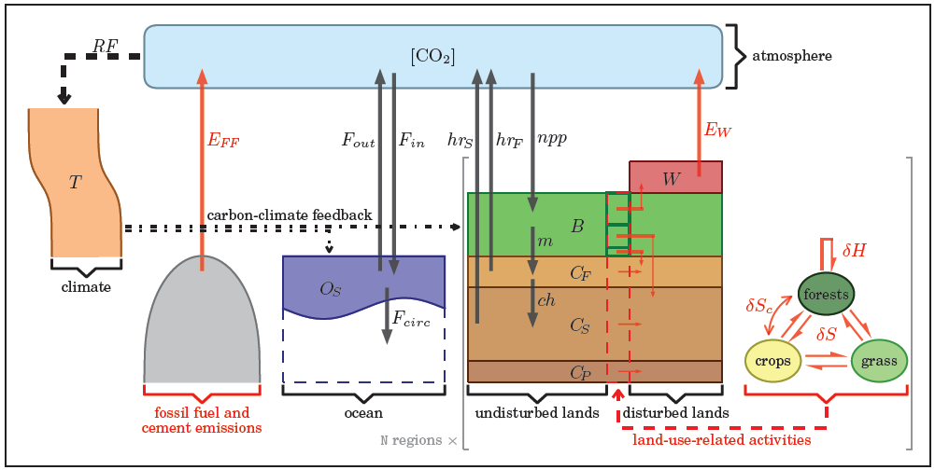
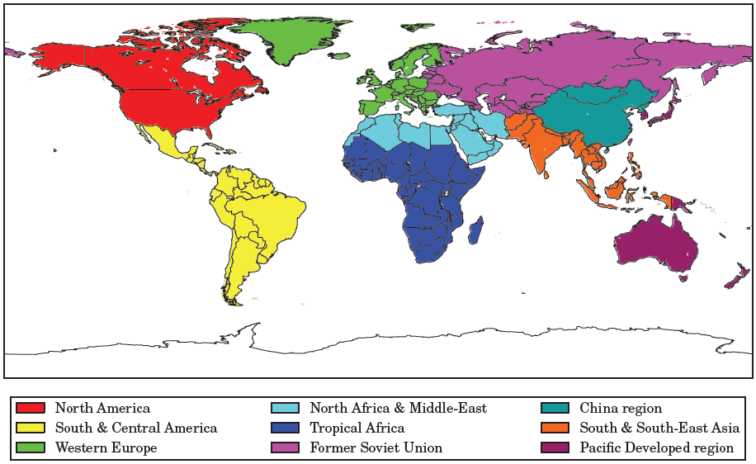
3. Simple modeling of the Earth system
The OSCAR v2.1 model (C-cycle and climate)
C-cycle box-model, with regionalized biosphere and a book-keeping module for LUC emissions, coupled to a regionalized climate impulse response function.
Its initial (yet updated) cause-effect chain:
cal. on
ORCHIDEE
and IPSL-CM5
C_{LAND}
LUC
book-keeping
C_{OCEAN}
[CO₂]
RF
irf HILDA
irf CMIP5
E_{FF}
T°

Slide 12
3. Simple modeling of the Earth system
The OSCAR v2.1 model (full causal chain)
IPCC AR4
WMO ozone
E_{Halo}
[Halo]
[O₃]_{s}
E_{CH4}
[OH]
IPCC TAR updated
cal. on ORCHIDEE
wetlands
[CH₄]
E_{NOx}
E_{CO}
cal. on
ORCHIDEE
and IPSL-CM5
IPCC TAR
E_{VOC}
C_{LAND}
[O₃]_{t}
LUC
book-keeping
C_{OCEAN}
[CO₂]
RF
irf HILDA
irf CMIP5
E_{FF}
T°
E_{N2O}
[N₂O]
IPCC TAR
E_{SO2}
E_{NH3}
cal. on IPCC AR4 (direct & indirect)
E_{OC}
E_{BC}
RF_{ant}
LCC biophysical
BC on snow
mineral dust

Slide 13
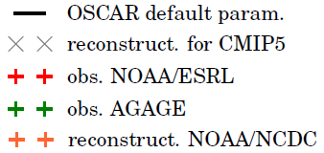
3. Simple modeling of the Earth system
The OSCAR v2.1 model performance
Atmospheric carbon dioxide:
Overall: reasonable performance given the simplicity of the model.
Atmospheric methane:
Global temperature change:

Slide 14
3. Simple modeling of the Earth system
Attribution algorithm (qualitative)
E_{Halo}
[Halo]
[O₃]_{s}
E_{CH4}
[OH]
[CH₄]
E_{NOx}
E_{CO}
E_{VOC}
C_{LAND}
[O₃]_{t}
LUC
C_{OCEAN}
[CO₂]
RF
E_{FF}
T°
E_{N2O}
[N₂O]
this happens at each time-step all along the cause-effect chain
forcings
are tagged
E_{SO2}
any state variable affected by a given forcing is tagged as well
E_{NH3}
E_{OC}
E_{BC}
RF_{ant}

Slide 15
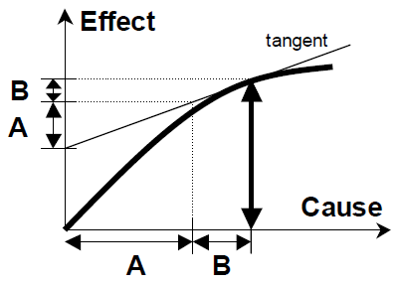
3. Simple modeling of the Earth system
Attribution algorithm (quantitative)
Every variable is:
expressed as a perturbation to the preindustrial,
disaggregated along 2 axis k (forcings) and j (regions).
The attribution is done along the 2 axis.
Given that any function f that relates a variable to another can be non-linear, the use of a linearization method is necessary for the attribution (normalized marginal):
where
We choose
with
UNFCCC, 2002
This algorithm is repeated at each time-step.

Slide 16
4. Attribution of anthropogenic RF
Attribution of the radiative forcing of 2008 to anthropogenic forcings
roles of ozone precursors isolated and quantified
aerosols RF attributed
(low confidence)
RF from atmospheric methane:
RF from aerosols (direct effect):
RF from tropospheric ozone:
RF from aerosols (indirect effect):

Slide 17
4. Attribution of anthropogenic RF
Attribution of the radiative forcing of 2008 to anthropogenic forcings
RF from atmospheric CO₂:
in the model: non-CO₂ species do not interact directly with the C-cycle, but through the climate feedback
RF from atmospheric CO₂ (with climate feedback isolated):

Slide 18
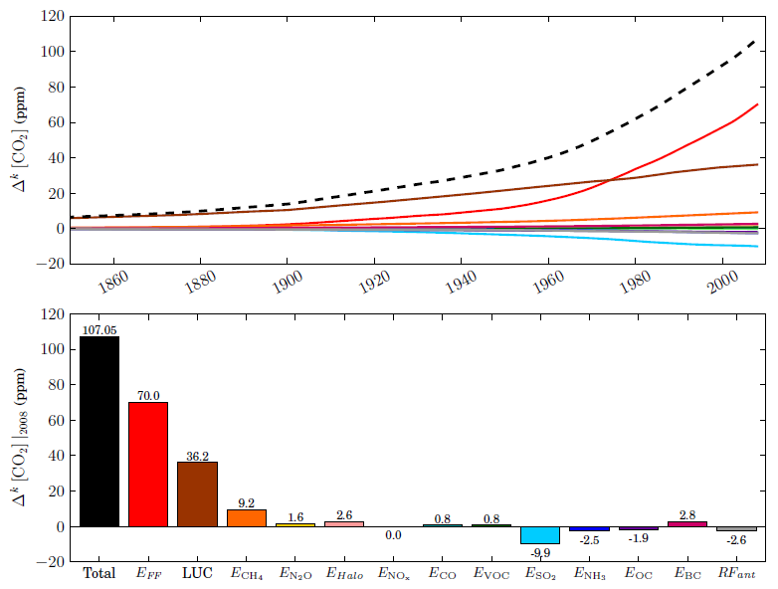
4. Attribution of anthropogenic RF
Focus on atmospheric CO2
Temporal profile of contributions of forcings to carbon dioxide:
total
contributions
of forcings,
summing to
the total
Contributions of forcings to carbon dioxide in 2008:
non-CO2 species are important… but they tend to compensate each other

Slide 19
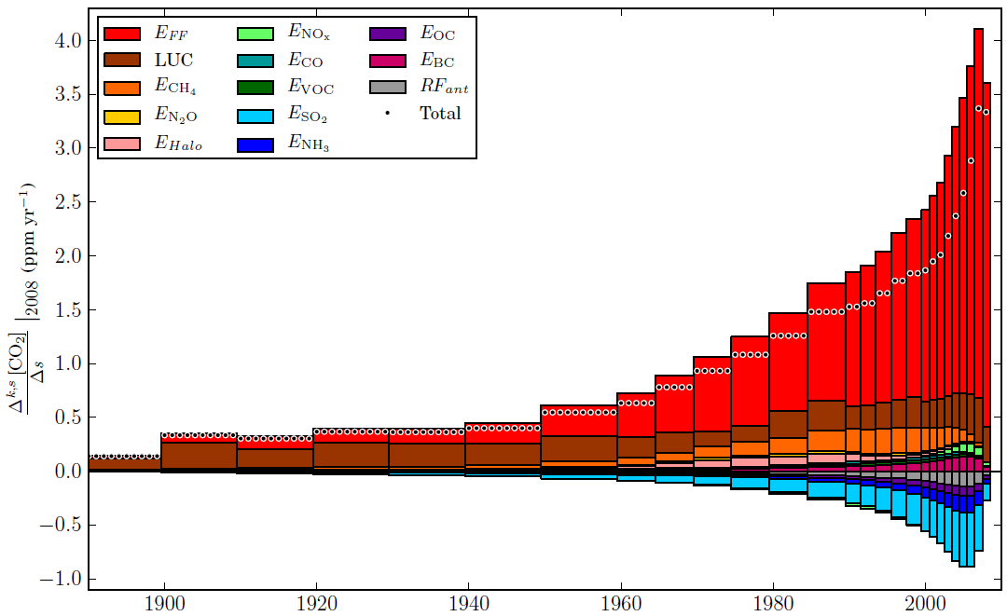
4. Attribution of anthropogenic RF
Focus on atmospheric CO2 (attribution to periods)
Contributions of forcings to increased atmospheric CO₂ in 2008:
* effects of non-CO₂ species on the C-cycle through the carbon-climate feedback (memory effect)
*

Slide 20
4. Attribution of anthropogenic RF
Focus on temperature change
Temporal profile of contributions of forcings to climate change:
Contributions of forcings to climate change in 2008:
Strongest contributors:
1
4
3
2
FF emissions
SO₂ emissions
CH₄ emissions
LUC

Slide 21
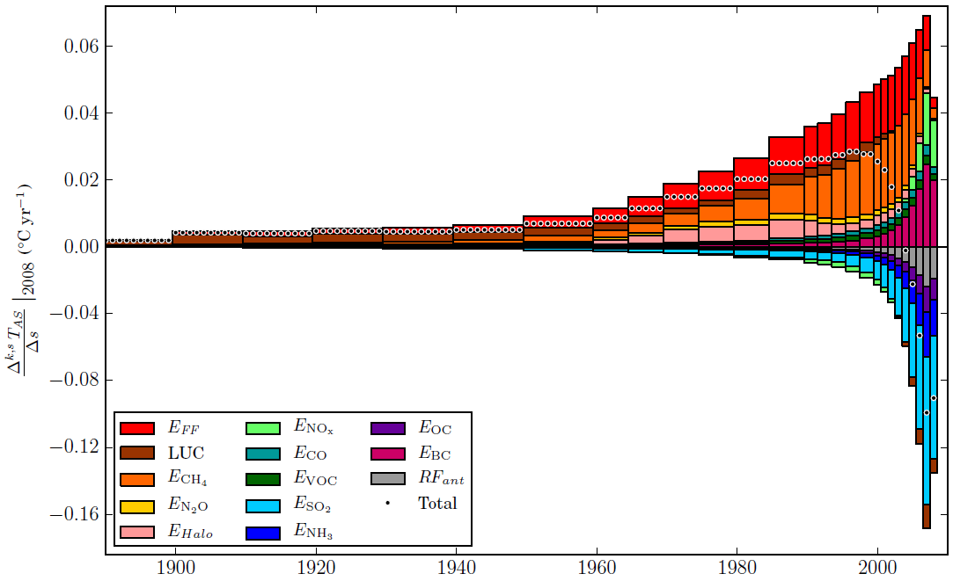
4. Attribution of anthropogenic RF
Focus on temperature change (attribution to periods)
Contributions of forcings to climate change in 2008:
temporal differences in the role of FF emissions vs. CH₄ emissions
role of past halogenated emissions
differentiation of the effects of NOx
legated effect of short-lived species
periods of activity

Slide 22
Conclusion
on what we did
We attributed atmospheric CO2 to:
its first order anthropogenic drivers (FF emissions and land-use change);
AND its second order anthropogenic drivers (all anthropogenic perturbations of the climate system).
Such kind of an attribution:
increases the relative importance of non-CO2 emissions;
decreases the relative importance of CO2 emissions;
BUT increases the need to understand the C-cycle.

Slide 23
Conclusion
on what is yet to be done
Uncertainty:
Not (yet) assessed;
Expected to be large because of the large range of sensitivities to CO2 (β) and climate (γ) from C-cycle models;
BUT expected to slightly increase the importance of non-CO2 species since the IPSL-CM5 model has a stronger β than the mean of CMIP5.
Account for “third order” effects:
especially N-deposition (caused by NOx and NH3 emissions);
but also O3 phytotoxicity (caused by ozone precursors emissions), P-deposition (caused by FF burning), Fe-deposition on the ocean.
Note that “third order” may be quantitatively significant.
Attribute change in biogeochemical cycle of other species:
CH4 (e.g. changes in tropospheric sink, wetland emissions)
N2O (e.g. changes in soils emissions)

Slide 24
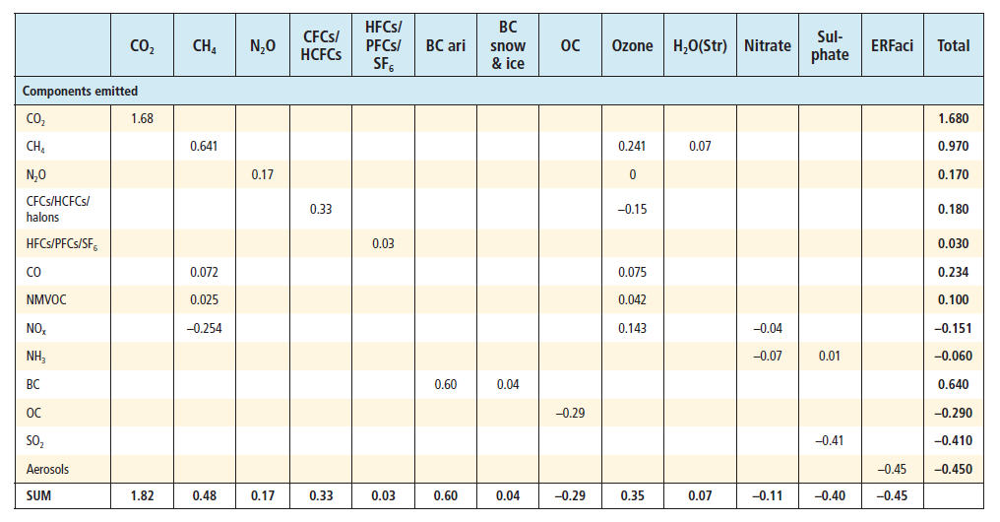
Conclusion
on what is yet to be done

