Slide 1
Estimation of human-accelerated loss in soil carbon and nitrogen in the steppe of China
Hongyan Liu
College of Urban and Environmental Sciences, Peking University, Beijing, 100871, China
Paris workshop, Sino-French Institute for Earth System Science (SOFIE)
Oct. 13-14, 2014

Slide 2
Contents
Scientific questions
Study area and methods
Results
Determinants of soil carbon and nitrogen contents
Land use-related carbon and nitrogen losses
Grassland degradation-related carbon and nitrogen losses
Discussion
How soil carbon and nitrogen losses related to wind erosion
How human land use accelerated carbon and nitrogen losses
Summary
Paris workshop, Sino-French Institute for Earth System Science (SOFIE)
Oct. 13-14, 2014

Slide 3
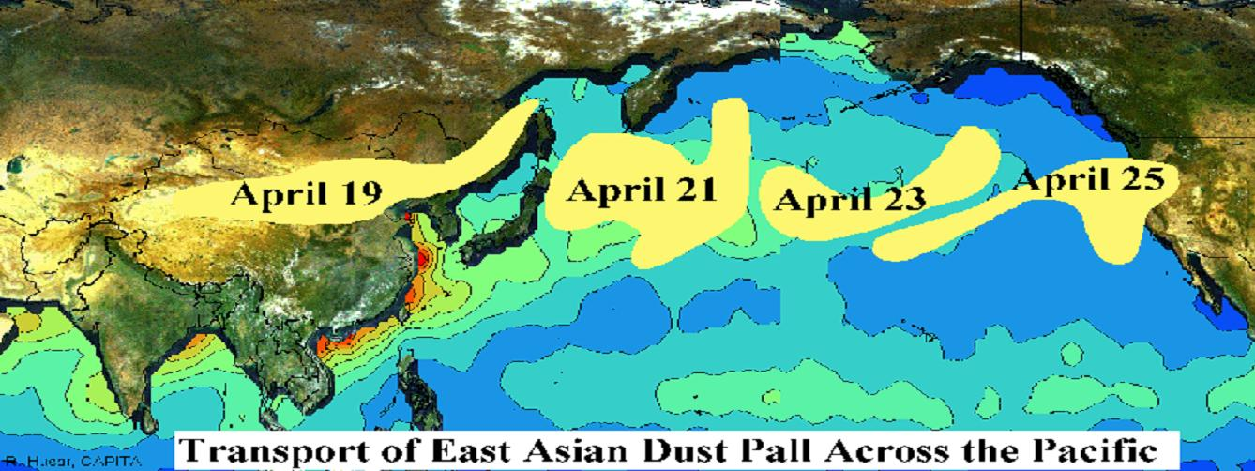
Northern China as a dust source
One of the main dust source over the world.
Strongly affects the NH climate and environment.
Paris workshop, Sino-French Institute for Earth System Science (SOFIE)
Oct. 13-14, 2014

Slide 4
Previous efforts on carbon loss estimation
Very limited studies (e.g. an et al., 2005; He et al., 2011)
Based mostly on surface soil data that can not reflect the source-sink relationship
Remote sensing estimation based on vegetation cover that is not a surrogate of human activities.
Knowledge gap
Although there are quantitative estimations of wind-eroded carbon loss, the relationship between eroded carbon and human land use remains unclear.
Paris workshop, Sino-French Institute for Earth System Science (SOFIE)
Oct. 13-14, 2014

Slide 5
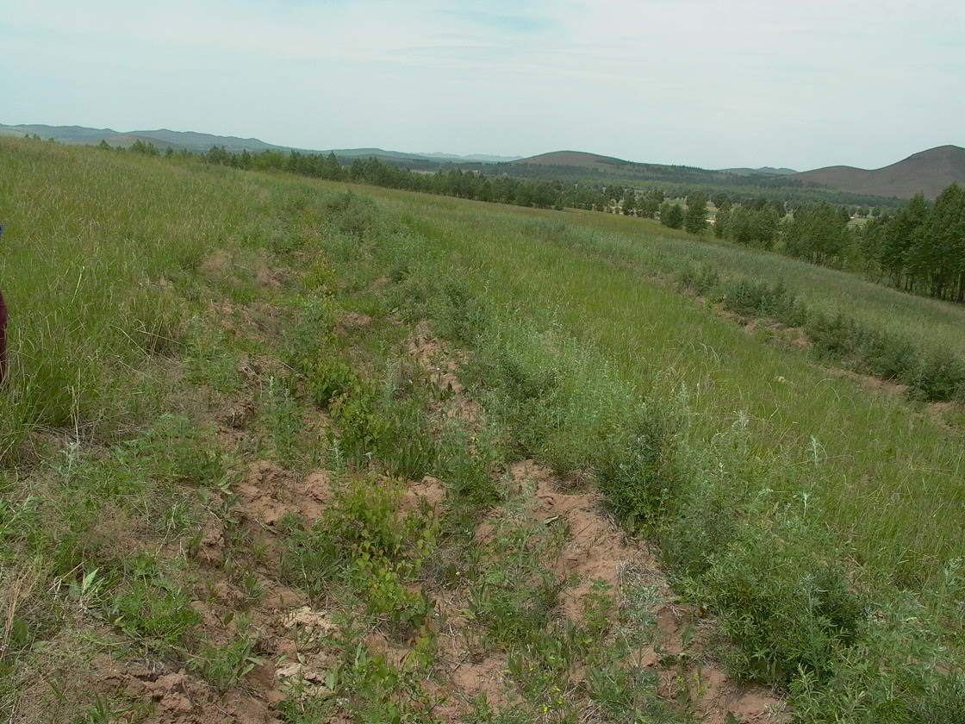
Aims of this study
Hypothesis
We hypothesize that plant species rather than vegetation cover better indicated human-induced soil carbon and nitrogen losses because of turnover of plant species along grassland degradation sequence.
Implication
Is the current vegetation restoration emphasizing vegetation cover effective in preventing soil carbon and nitrogen losses?
Planting trees on grassland
Paris workshop, Sino-French Institute for Earth System Science (SOFIE)
Oct. 13-14, 2014

Slide 6
Study area
Main part of the Inner Asian steppe, with huge area of dust sheet.
Mongolia
China
HLJ
JL
Land Use Types
Inner Mongolia
Cropland
Abandoned cropland
LN
Plantation
HB
Grassland (sandy)
km
Grassland (non-sandy)
Sand sheet
Paris workshop, Sino-French Institute for Earth System Science (SOFIE)
Oct. 13-14, 2014

Slide 7
Cropland
Abandoned Cropland
Plantation
Grassland on sandy soil
Grassland on non-sandy soil

Slide 8
Methods
Field vegetation survey and soil sampling at 5 cm interval, at least 30 cm in depth;
Human disturbance index (HDI) based on plant species composition for each plot;
Soil profile categorization:
Negative exponential distribution of C, N along the profile
Yes
No
Non-eroded soil profile
Eroded soil profile
Historical loss of carbon and nitrogen due to land use change:
Percentages of eroded soil profiles
Area of each land use type
X
X
Reduction in carbon and nitrogen densities
Historical loss of carbon and nitrogen due to grassland degradation:
HDI change HDI related soil carbon and nitrogen reduction
X
Paris workshop, Sino-French Institute for Earth System Science (SOFIE)
Oct. 13-14, 2014

Slide 9
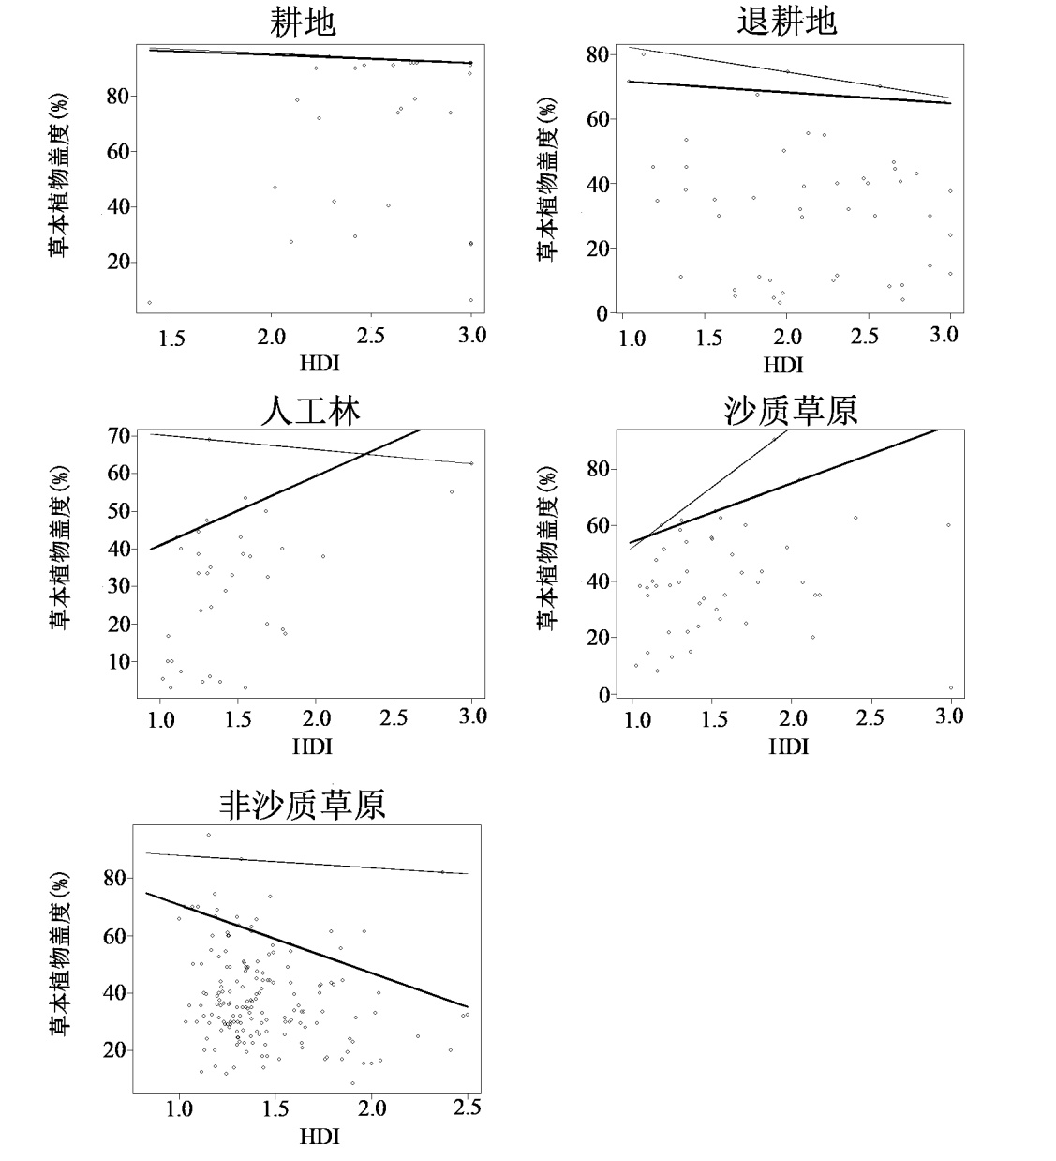
Human disturbance index (HDI)
HDI based on species composition well indicates human land use.
HDI is negatively correlated with vegetation cover only for abandoned cropland and grassland on non-sandy soil.
A
B
Cover
Cover
C
D
Cover
Cover
A
B
C
D
E
HDI
HDI
A
Cropland
E
B
Abandoned cropland
C
Plantation
D
Grassland (sandy)
Cover
E
Grassland (non-sandy)
HDI
Paris workshop, Sino-French Institute for Earth System Science (SOFIE)
Oct. 13-14, 2014

Slide 10
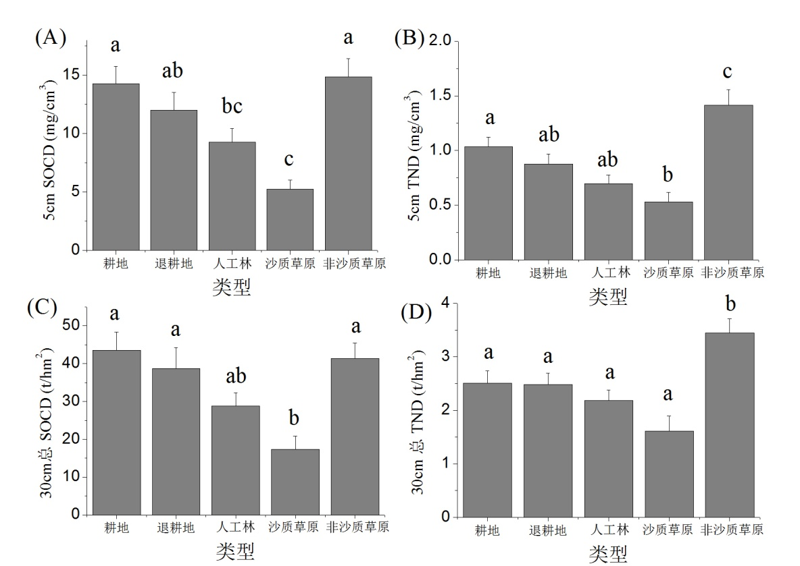
Densities of SOC and TN for land uses
Land use types show different SOCD and TND.
Patterns of SOCD and TND differ.
Patterns of upper and lower layers differ.
A
Cropland
B
Abandoned cropland
A
B
C
D
E
A
B
C
D
E
C
Plantation
D
Grassland (sandy)
E
Grassland (non-sandy)
A
B
C
D
E
A
B
C
D
E

Slide 11
Soil carbon and nitrogen against texture
All particle size groups except fine sand show significant relationships with SOCD and TND.
 | SOCD (mg/cm³) of top 5 cm |  |  | TND (mg/cm³) of top 5 cm
 | a | b | R² | a | b | R²
Clay (%) | 3.365 | 2.052 | 0.311*** | 0.304 | 0.163 | 0.308***
Fine silt (%) | 3.396 | 0.351 | 0.468*** | 0.348 | 0.026 | 0.401***
Coarse silt (%) | 5.453 | 0.383 | 0.259*** | 0.558 | 0.024 | 0.164***
Fine sand (%) | 13.125 | -0.063 | 0.015 | 1.035 | -0.004 | 0.008
Coarse sand (%) | 15.090 | -0.159 | 0.306*** | 1.209 | -0.012 | 0.253***
 | SOCD (t/hm²) of entire profile |  |  | TND (t/hm²) of entire profile
 | a | b | R² | a | b | R²
Clay (%) | 3.259 | 8.161 | 0.460*** | 0.705 | 0.468 | 0.439***
Fine silt (%) | 6.657 | 1.132 | 0.496*** | 1.032 | 0.059 | 0.395***
Coarse silt (%) | 10.790 | 1.540 | 0.407*** | 1.431 | 0.068 | 0.232***
Fine sand (%) | 42.251 | -0.271 | 0.025 | 2.728 | -0.009 | 0.008
Coarse sand (%) | 48.032 | -0.575 | 0.384*** | 3.198 | -0.030 | 0.304***
The regression of soil texture and SOCD, TND. The formula is SOCD/TND = a + by (y is particle content).
***.P < 0.001
Paris workshop, Sino-French Institute for Earth System Science (SOFIE)
Oct. 13-14, 2014

Slide 12
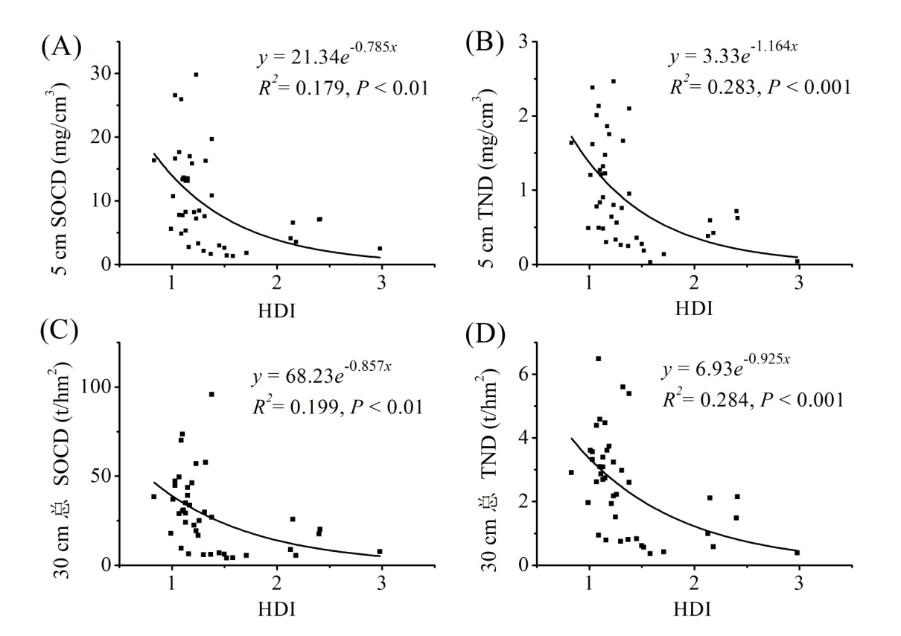
Soil carbon and nitrogen against HDI
Both SOCD and TND significantly decrease with HDI.
Paris workshop, Sino-French Institute for Earth System Science (SOFIE)
Oct. 13-14, 2014

Slide 13
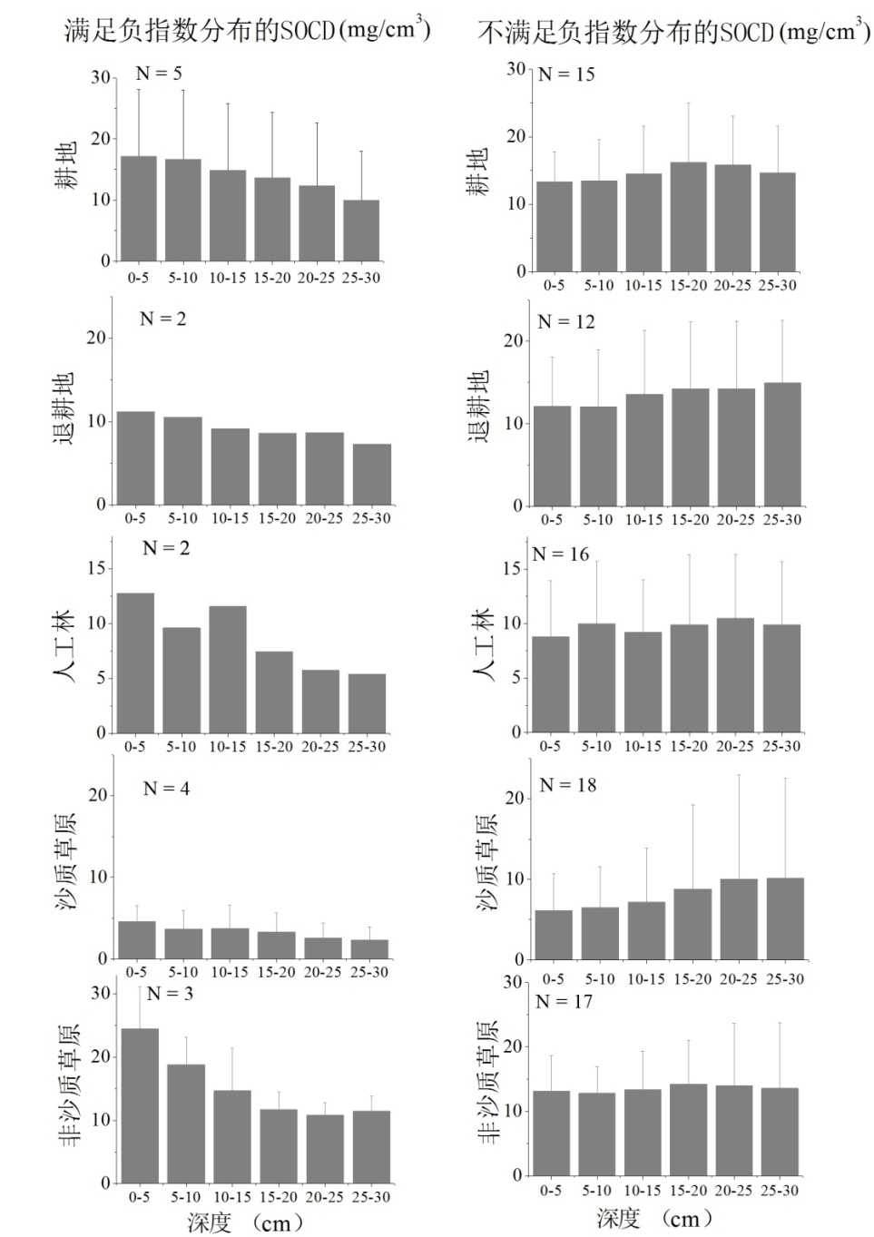
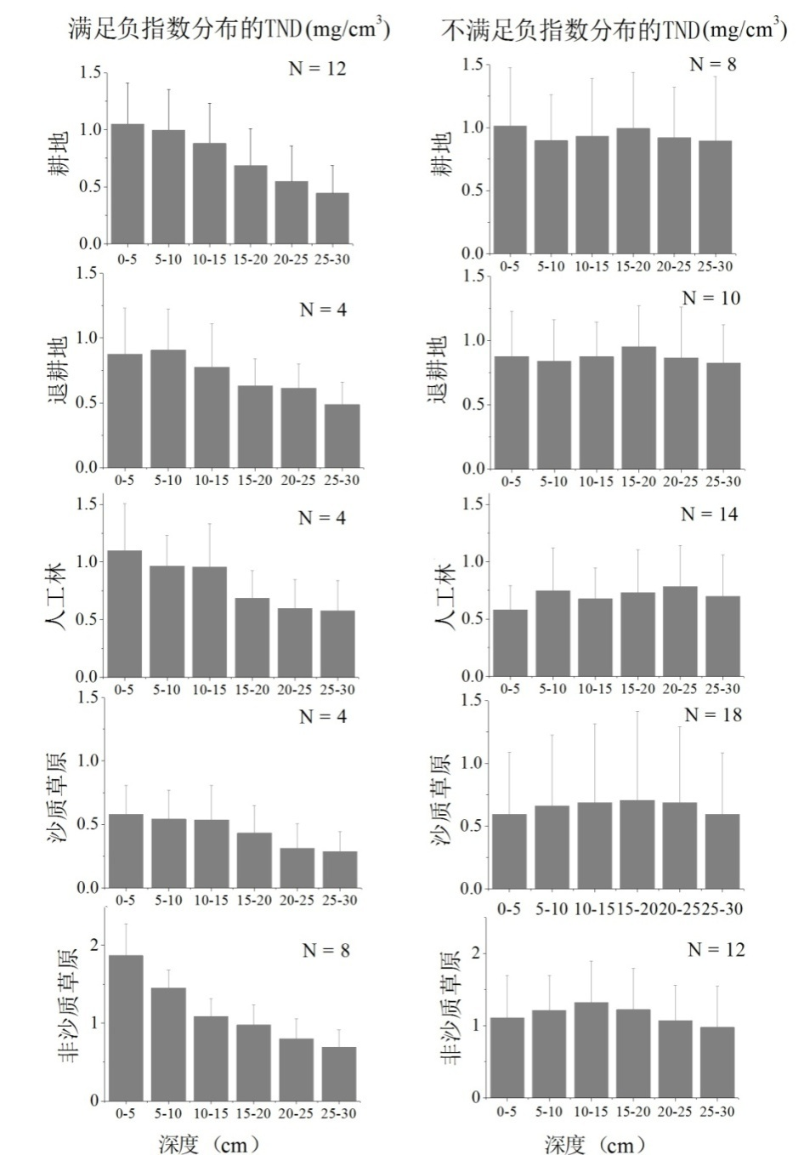
Vertical distributions of SOCD and TND
SOCD
TND
Non-eroded Eroded
Non-eroded Eroded
Cropland
Abandoned cropland
Plantation
Depth (cm)
Grassland (sandy)
Grassland (non-sandy)
Paris workshop, Sino-French Institute for Earth System Science (SOFIE)
Oct. 13-14, 2014

Slide 14
Proportion of eroded profiles
 | SOCD | TND
Cropland | 75% | 40%
Abandoned cropland | 86% | 71%
Plantation | 89% | 78%
Grassland (sandy soil) | 82% | 82%
Grassland (non-sandy soil | 85% | 60%
Paris workshop, Sino-French Institute for Earth System Science (SOFIE)
Oct. 13-14, 2014

Slide 15
Carbon and nitrogen reductions per hectare
Land use type | SOCD (t/hm²) | TND (t/hm²)
Cropland | 10.9 | 1.0
Abandoned cropland | 8.4 | 0.7
Plantation | 13.6 | 0.8
Grassland (sandy soil) | 11.1 | 0.6
Grassland (non-sandy soil) | 32.9 | 0.1
Carbon loss = EC_{lower} × Ratio (NC) – EC_{upper}
Nitrogen loss= EN_{lower}× Ratio (NN) – En_{upper}
Ratio (NC) = NC_{upper}/NC_{lower}
Ratio (NN) = NN_{upper}/NN_{lower}
TND for plantation
TND for plantation
Depth (cm)
Depth (cm)
Paris workshop, Sino-French Institute for Earth System Science (SOFIE)
Oct. 13-14, 2014

Slide 16
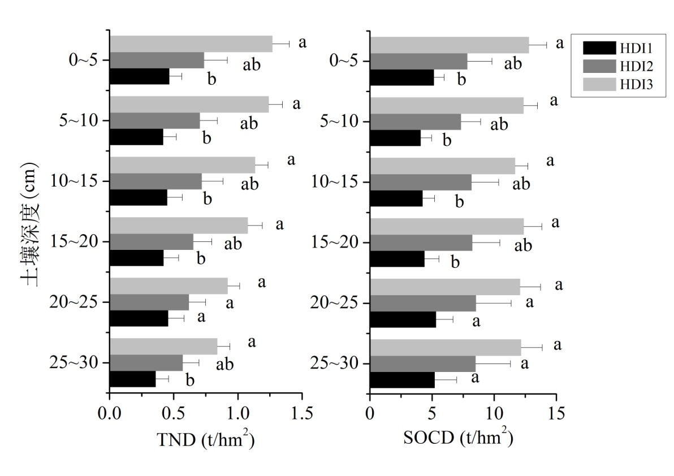
SOCD and TND distributions with HDI
Soil depth (cm)
 | TND(t/hm²) | SOCD (t/hm²)
HDI1 Severe degradation | 1.28 (0.31)a | 14.18 (3.32)a
HDI2 Moderate degradation | 2.00 (0.41)ab | 24.29 (6.42)ab
HDI3 Slight degradation | 3.24 (0.28)b | 36.72 (3.75)b
Paris workshop, Sino-French Institute for Earth System Science (SOFIE)
Oct. 13-14, 2014

Slide 17
Historical carbon and nitrogen losses
Grassland degradation was the severest from the 1970s to the 1990s.
Degraded area had increased from 2.13 × 10⁵ km² to 3.87 × 10⁵ km² , but level of degradation is not clear.
We assume three scenarios.
Slight degradation
34 Tg N loss
391 Tg C loss
22 Tg N loss
216 Tg C loss
13 Tg N loss
176 Tg C loss
Severe degradation
Medium degradation
N loss: 13Tg—34Tg; C loss:176Tg—391Tg
Paris workshop, Sino-French Institute for Earth System Science (SOFIE)
Oct. 13-14, 2014

Slide 18
Human contribution to C and N losses
Particle size of long-distance transported dust is confined to 2—16 µm (clay and silt). Carbon and nitrogen are adhered to fine particles. Eroded fine particles lead to carbon and nitrogen losses, implying that most of the eroded carbon and nitrogen were transported a long-distance to downwind regions.
Human accelerated carbon and nitrogen losses are not necessary related to vegetation cover. Annuals in degraded grassland, cropland and plantation might not function well as perennials in mature grassland.
Paris workshop, Sino-French Institute for Earth System Science (SOFIE)
Oct. 13-14, 2014

Slide 19
Summary
Application of human disturbance index (HDI) reveals how human land use accelerates carbon and nitrogen losses.
Early stage of grassland degradation has the highest carbon loss. Grassland on non-sandy soil has the highest soil carbon density and should be protected from further erosion.
Simply planting trees and grasses to restore vegetation cover should be avoided. Increase perennial cover is recommended.
Next step: to add the recent collected 235 soil profiles to the current database with 114 soil profiles used in this study.
Paris workshop, Sino-French Institute for Earth System Science (SOFIE)
Oct. 13-14, 2014

Slide 20
Thank you very much for your attention!

