Slide 1
Question 2: How to understand/assess the uncertainties in the direct radiative forcing of aerosols?
Maiheliyaer Sadeke (Mac)
Senior student in Environmental Science
Advised by Prof. Junfeng Liu

Slide 2
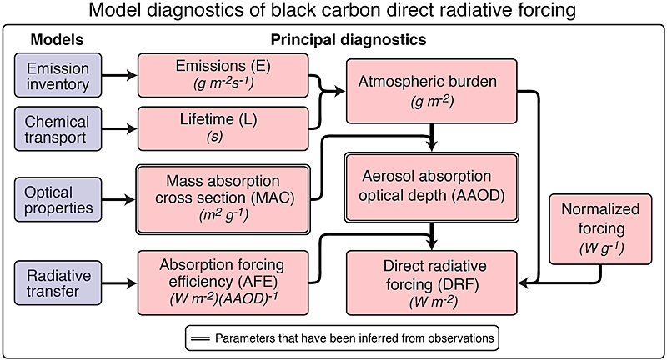
Introduction
Can be constrained
by measurements
Uncertainty in BC DRF can be attributed to variations in four factors:
Emission: 6000-18000 Gg/yr
Lifetime: 3.8-11.4 days
MAC: 4.4-13.4 m2/g
AFE: 90-270 W/m2 per AAOD
T.C. Bond et al. 2013

Slide 3
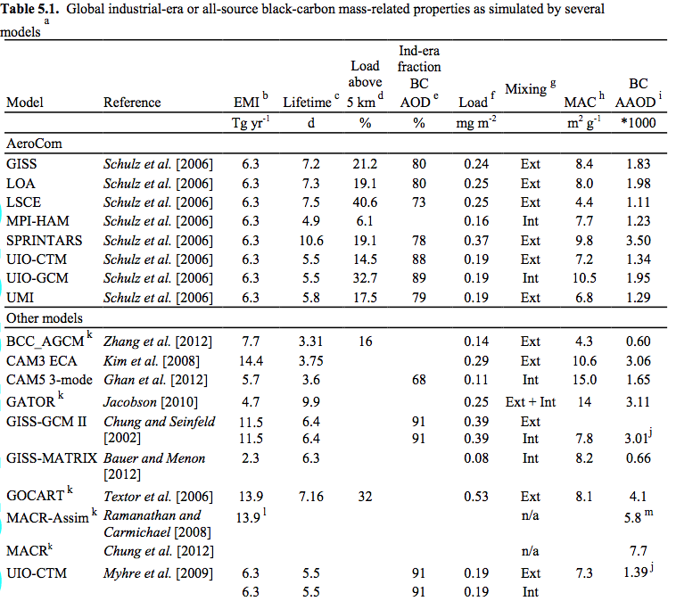

Slide 4
Emission, Lifetime, and Burden
Impact of emission rate on RF varies regionally and globally.
Representation of scavenging affects the magnitude and seasonality of BC concentration.(Internal mix & External mix)
In most models, simulated surface BC concentration is weak over-predicted in Europe, under predicted in biomass burning regions, and large under predicted for eastern and southern Asia. [Bond et al. 2013]
Vertical profiles of BC show that simulated concentrations have large biases in the free troposphere. [B.H. Samset et al. 2012]

Slide 5
Mass Absorption Cross Section (MAC)
AAOD provoked per gram of burden, absorbing ability of pollutant.
MAC depends on refractive index, water content, particle size, and mixing state.
Mixing state: mixing with other aerosol components increases MAC, leading to an increase in absorption and positive forcing. [Haywood and Shine 1995]
Chung and Seinfeld [2002] found a forcing increase of 36% for BC with homogeneous internal mixing compared with external mixing.

Slide 6
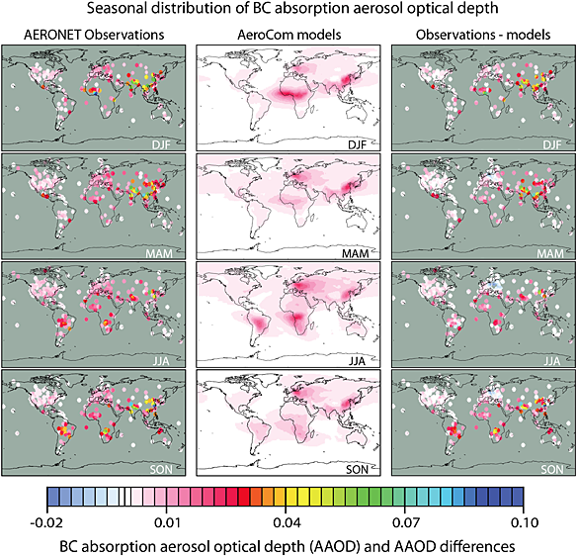
AAOD observation vs. simulation:
AAOD is the product of emission, lifetime and MAC, and it can be scaled to observations to reduce uncertainty.
Top-down method.
AAOD constraining brings bias:
BC AAOD was got from total AAOD
subtracting dust AAOD(high bias).

Slide 7
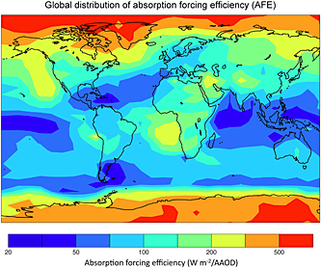
Forcing Efficiency:
Radiation perturbation caused by one unit of AAOD.
Forcing efficiency depends highly on environmental variables, especially the reflectivity of the underlying surface.
Vertical location of BC: AFE is enhanced when BC is over clouds. The model with lowest AFE has 14% of BC above 5km, while the highest has 37%. [Textor et al. 2006]
Horizontal distribution of BC.

Slide 8
Summary:
Bond et al.[2013] have the final estimate of 90% uncertainty range of +0.08 to +1.27 W/m2 with central estimate of +0.71 W/m2 (BC DRF). Uncertainty comes from uncertainties in AAOD and 50% uncertainty in AFE.
Bottom-up method
Emission
Lifetime
AAOD
AFE
Top-down method
Observation

Slide 9
Thanks for your listening

