Slide 1
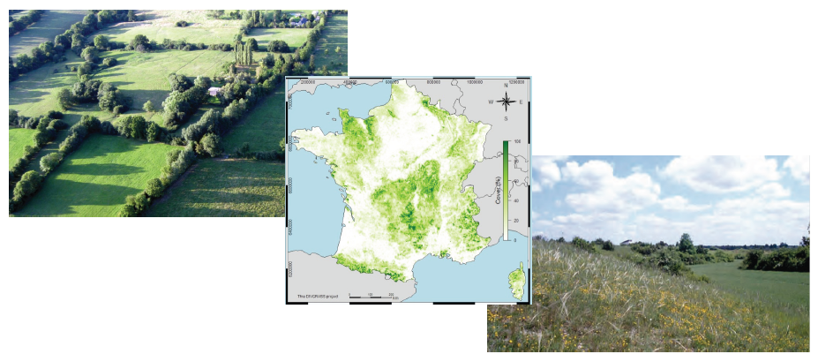
DIVGRASS: functional diversity of french permanent grasslands

Slide 2
Objectives of DIVGRASS
Compile a unique dataset on vegetation distribution on French grassland
Compile a unique dataset on functionnal traits
based on french datasets and the TRY database
Analyse the coupling between floristic releves and traits
Define new relationships to be include in vegetation models

Slide 3
Method
Releves allows to know the number of species and there occurrence in each gridcell
A community Weighted mean is calculated for each traits weighting species traits values by there relatives occurrences
Relationship between CWM and environment is estimated
Spatial maps of traits are defined and included in ORCHIDEE

Slide 4
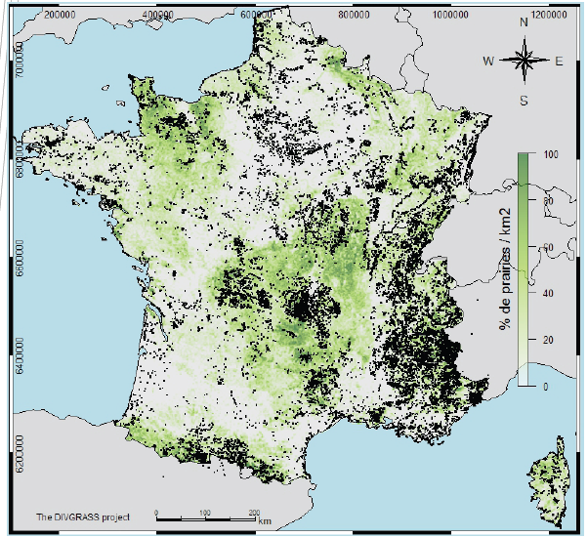
The floristic releves database
About 90 000 releves

Slide 5
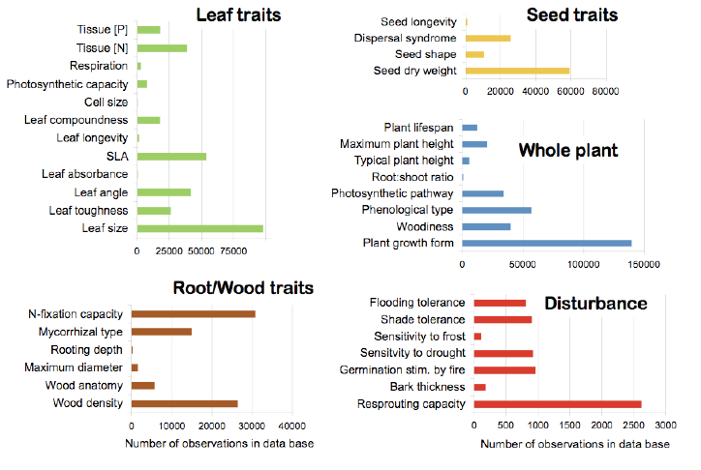
The TRY database
Number of observations per traits

Slide 6
Other useful drivers from French AGRESTE statistics

Slide 7
Relationship between traits and CWM
Specific leaf area (SLA)
(m².kg-1)
Leaf Dry Mass Content (LDMC)
(g.kg-1)
Leaf N
(g.kg-1)
Leaf P
(g.kg-1)

Slide 8
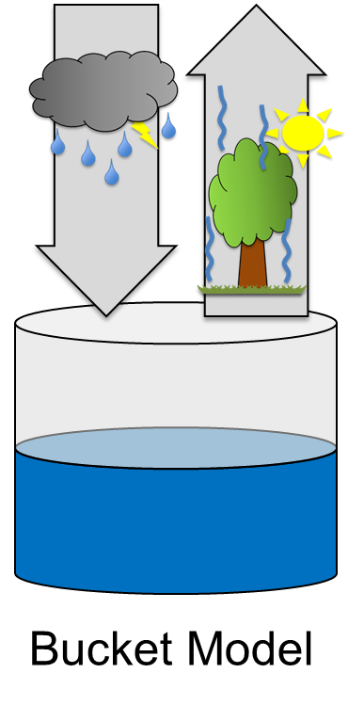
Bucket Model: Water limitation
Mean Daily Temperature
Prec
PET
5°
GSLt
1 year
mm
AWC
100%
PET
Precipitation
AWC
0%
20%
GSLw
GSLtw
→ GSLtw: Temperature & Water limitations

Slide 9
Relationship between traits and CWM
Specific leaf
area (SLA)
(m².kg-1)
Leaf Dry Mass
Content (LDMC)
(g.kg-1)
Leaf N
(g.kg-1)
Leaf P
(g.kg-1)

Slide 10
Residuals ~ Fertilization

Slide 11
Correlations between drivers and traits
GSLtw
0.43
0.36
Fertilisation
SLA
0.14
0.41
fPAR
0.24

Slide 12
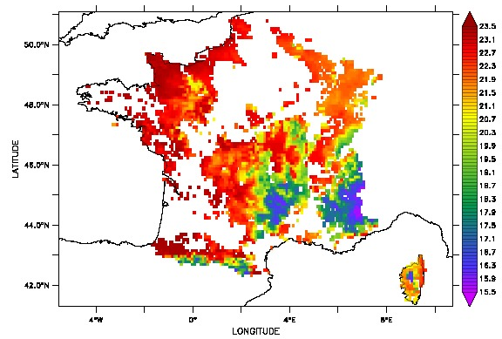
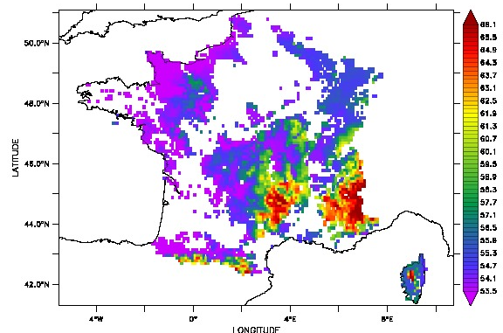
Maps of estimated traits (SLA and Vcmax)
SLA
Vcmax

Slide 13
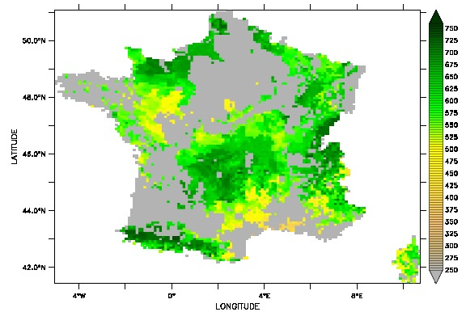
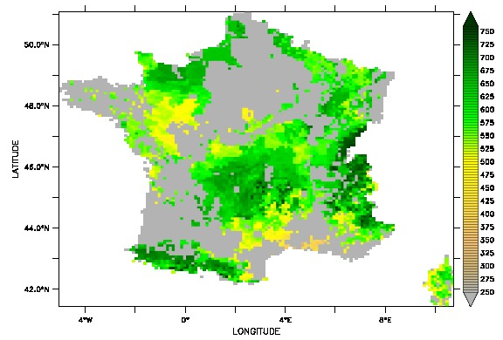
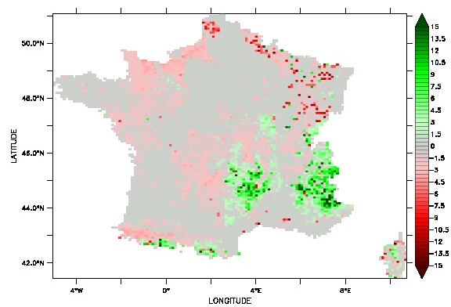
Impact of spatial mean trait variation
CWM SLA
CWM Vcmax
Annual NPP gC/m2) with mean SLA/VCMAX
Annual NPP (gC/m2) with trait maps
Viovy N, Borgy B, Violle C. Choler P.
Annual NPP difference (%)

Slide 14
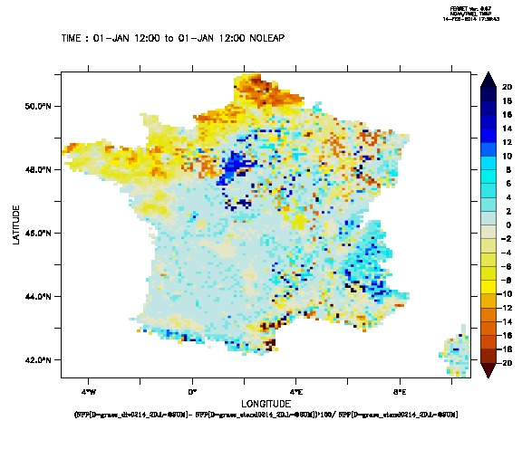
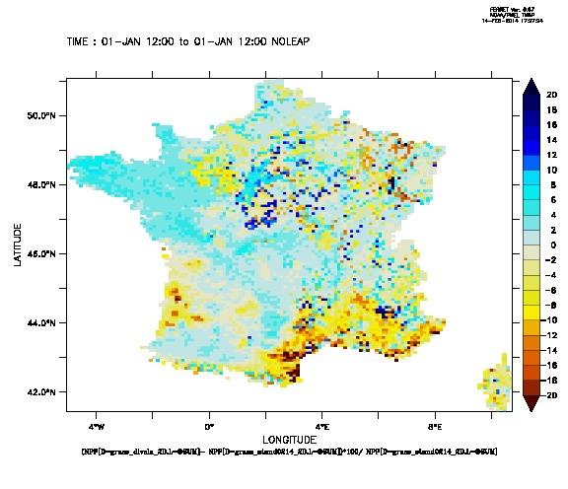
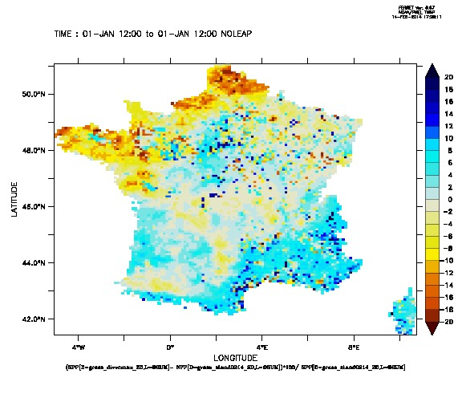
Relative impact of SLA and VCMAX
Vcmax+SLA
SLA only
Vcmax only

Slide 15
conclusion
A first attempt to compile all the data available on French permanent grassland.
Important results have been found in particular the impact of land use on the traits that appear more important that impact of climate
A first attempt to include spatial variability of traits in ORCHIDEE
Impact on NPP is important and can lead to error of more than 20% is estimated NPP

