Slide 1
Water-use Efficiency of Terrestrial Ecosystem:
Global Spatial Pattern & its Responses to Climate Variables
Yan Sun
Advisor: Professor Shilong Piao
College of Urban and Environment Sciences, Peking University
PKU-LSCE meeting, 15 MAY 2014
Notes:
Good morning, every body. I’m pleasure to present my reseraches about WUE. And I will introduce it from the view of global spatial pattern. And then another student will bring her presentation about interannual changes of WUE.
So what is WUE?

Slide 2
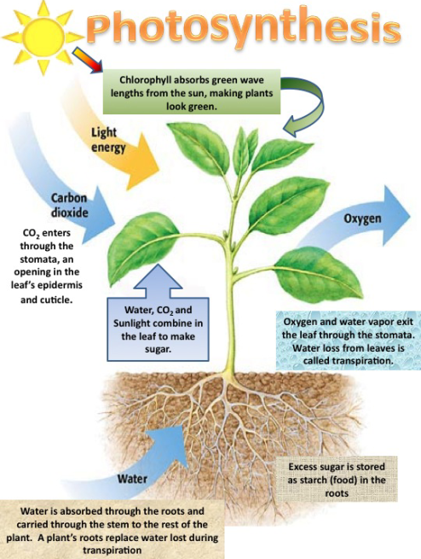
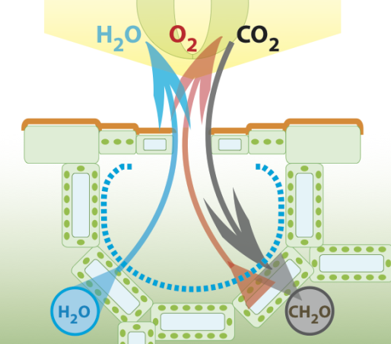
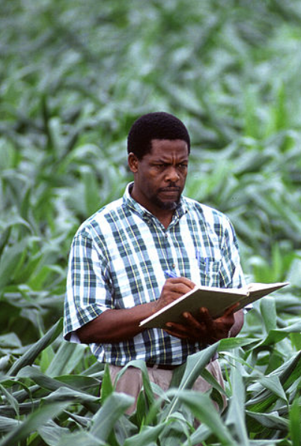
Background
What is Water-use efficiency (WUE) ?
Precipitation
Temperature
Radiation
Soil nutrient status
…
WUE
Stomata conductance
Notes:
This concept was first proposed by agronomist and was generally used in agriculture. It quantifies the relationship between water cost and carbon-fixation driven by photosynthesis. As this equation shows, WUE is calculated as …,those two processes are regulated by leaf stomata, that CO2 in meanwhile water vapor out. So a lot of previous studies on leaf level focused on the stomata behaviors and try to specify its relationship with environmental factors like…. And because water crisis is becoming more and more serious and insuffient water can directly influence the grain yield. So they concerned more about the correlation of WUE with precipitation or soil moisture or something else related with water availability.

Slide 3
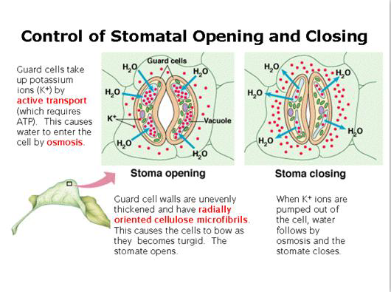
Background
Leaf scale theory of gas exchange
The conductance of water vapor is 1.6 times than that of CO₂.
Low conductance leads to high leaf WUE.
Leaf WUE is generally thought to increase under water stress due to reduced leaf stomata conductance.
Drought-resistance
Threshold
Farquhar& Sharkey et al., 1982, Annual review of plant physiology
Notes:
What about their conclusions?
Yes, that is …. They found the …
That means water loss via stomata is more easier than CO2 in.
So low conductance …
When environment is dry, plant reduce its stomata conductance and increase WUE, this response to water stress is called drought-resistance.
But this positive correlation will be inversed when environment becomes extreme dry. Because physiological processes will be affected, that is the threshold, indicates there exists a two-stage relationships between WUE and water availability.

Slide 4
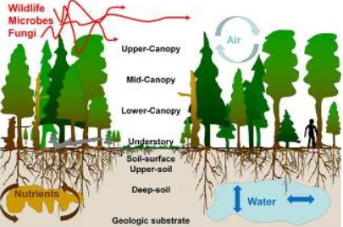
Background
Leaf scale
Ecosystem scale
ET
GPP
Transpiration
Evaporation
Notes:
However, when we talk about ecosystem WUE, the theory based on leaf level maybe not fit. Because more processes are involved and it turns to be more complex. For ecosystem, the total assimilation of CO2 is gross primary productivity (GPP), and the total water loss includes both canopy transpiration supporting plant photosynethsis and evaporation from canopy and soil surface. WUE at this scale is expressed as the ratio of GPP and ET.

Slide 5
Background
Ecosystem WUE
Stomata conductance per unit of leaf area
Vegetation structure, age and composition (ecosystem properties of vegetation-atmosphere interaction as the
result of long-term adaptation to the climate conditions)
What about the relationship between ecosystem WUE and precipitation?
Notes:
To be specific, there are key factors involved in ecosystem. We should pay attention to them. …is not only regulated by stomata conductance per unit of leaf area, but also combines ecological processes related to the vegetation structure, age and composition. And all these are the result of long-term adaptation to the climate conditions. Different ecosystem may shows different coupling relationship between water and carbon flux.
Essentially ,this quality indicates the ecosystem properties of vegetation-atmosphere interaction.
So there is a question: what about the…? Is it just like the responses occur in leaf level?

Slide 6
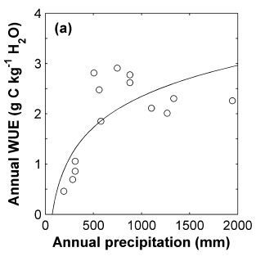
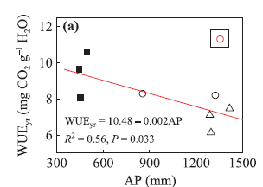
Previous studies
There is no consistent conclusion in WUE variability along precipitation gradients!
Xiao et al. (2013) showed that WUE increases with precipitation. Hu et al.(2008) pointed out that high LAI associated with sufficient precipitation leads to high WUE for grassland.
Yu et al. (2008) and Ito & Inatomi et al. (2012) reported that vegetations in dryer ecosystems tend to have higher WUE values.
Xiao et al.,2013, New Phytologist
Yu et al.,2007, AFM
Notes:
Here we list some findings from previous studies. Some paper reported that WUE increases with precipitation, but some results show opposite trends along the rainfall gradients.

Slide 7
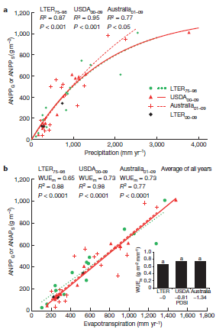
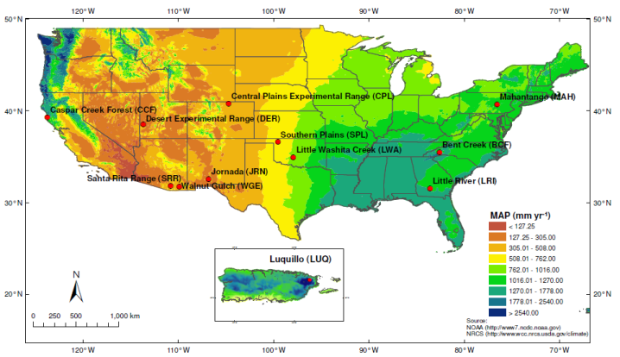
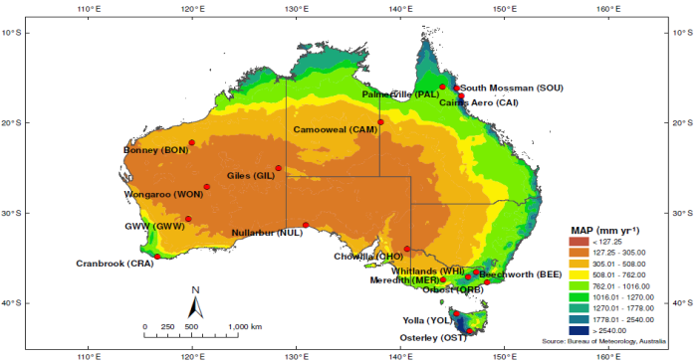
Campos et al.(2013) concluded to a constant WUE across different biomes, which they explained by ecosystem resilience. (WUE=ANPP/ET)
Campos et al.,2013,nature
Notes:
However, Campos concluded a constant WUE across different biomes based on the site-level observations. The experimental sites are distributed in America and Australia with a mean annual precipitation gradient ranging from about 100mm to 3000mm .But we note that the WUE in this paper was defined as the ANPP and ET ratio, ANPP is aboveground net primary productivity.

Slide 8
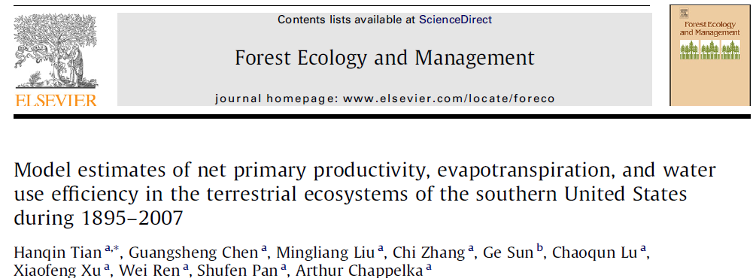
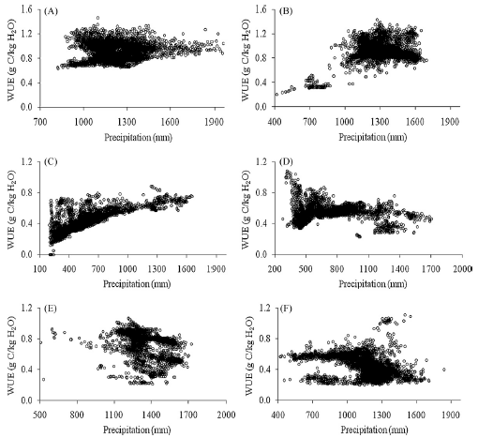
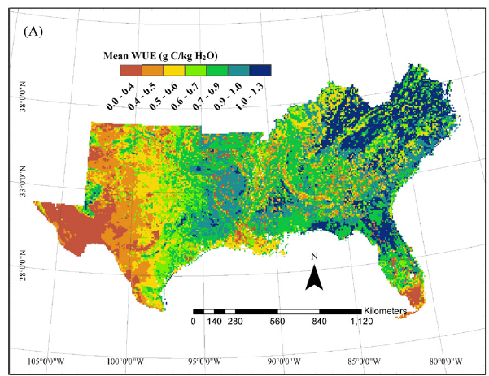
Tian et al.(2013) found the relationship between WUE and precipitation is ecosystem-specific. (WUE=NPP/ET)
Tian et al.,2010
Notes:
And Tian found that WUE trends along precipitation gradients are ecosystem-specific. Wetland and cropland biomes show negative correlations with precipitation, while WUE of forest and grassland ecosystems increases with precipitation. Here, WUE is NPP,ET ratio.

Slide 9
Previous studies
Problem
Different definitions of WUE
Local results
Confounding effect of temperature
Site-level observations
Notes:
So we sum up four main problems existed in previous studies.
First one is: different definitions of WUE were used. someone use GPP/ET, and someone use NPP/ET ratio or ANPP/ET ratio.
The second problem: Contradictions among local results can be partly due to their lack of spatial representativeness, and we want to get a view from larger scale.
The third, many studies just find the WUE trends along annual precipitation gradients, but ignore the confounding effect of temperature.becaues temperature and precipitation are covariant climate factors.
At last, if site-level observations like flux towers and long term ecological research stations can entirely represent the whole ecosystem status? Maybe there are bias compared with the whole ecosystem status.

Slide 10
Objective
To provide an analysis of the global spatial patterns of WUE.
To explore the drivers / limiting factors controlling WUE under different climate conditions.
Notes:
Based on all mentioned above, we carried out our study with the purpose to … and to …

Slide 11
Material and methods
Remote-sensing Data:
GPP | ET | Year | Resolution
MODIS | MODIS | 2000-2012 | 0.5*0.5deg
 | JUNG | 2000-2008
 | ZHANG | 2000-2006
 | WB-MTE | 2000-2009
JUNG | MODIS | 2000-2008
 | JUNG | 2000-2008(1982-2008)
 | ZHANG | 2000-2006(1983-2006)
 | WB-MTE | 2000-2008(1982-2008)
Notes:
We used Two sets of gridded GPP satellite products (MODIS and JUNG) and we use four ET remote-sensing products. Those data are all based on global scale and make it possible to solve the spatial representativeness problem mentioned before.
As this table shows, we can produce 8 maps with all of these data. And we choose generally same time periods to calculate the mean value of multi-year WUE. We can see the time span is 7-13 years.

Slide 12
Material and methods
Process-based models:
MODEL | Year | Resolution | Scenario
CLM version4.0 | 2000-2009(1982-2009) | 0.5*0.5deg | Climate change +CO₂+nitrogen deposition + land use change
LPJ | 2000-2010(1901-2010) |  | S2 (climate change+CO₂)
CABLE version3.5 | 2000-2010(1901-2010)
ORCHIDEE | 2000-2010(1981-2010)
Notes:
We used four proccess-based models :CLM, LPJ,CABLE and ORCHIDEE. For lpj, cable, orchidee, the simulation of GPP and ET are forcing by climate change and CO2 variation. In addition of climate and CO2, CLM also take nitrogen deposition and land use change into account.
Similar with remote-sensing data, we also choose a time span of about 10 years.

Slide 13
Material and methods
Calculation of WUE:
Partial correlation analysis between WUE and climate variables: moving window of 4.5°×4.5°
Notes:
And in this study, we primarily use the GPP/ET ratio as the WUE, but some other definitions will be put forward and I will introduce them latter. And then We carried out the partial correlation analysis between WUE and climate varibles (they are preci+temp), we used a moving window of 4.5 by4.5 degree and try to remove the confounding effect and discover the separate influnce of precipitation and temperature.

Slide 14
Results & Discussion
Part I: Global spatial pattern of WUE
Notes:
And Part I, I will show the results of WUE global spatial pattern.

Slide 15
Global patterns of WUE derived from remote-sensing data
Notes:
This figure shows 8 WUE maps derived from statellite data products and all of those patterns show high spatial variability. By comparison, we found there exist great differences among 8 maps especially for tropical dry lands with extreme low productivity. And We primarily attribute those disagreements to high uncertainties among 4 different data-driven ET estimations.

Slide 16
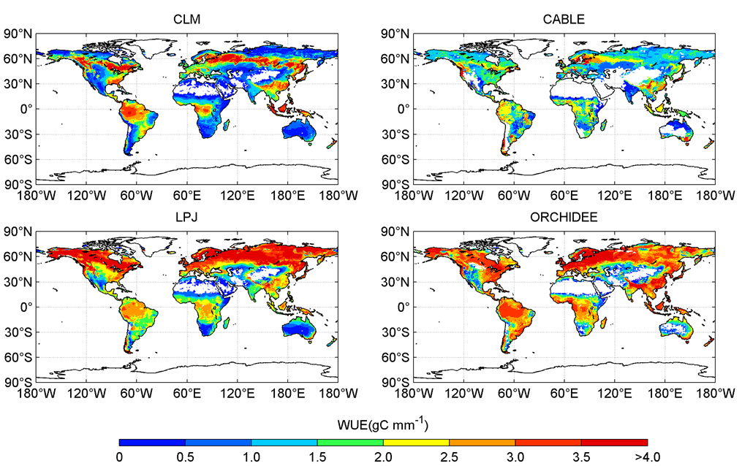
Global patterns of WUE derived from process-based models
Notes:
For process-based models, we found the differences among those 4 maps are larger than remote-sensing results especially for the high-latitude regions. CLM and CABLE think WUE of high latitude is low, but LPJ and ORCHIDEE think it high, and from the view of global, CLM shows lower values than the other three models. and that’s because we consider more limitation (nitrogen and land use change in CLM),and all of those disagreements can be mainly due to the big differences among simulated GPP outputs.

Slide 17
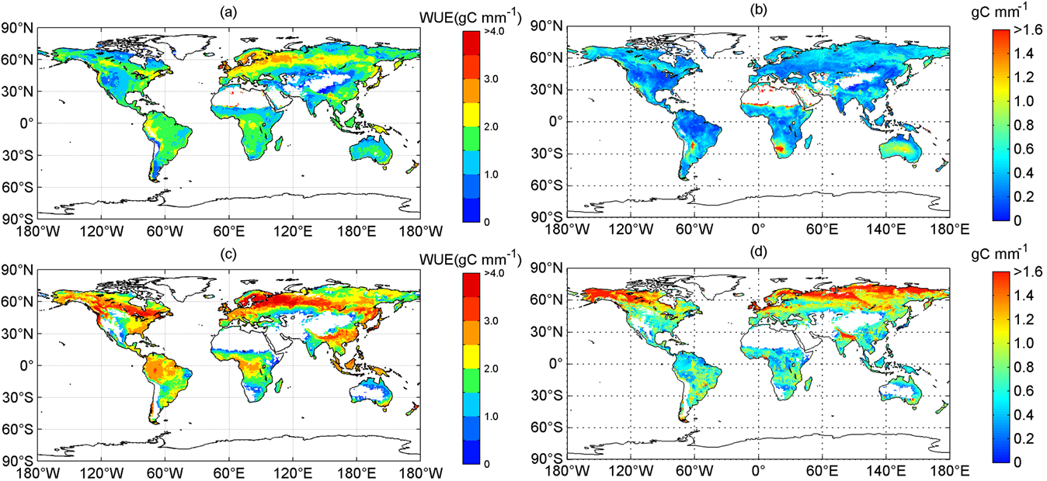
Comparison between data-driven and model results
Mean WUE derived from remote-sensing data
Standard deviations of RS results
Mean WUE derived from process models
Standard deviations of model results
Notes:
We calculated the mean WUE of RS and model results respectively, from the mean result of RS data, we can see The highest values are generally located in Northern Europe, followed by the northern Eurasia continent (roughly around 50 °N), then tropical rainforest areas.
The lowest WUE are found in the Qinghai Tibet Plateau region, India, dry land of North America and tropical area. the standard deviations are not very high. WUE from process models shows generally higher WUE values, especially in mid- and high latitude regions. But, we found this WUE pattern still keep basically consistent with remote-sensing result. We found the stds in high-latitdes are very high.
Overall, process models systematically overestimate WUE by about 25% on average and even by about 50% for boreal biomes.

Slide 18
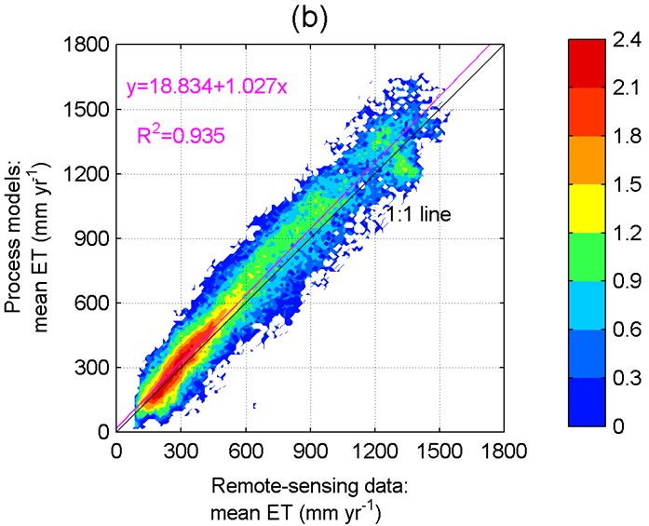
Overestimated GPP lead to higher WUE simulated by models
Notes:
Why model result is higher than remote-sensing result?
We compared the mean GPP of RS and models, and mean ET of RS and models. we found that model GPP are overestimated. because we didn’t consider human disturbances such as environment pollution and land use changes (and use change is considered in CLM but not involved in other three models.

Slide 19
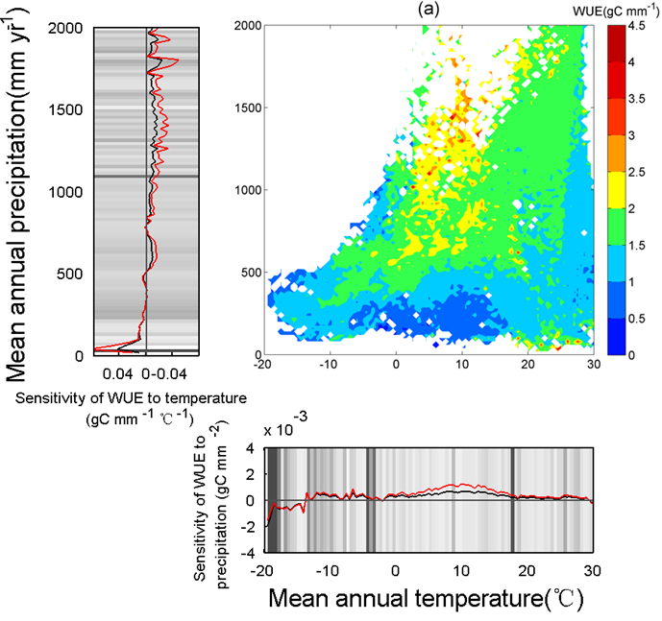
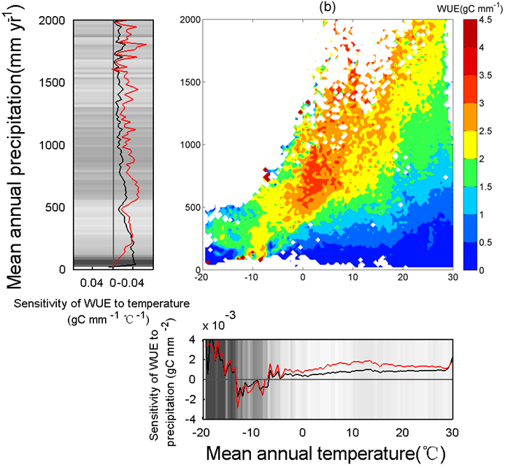
Distribution of WUE in MAT-MAP domain
Notes:
This picture, x-axis refers to mean annual temperature, y-axis means mean annual precipitation, all the climate space were divided into temperature intervals of 0.5℃ and precipitation intervals of 20 mm. diagonal distributions of WUE across the whole climate space, implying that highest WUE occur in regions with a optimal ratio of MAP and MAT. and here, based on these results, we calculated the temperature-sensitivity and precipitation-sensitivity. This black line indicates the sensitivity. here, we found the uncertainties in cold regions are very large, Data-driven results show an inverted U-shaped sensitivity curve to MAT, Differently, process-models exhibit first increasing positive sensitivities and then a basic constant high value maintained after MAT reaches 10 ℃.

Slide 20
The highest values are generally found in wetter ecosystems with high GPP!
Contradict with leaf-level conclusions?
Evaporation?
Notes:
From this part, we can conclude the highest values are generally located in wetter ecosystems with high GPP but not complete equivalency like although rainforest have the highest GPP but the intensive ET depress the WUE. and this finding seems to contradict with leaf-level conclusions.
In leaf-level, we don’t consider evaporation, we put forward another question: if the insert of evaporation make the differences between leaf and ecosystem?
Here, we defined another type of WUE, called transpiration-based WUE, equals GPP divided by transpiration via stomata.

Slide 21
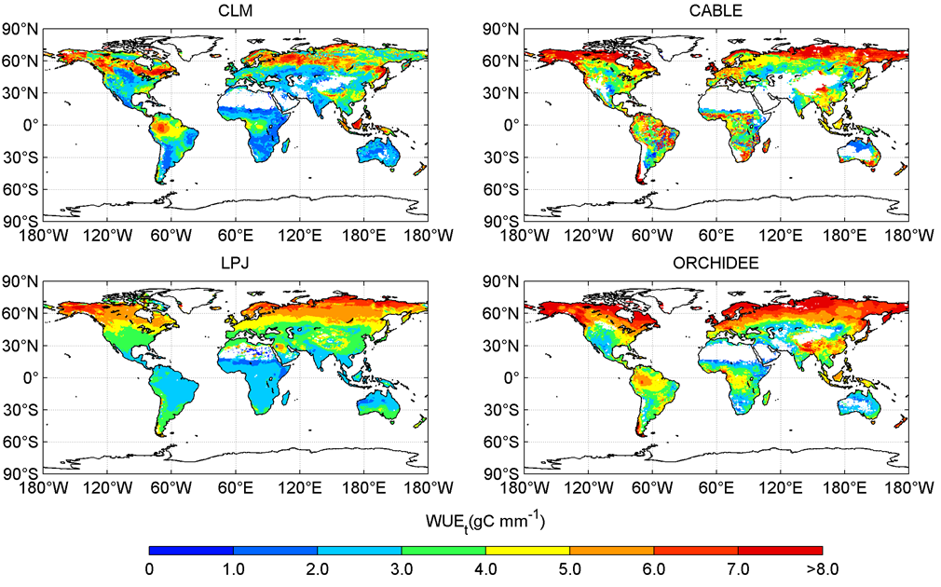
Global pattern of WUE_{t} derived from models
Notes:
This figure shows WUEt pattern, and we found they are similar with WUE pattern. Previous studies based on canopy scale have explored mechanism regulating WUEt that closed canopy absorbed more photosynthetic active radiation than the sparse ones. Differences in carbon uptake capacity were also pointed out as the main cause of WUEt variations along the humidity conditions. Consequently, well-watered ecosystem with high vegetation coverage displays overwhelming superiority in production (GPP) and hence has higher WUEt value than dryer area.

Slide 22
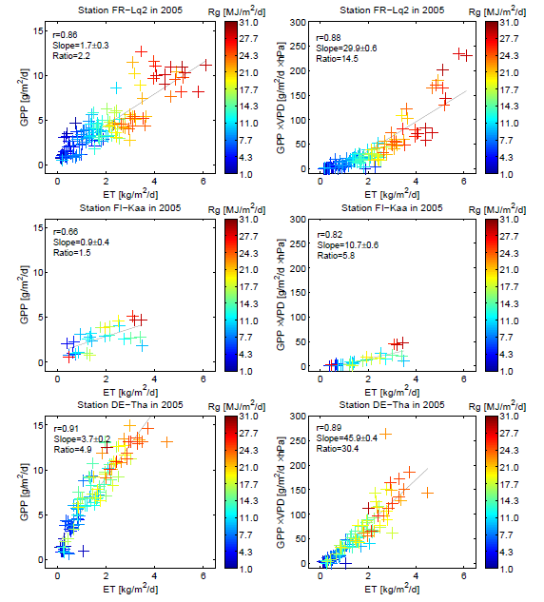
The influence of Vapor pressure deficit (VPD)?
Ponton et al., 2006, GCB
Beer et al., 2009, GBC
Notes:
Severe water concentration deficit is considered to greatly reduce leaf WUE, direct effect of VPD on WUE was also discovered at canopy or ecosystem scale. Essentially, this transfer response driven by atmospheric saturation deficit is a stomata-related physical process strongly affected by ambient conditions. Beer introduced inherent water-use efficiency into ecosystem-scale study by removing the effect of vapor pressure deficit (VPD) and reported a stronger relationship between GPP and ET·VPD than that of GPP and ET.

Slide 23
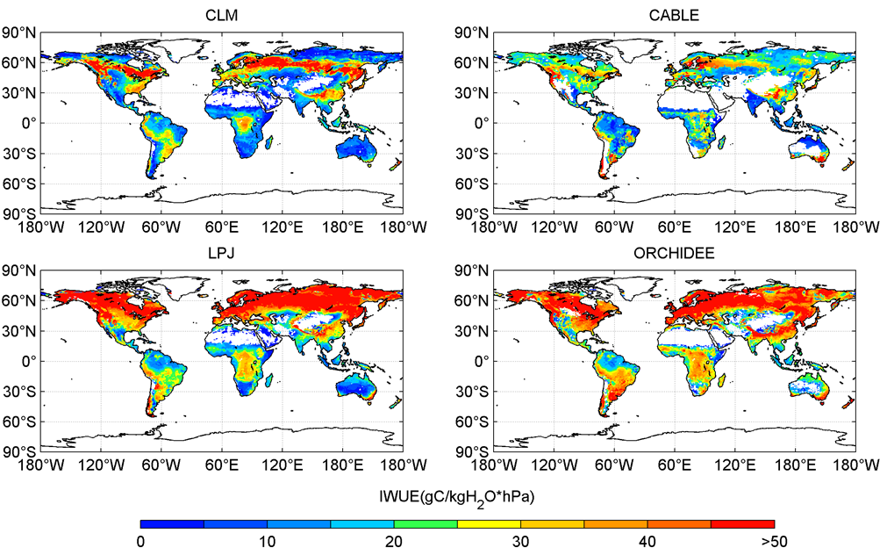
lo
Global pattern of IWUE derived from models
Notes:
Here, we just show the IWUE global pattern from models. very intresting, iwue show similar pattern with WUE and WUEt except for amzon rainforest show a low value. This result indicates both insufficient and superfluous rainfall can lead to poor physiological and ecological functions.

Slide 24
Results & Discussion
PART II: Partial correlation with climate variables
Notes:
Part2, we want to show the separate effect of precipitation and temperature on WUE. I don’t have many time to discuss our results, here I just talk about it briefly.

Slide 25
Partial correlation of mean WUE and precipitation
Notes:
We found in high-latitude, WUE decreases with increasing precipitation. The main reason is the temperature-limitation will be more serious. GPP lagely decrease and hence WUE decrease.
But for mid- and low latitude, we found WUE is positive related with precipitation, because precipitation increase GPP, and the relationship between precipitation and GPP can be clearly found in the Beer’s paper on nature

Slide 26
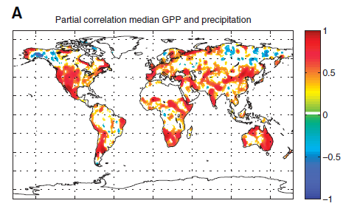
Beer et al., 2010, Nature

Slide 27
Partial correlation of mean WUE and temperature
Notes:
And the responses of WUE to temperature is positive for high latitude and negative for mid- and low latitude. but some tropical regions show decrease trends due to the hot-damage. in dryer ecosystems, WUE presents stronger and more consistent negative response to temperature.

Slide 28
Conclusions
Both data-driven and model results show generally similar WUE patterns characterized by higher value of WUE in wetter regions with higher ecosystem GPP.
Process models systematically overestimate by about 25% on average and even by about 50% for boreal biomes.
WUEt and IWUE exhibit similar patterns with WUE except for IWUE of Amazon Rain forest showing as low value as arid ecosystem.
Increased precipitation appears to be associated with high WUE in low and mid- latitudes but with low value in high latitude regions.
Increased temperature enhance WUE, while WUE of low and mid- latitudes declines with temperature and presents stronger and more consistent negative response to temperature in dryer ecosystems.
Notes:
There are conclusions.
And we also found the responses of WUE to precipitation and temperature.

Slide 29
Thanks!

