Slide 1
Stable carbon isotopes to monitor CO₂ source mix in the urban environment
F. R. Vogel, L. Wu, J-L. Bonne, M. Ramonet, G. Broquet,, P. Ciais, L. Huang and D. Worthy
Laboratoire des Sciences Du Climat et de L‘Environment, Gif-sur-Yvette, France
Environment Canada, Climate Research Division, Toronto, Canada

Slide 2
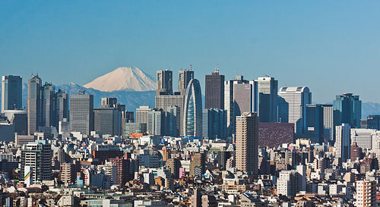
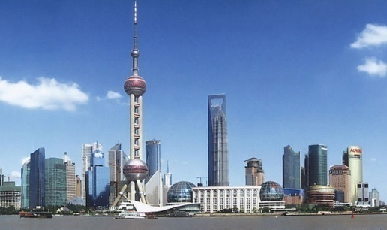
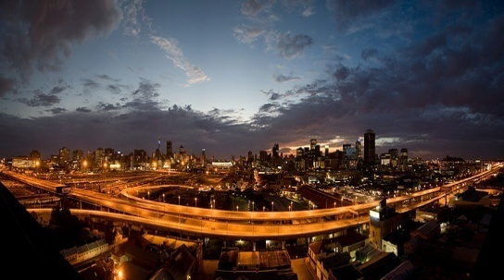
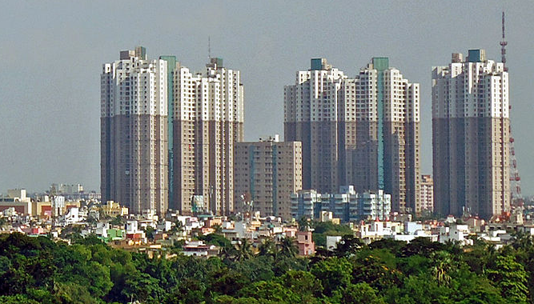
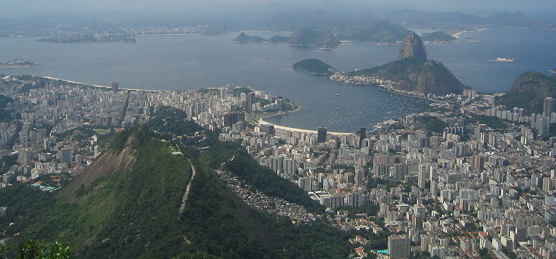
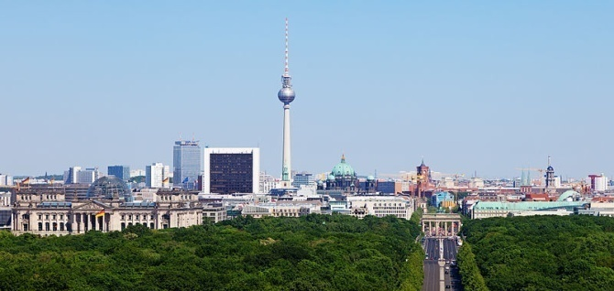
City-scale emissions
Urban areas are responsible for 67% of global primary energy consumption and 71% of global energy related (≈ fossil fuel) CO₂ emissions (IEA, 2008)…
..the urban contribution to CO₂ emissions from primary energy use is predicted to rise to 76% globally in 2030 (Dhakal, 2010).

Slide 3
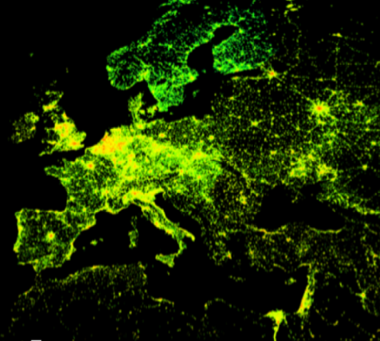
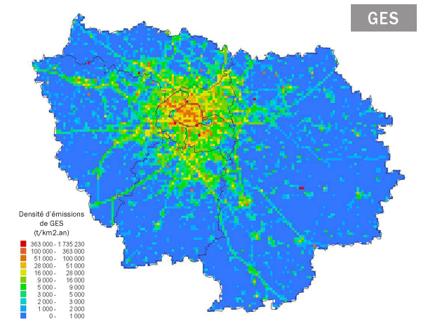
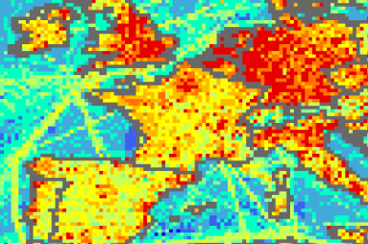
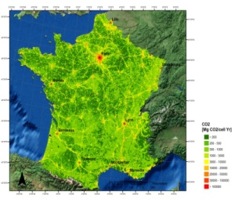
« Uncertainty » of city-scale emissions
<10%
Inconsistencies
>50%
(Developed countries, annual total)
(km-scale, hourly)
 | EDGAR V4 | IER 2005 | AIRPARIF2008 | Max – Min
Resolution | 0.1° x 0.1° | 1min x 1min | 1km x 1km
Annual budget of Ile-de-France (TgC)
Residential | 6.75 | 5.36 | 7.80 | 31%
Road | 8.50 | 6.03 | 3.37 | 60%
Industry | 5.19 | 4.61 | 3.09 | 42%
Total | 24.65 | 16.39 | 14.26 | 50%
Courtesy: Lin Wu

Slide 4
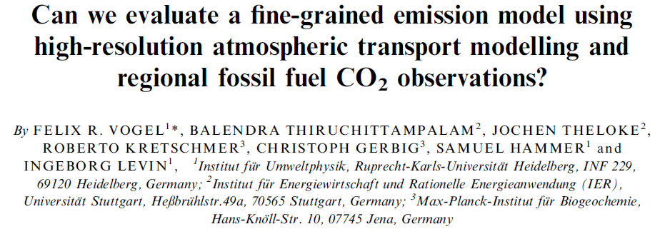
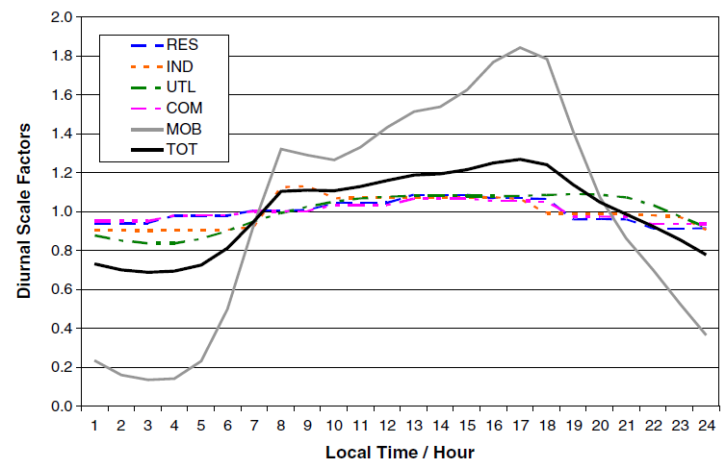
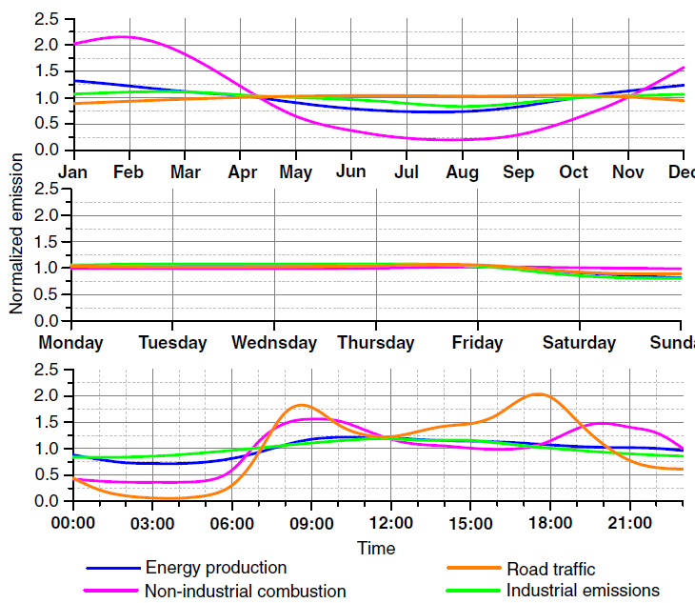
Temporal variation of fossil fuel CO₂ emissions
Uncertainty in temporal emission factors
Potential bias for selected data sets (flasks, satellites, inversion using pm only)

Slide 5
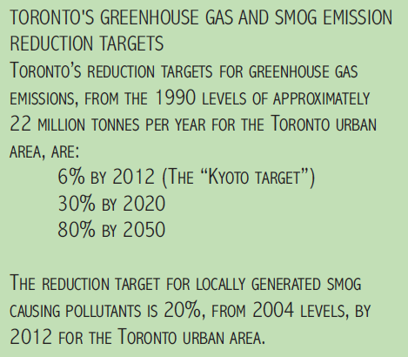
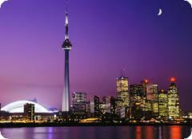
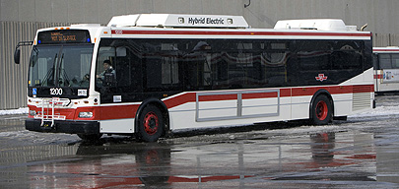
http://www.toronto.ca/environment/
>100 Million $ - retrofitting of houses and city facilities (2007)
800 Million $ - renewal of TTC bus fleet to diesel-hybrids, etc (2005-2009)
Bike lanes from 300km to 1000km until 2012
Green roof program ongoing
(Phasing out of coal power plants in Ontario)

Slide 6
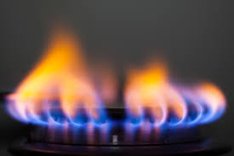
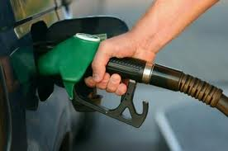
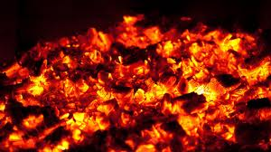
δ¹³C in CO₂ in different source sectors
Background + Fossil fuel + Bio = Total
Residential
Road traffic
Industrial

Slide 7
δ¹³C in CO₂ in different source sectors
Natural Gas
Liquid fuels
Solid fuels
Data from Environment Canada, ICF International and City of Toronto

Slide 8
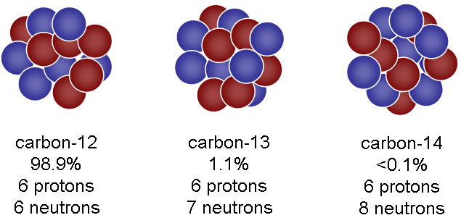
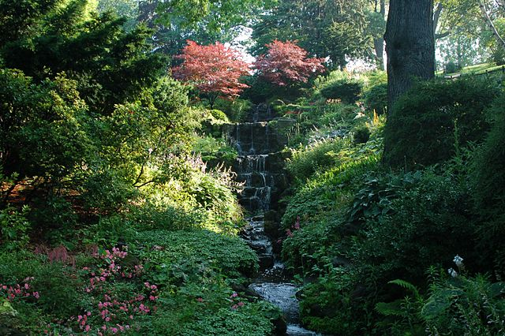
δ¹³C in CO₂ in different source sectors
Natural Gas
Carbon-13
-44‰ to -48‰
Liquid fuels
Biogenic CO₂
-27‰ to -28‰
Solid fuels
-24‰ to -27‰
C3: -20‰ to -30‰
C4: -10‰ to -15‰
Data from Environment Canada, ICF International and City of Toronto

Slide 9
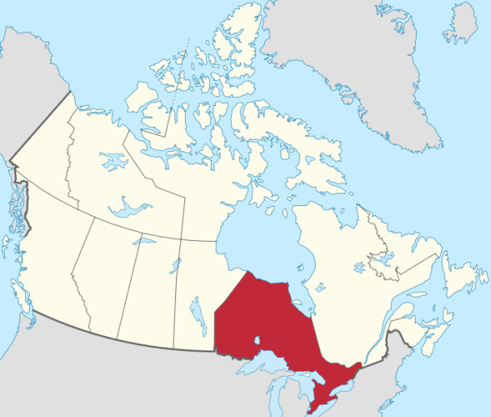
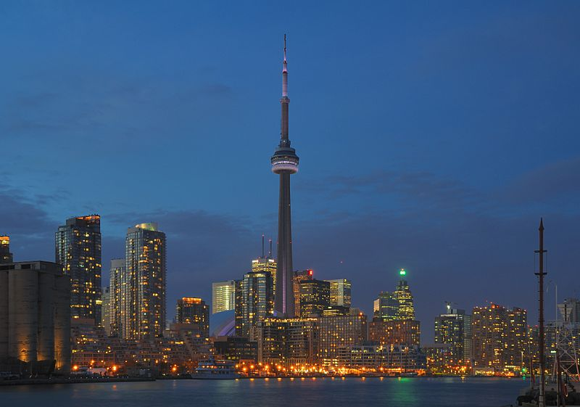
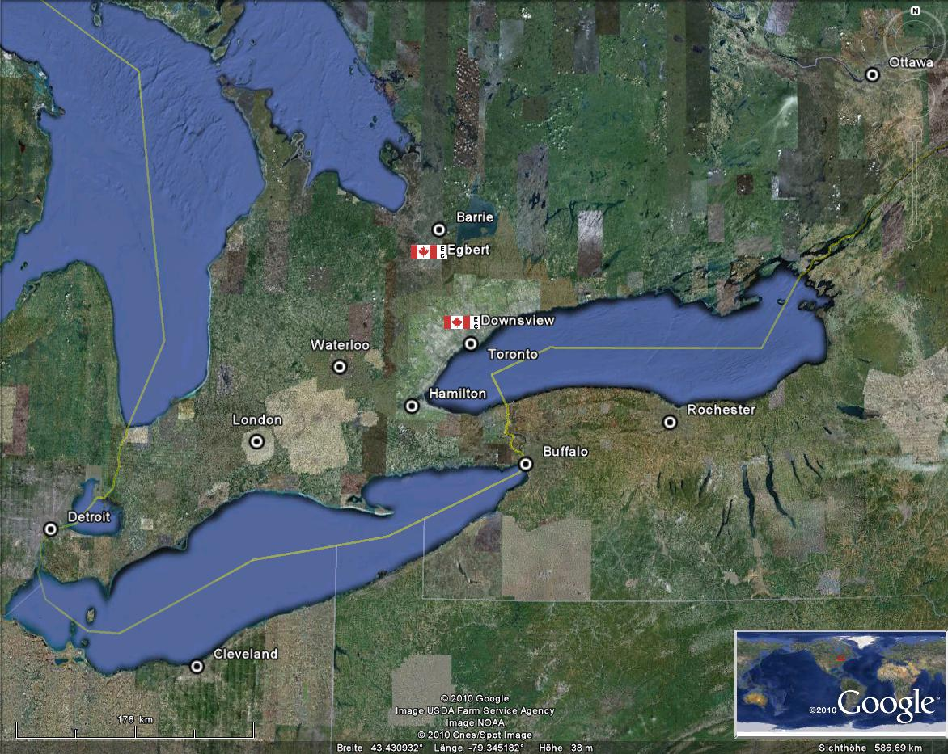
Southern Ontario, Canada
δ¹³C in CO₂ observations in Toronto, Canada

Slide 10
δ¹³C in CO₂ observations in Toronto, Canada

Slide 11
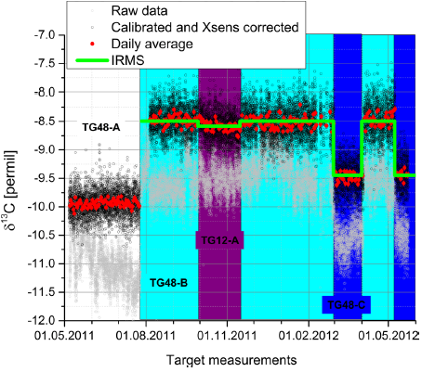
δ¹³C in CO₂ observations in Toronto, Canada
Drift disappears after calibration
Typical precision ca. 0.2 permil for 15min averages

Slide 12
δ¹³C in CO₂ observations in Toronto, Canada
Instrument performance 2014
Drift disappears after calibration
Typical precision ca. 0.2 permil for 15min averages

Slide 13
δ¹³C in CO₂ observations in Toronto, Canada

Slide 14
δ¹³C source signatures in Toronto
observations
Simple mixing calculation (keeling plot) reveals mean source signature

Slide 15
Seasonal cycle - δ¹³C source signatures in Toronto
Clear seasonal cycle in source signature

Slide 16
Seasonal cycle - δ¹³C source signatures in Toronto
Summer contribution: Bio 0.4, coal 0.2, liquid 0.3, gas 0.1
Winter contribution: Bio 0.05, coal 0.1, liquid 0.225, gas 0.675

Slide 17
Seasonal cycle - δ¹³C source signatures in Toronto
Are diurnal variations systematic?
Summer contribution: Bio 0.4, coal 0.2, liquid 0.3, gas 0.1
Winter contribution: Bio 0.05, coal 0.1, liquid 0.225, gas 0.675

Slide 18
δ¹³C source signatures in Toronto, Canada
Natural Gas
Carbon-13
-44‰ to -48‰
Liquid fuels
Biogenic CO₂
-27‰ to -28‰
Winter
Solid fuels
-24‰ to -25‰
C3: -20‰ to -30‰
C4: -10‰ to -15‰
Data from Environment Canada, ICF International and City of Toronto

Slide 19
Diurnal cycle (winter) - δ¹³C source signatures in Toronto
daytime
daytime
Data selected: ΔCO₂ >20ppm, R²>0.9 -> typically 15-20 point per hour bin
Clear daily cycle for winter data (Jan&Feb)

Slide 20
Diurnal cycle (winter) - δ¹³C source signatures in Toronto
daytime
daytime
Relativ emission strength: liquid vs gas (1:3) and (1:1)
Emissions for bio assumed below 5% and coal fixed at 10% (inventory and aerosols)

Slide 21
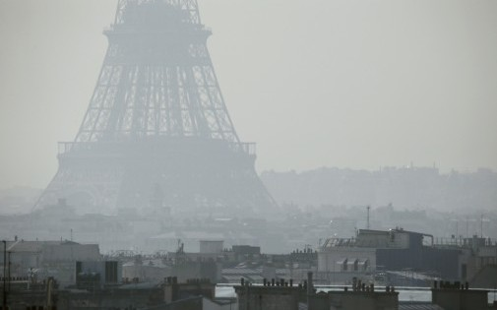
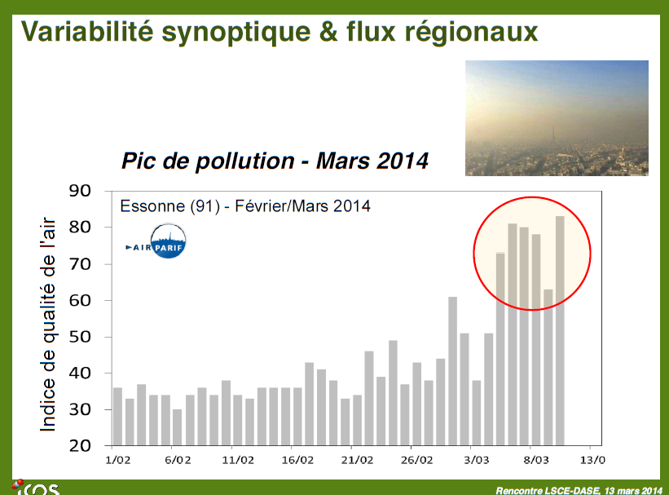
Influence of remote sources on the urban environment

Slide 22
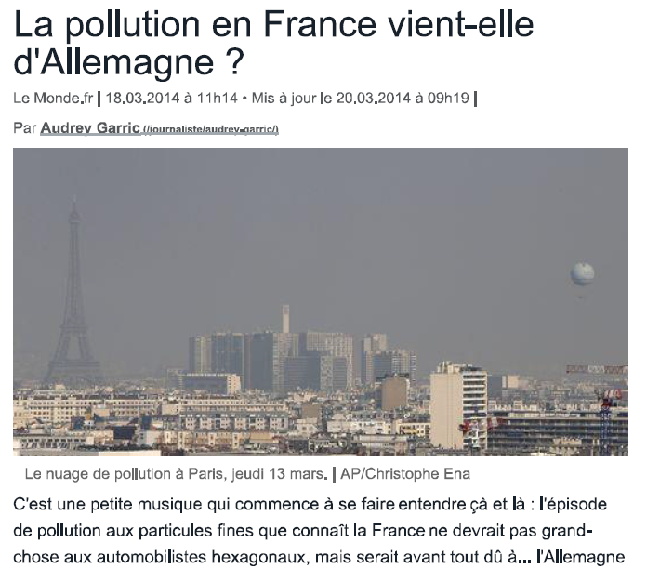
Influence of remote sources on the urban environment

Slide 23
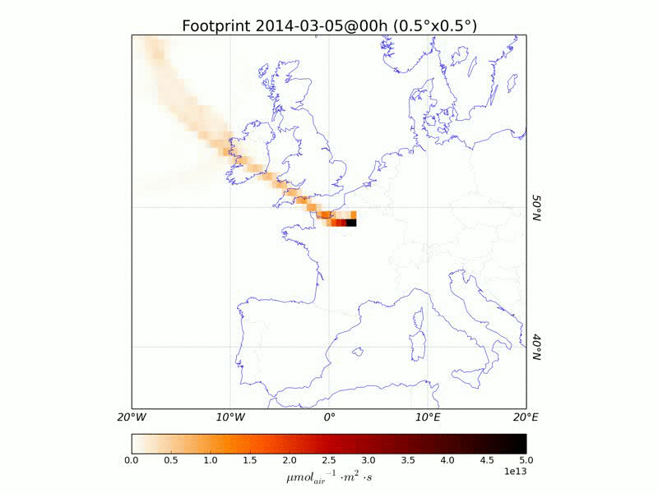
Influence of remote sources on the urban environment
Atmospheric transport model suggests sources from Germany could/should contribute

Slide 24
Influence of remote sources on the urban environment
Strong signals in δ¹³C anti-correlated with CO₂ concentration
Isotopes CAN reveal emission source

Slide 25
Influence of remote sources on the urban environment
Monthly source signature Southern Germany: (Kaul, 2007): -26 ‰ to -31 ‰
Source signature of Paris Winter 2010 (Lopez et al. 2013): -36 ‰ to -39 ‰

Slide 26
Summary of δ¹³C in CO₂ in the urban environment
Urban environments are complex, and they account for the majority of fossil fuel CO₂ emissions
δ¹³C is a fuel specific proxy
We can trace seasonal changes in the sources mix and diurnal cycle of sources (in winter)
Source signature can help to identify remote sources…
…but better constraints on sources needed to constrain emissions more precisely
Model framework (transport and inventory) needed for better interpretation of signals… under development!

Slide 27
Summary of δ¹³C in CO₂ in the urban environment
Urban environments are complex, and they account for the majority of fossil fuel CO₂ emissions
δ¹³C is a fuel specific proxy
We can trace seasonal changes in the sources mix and diurnal cycle of sources (in winter)
Source signature can help to identify remote sources…
…but better constraints on sources needed to constrain emissions more precisely
Model framework (transport and inventory) needed for better interpretation of signals… under development!
Thank you

Slide 28
Uncertainties - δ¹³C source signatures in Toronto
Natural Gas
Carbon-13
Sensitivity of method
if 20 ‰ discrimination gas to liquid:
1‰ uncertainty in keeling plot equates to 5% uncertainty of contribution
-44‰ to -48‰
Liquid fuels
Potential bias/uncertainty:
Uncertainty in gas source signature of 4‰ translates to up to 16% bias of contribution
Uncertainty in all sources of 1‰ can cause a bias of up to 10% in contribution
-27‰ to -28‰
Solid fuels
-24‰ to -25‰
Data from Environment Canada, ICF International and City of Toronto

Slide 29
City-scale observation
Paris
Natural Gas
Carbon-13
~ -39‰ to -41‰
Liquid fuels
Biogenic CO₂
~ -28‰ to 29.5‰
Winter
Solid fuels
~ -24‰ to -25‰
C3: -20‰ to -30‰
C4: -10‰ to -15‰
[Lopez et al. 2013 ACP]

Slide 30
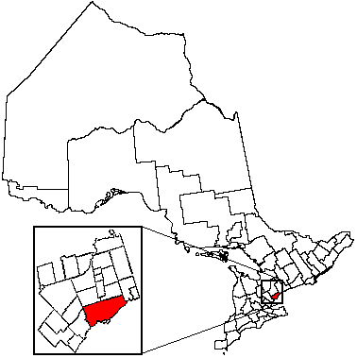
Observed δ¹³C_{source}
Bottom-up model (ICF 2008)
GTA ≈ 60 Mt CO₂
Night-time observation: -42.1± 0.7‰
Night-time : -40.4‰ to -43.8‰
Natural gas: 55±7% - Domestic heating, natural gas power plants
Liquid&solid fuels: 45±7% - Transportation, industrial processes & energy

Slide 31
δ¹³C in CO₂ observations in Toronto, Canada
Noticable instrumental drift over the course of months

Slide 32
