Slide 1
Response of terrestrial NPP to temperature variability (Ɣ_{NPP})
Huijuan Nan
Directed by Philippe Ciais & Shilong Piao

Slide 2
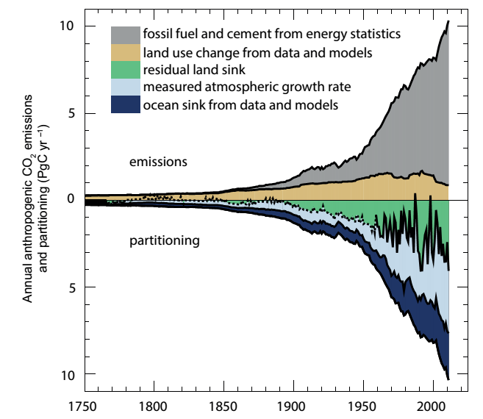
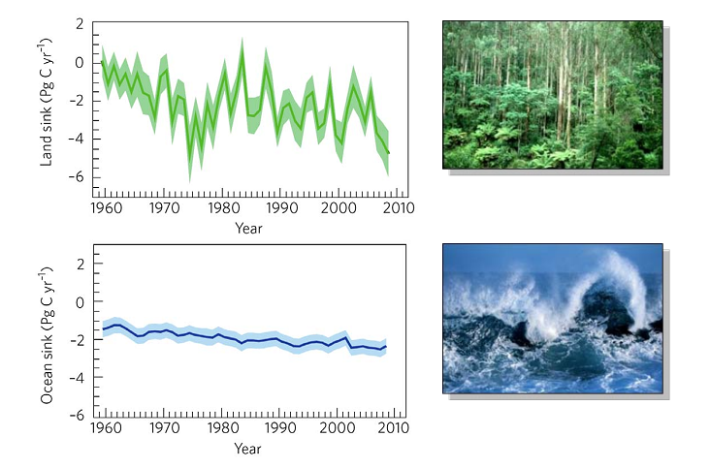

Slide 3
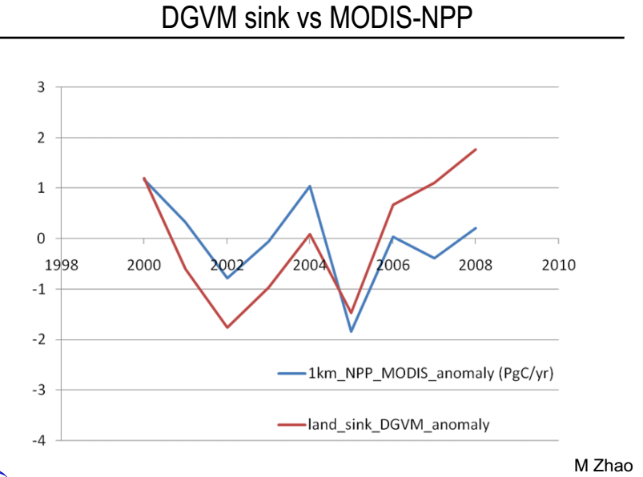
http://www.globalcarbonproject.org/global/pdf/DynamicVegetationModels.pdf

Slide 4
Climate variability and CO₂
Wang et al., Nature. 2014

Slide 5
Definition
‘gamma’ (Ɣ) measures the strength of changes in carbon fluxes by land or ocean in response to changes in climate.
(IPCC AR5)

Slide 6
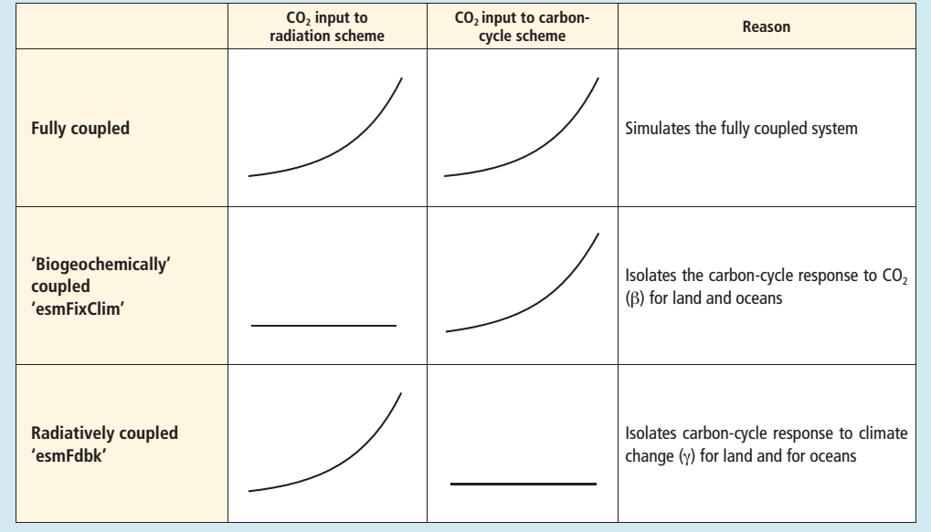
Definition

Slide 7
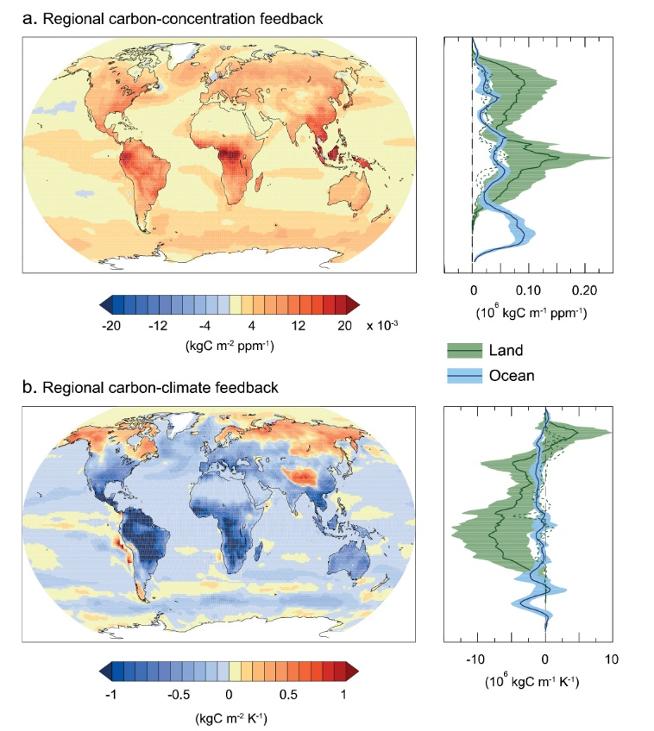

Slide 8
Definition
$$y=γ^{int}x_{T}+δ^{int}x_{P}+ε$$
The fitted regression coefficient $γ^{int}$ defines the apparent carbon flux sensitivity to interannual variations in temperature.
(Piao et al., GCB, 2013)

Slide 10
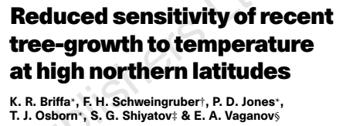
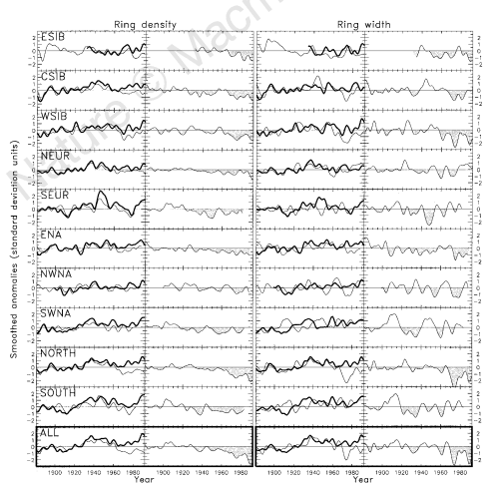

Slide 11
Change in Ɣ_{NPP} in CMIP5 ESM
$$y=γ^{int}x_{T}+δ^{int}x_{P}+ε$$
Fully coupled models
20-yr moving window
Each variable is detrended for the corresponding study period

Slide 12
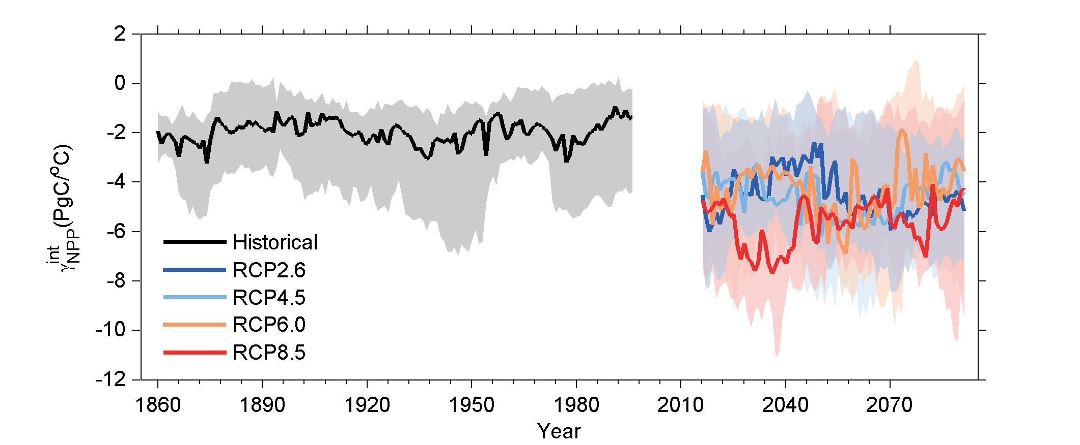
Change in Ɣ_{NPP} in CMIP5 ESM

Slide 13
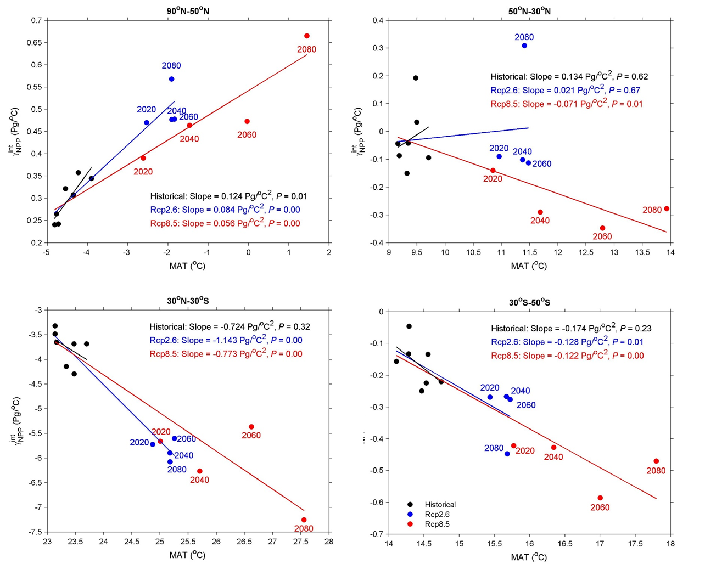
Change in Ɣ_{NPP} in CMIP5 ESM
BOREAL
TEMPERATE
TROPICAL
SH

Slide 14
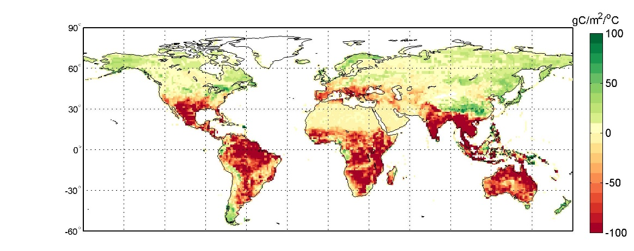
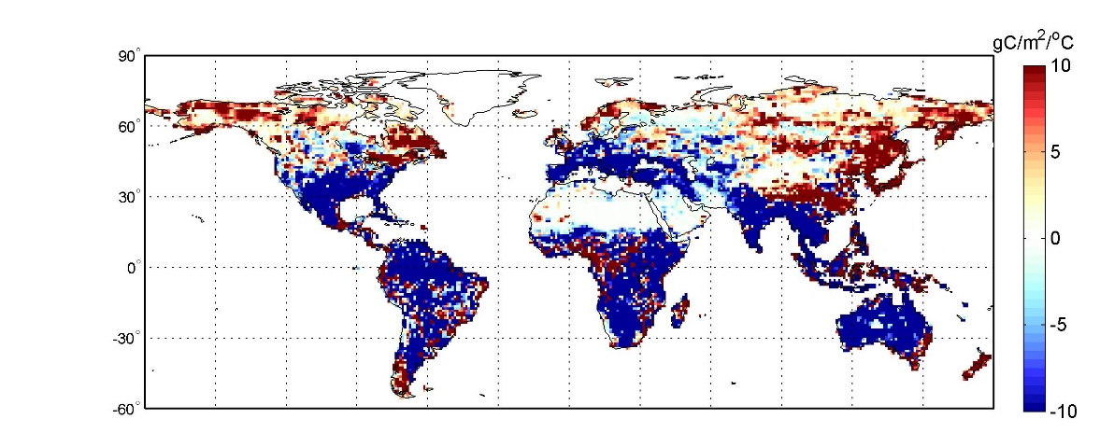
Change in Ɣ_{NPP} in CMIP5 ESM
Ɣ_{NPP} 1986-2005
Ɣ_{NPP} 2081-2100
RCP8.5
Difference in Ɣ_{NPP}

Slide 15
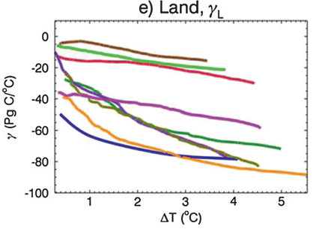

Slide 16
Thank you!

Slide 18
Trend
Interannual variability
+

