Slide 1
Global Pattern of Rain Use Efficiency and Its Impact Factors
Instructor: Hongyan Liu
Qiuyi Wang

Slide 2
Outline
Backgrounds & Scientific issues
Methods & Data sources
Preliminary results
Plans

Slide 3
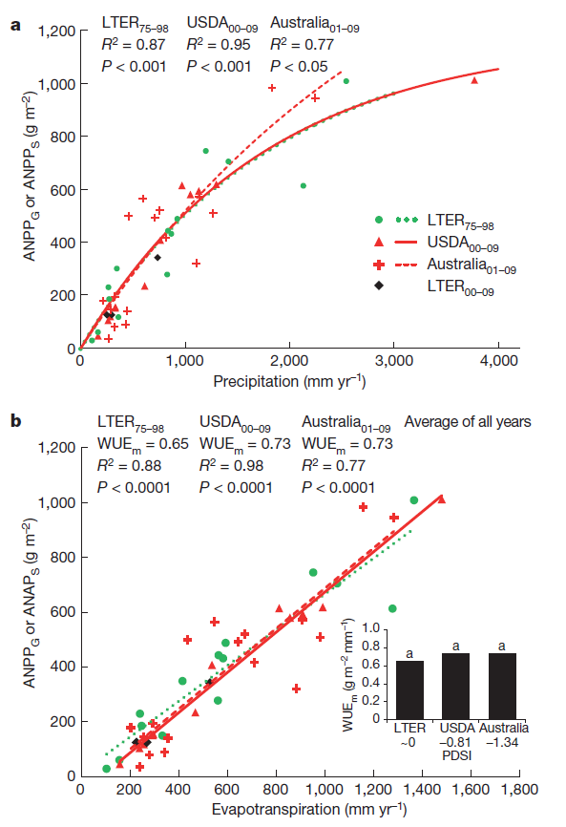
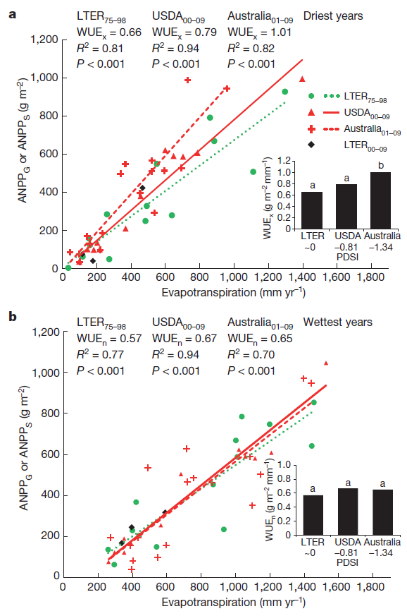
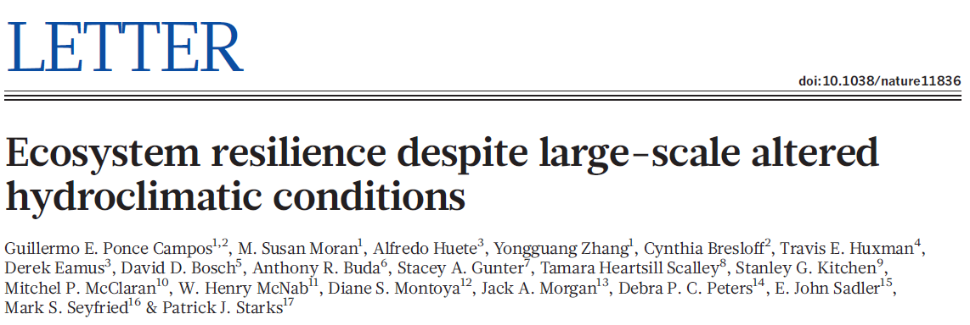
Back- grounds
Study region: USA & Australia
Cross-biome WUE:
ANPP/ET
Notes:
ET由年降水和森林覆盖度（由Google earth得出）用经验模型计算。
RUE随降水增多而减小主要是由于降水不可被完全利用，因为产生径流、补充地下水和增加土壤水，而WUE则不随降水量变化而变化，并且三个序列之间不存在显著差异
干旱年份的最高WUE指示了在十年尺度上的面对年际的降水亏缺生态系统表现出的恢复力，湿润年份统一的最低WUE则表示不同地区不同气候时期响应高降水的能力相同
ANPP与NPP的差别

Slide 4
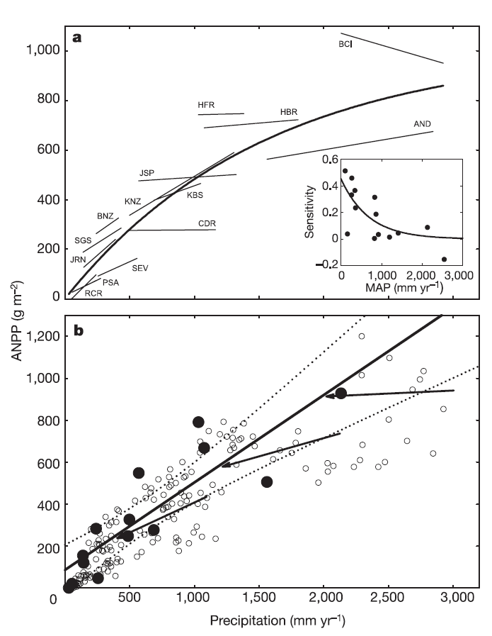
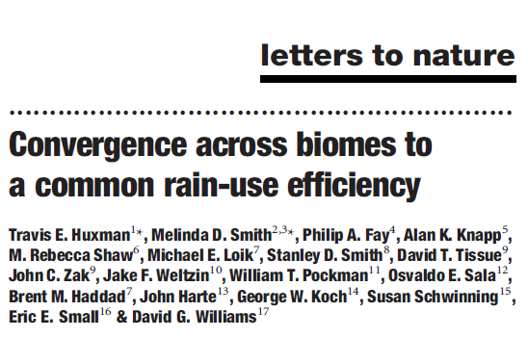
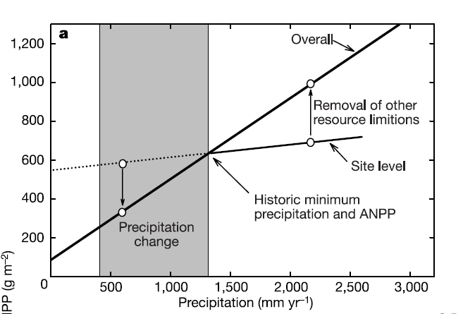
Backgrounds
Study region: North & South America
Cross-biome RUE : ANPP/Prec
High MAP : soil nitrogen or other limiting resources
Low MAP : precipitation
Water limitations → greatest : a common RUEmax
Notes:
水分最为受限的年份，荒漠、草原、森林的RUE相同，
a:粗线是将全部数据汇总在一起做出的指数函数回归，小图是14个地点的slope
b:粗线是14个地点在降水最少的年份获得ANPP的线性回归，箭头分别是降水条件最差、适中和最好的地点的slope
提出预测：变干旱：RUE增加，ANPP减少更多；湿润地区养分增加，降水成为限制条件，RUE增加，ANPP增加更多

Slide 5
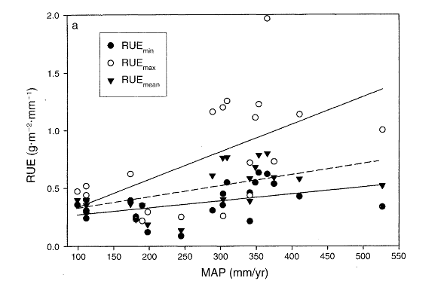
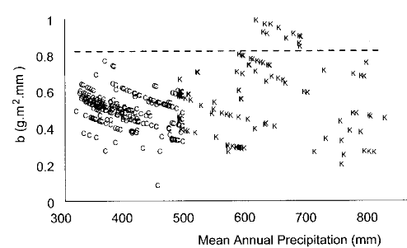
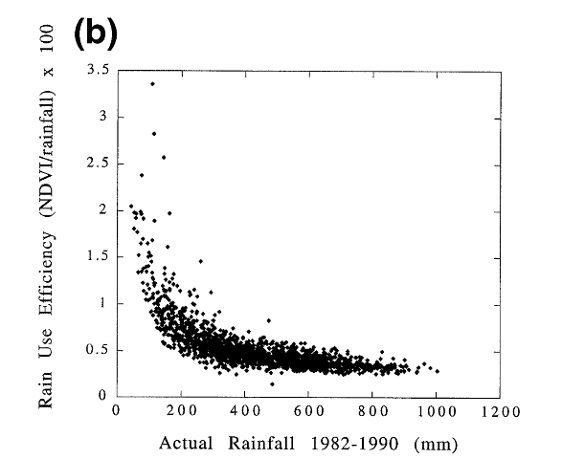
backgrounds
Mongolia Plateau
(Bai et al, 2008)
Different conclusions in different regions
Central Great Plains of USA
(Lauenroth et al, 2000)
Sahelian
(Prince et al, 1998)
Tibetan Plateau
(Yang et al, 2010)

Slide 6
Scientific issues
Vegetation rain use efficiency:
Represented the impact of water availability on ecosystem production
Connected carbon cycle and water cycle in terrestrial ecosystems
Helped to predict the response of vegetation to climate
In global scale:
Is there an uniform significant trend of RUE along precipitation gradient?
Different biomes have different RUE?
Whether climate type affect RUE within a biome?

Slide 7
Methods & Data sources
How to calculate RUE?
× Slope of linear regression of NPP and MAP
√ Ratio of NPP and MAP (gC/m^2/yr/mm)
Remove the abnormal values(0.5%)
NPP data: MODIS17-NPP Products
MAP data: CRU TS3.1
Time scale: 2000-2006
Spatial resolution: 0.5°× 0.5°

Slide 8
Global Pattern of rain use efficiency
Notes:
高值：中高纬，40-70N 20-50S，低值：地纬地区：热量带作用
高值区：欧亚大陆上蒙古-西伯利亚高原，大兴安岭山脉一线，澳大利亚南部沿海，北美西北部和南北美科迪勒拉山脉一线；
低值区：则主要在低纬稀树草原，高纬苔原和青藏高原

Slide 9
Test the results
calculated
measured
calculated
measured
Compared with measured results in Bai’s research
21 sites in Mongolia Plateau
Possible cause of the differences : MODIS NPP includes root biomass

Slide 10
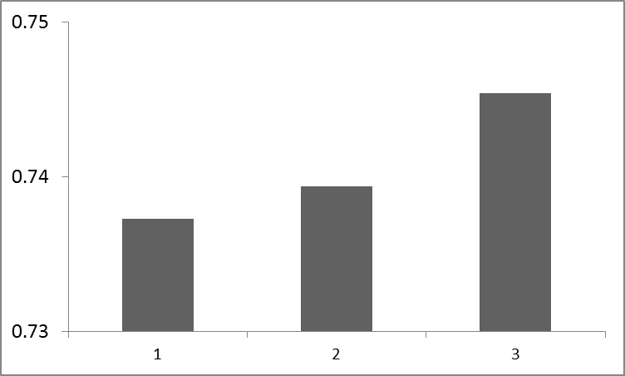
Water balance area
a
a
P/ET = 0.8 ~ 1.2
No significant difference between different ranges
a
[0.9 1.1]
[0.85 1.15]
[0.8 1.2]

Slide 11
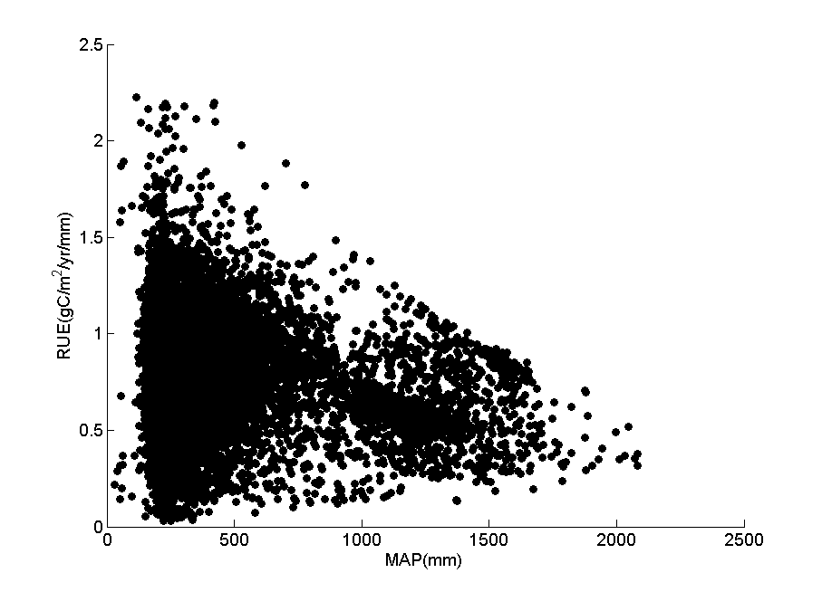
RUE-MAP
Low MAP : high variation
High MAP: low variation
Correlation coefficient = -0.061（p<0.01）
Regression :
Linear : R²=0.0036（p<0.001）
Log : R²=1.26E-05（p=0.71）

Slide 12
Compare RUE of different biomes
Classify our study region according to global biome map
And model results of upper and lower limits of NPP
Tundra: 0~423
Taiga: 124~434
Temperate Conifer: 208~704
Desert: 0~370
Temperate Grassland: 68~785
Broadleaf Forest: 81~1001
Tropical Grassland: 88~786
Tropical Forest: 323~1422

Slide 13
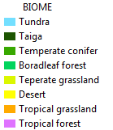
water balance area
P/ET = 0.8 ~ 1.2

Slide 14
Excluded the points beyond NPP range
Notes:
NPP range

Slide 15
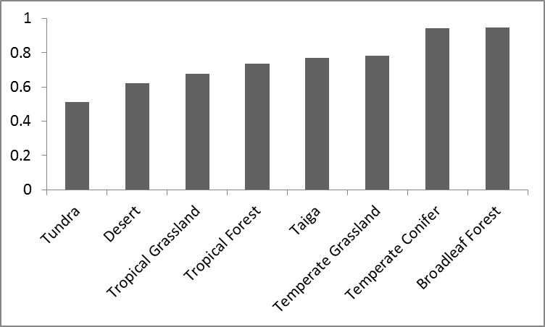
Compare RUE of different biomes
There are significant differences in RUE between biomes
No significant differences between :
Temperate Conifer & Broad leaf Forest
Taiga & Temperate Grassland

Slide 16
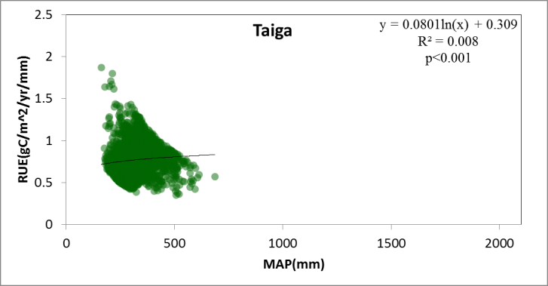
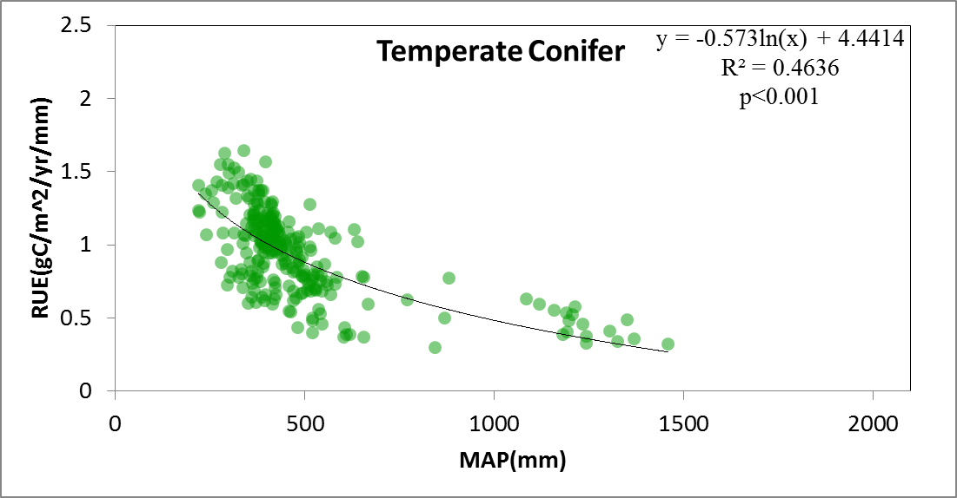
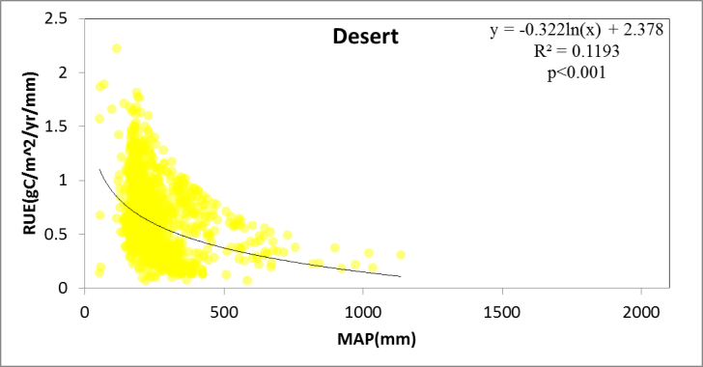
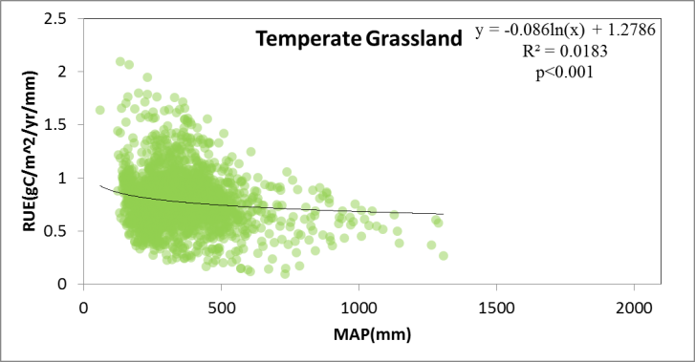
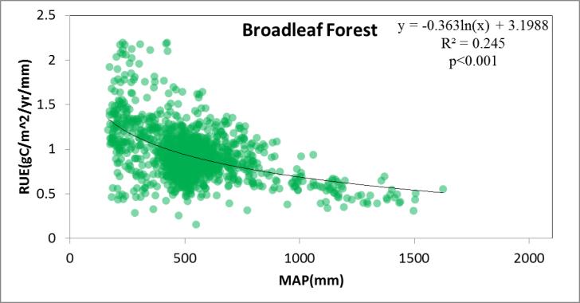
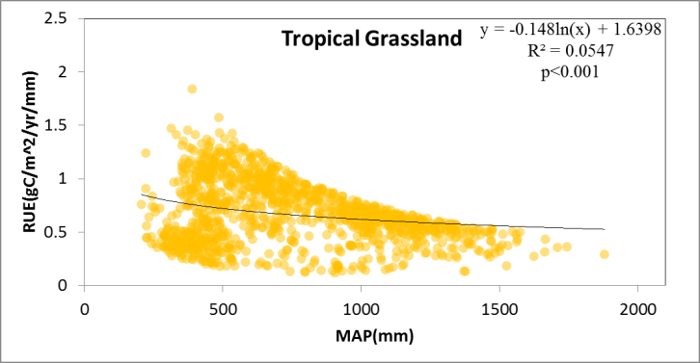
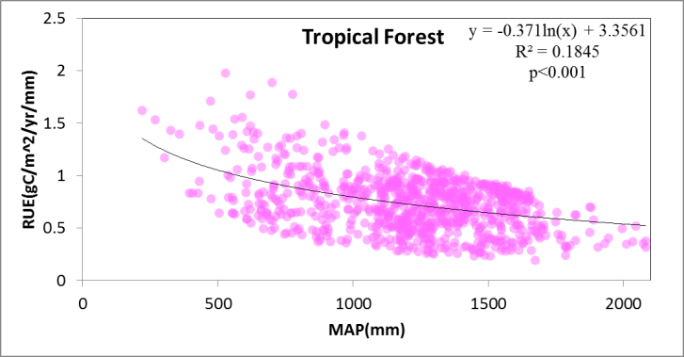
Compare RUE of different biomes
Significant negative log trend :
(except tundra and taiga)
Within the same biome, areas with water limits may have higher RUE to remain NPP.

Slide 17
Compare RUE of different climate type
* Significantly different from each other
The number is the mean RUE of the climate type
Tundra | Cold Without Dry Season Cold Summer | Cold Without Dry Season Very Cold Winter | Polar Tundra
CWC | 0.5539
CWV | * | 0.4794
PT | * | * | 0.4295
Taiga | Cold Dry Winter Cold Summer | Cold Without Dry Season Cold Summer | Cold Without Dry Season Very Cold Winter
CDC | 0.9299
CWC | * | 0.7708
CWV | * | * | 0.7045

Slide 18
Compare RUE of different climate type
Temperate Conifer | Cold Dry Winter Warm Summer | Cold Dry Winter Cold Summer | Cold Without Dry Season Warm Summer
CDW | 0.9082
CDC |  | 1.0064
CWW |  |  | 1.0153
Desert | Arid Desert Hot | Arid Desert Cold | Arid Steppe Hot | Arid Steppe Cold
ADH | 0.6032
ADC | * | 0.7545
ASH |  | * | 0.5583
ASC |  | * |  | 0.6143

Slide 19
Compare RUE of different climate type
Temperate Grassland | Arid Steppe Cold | Cold Dry Winter Warm Summer | Cold Dry Winter Cold Summer | Cold Without Dry Season Hot Summer | Cold Without Dry Season Warm Summer
ASC | 0.7850
CDW |  | 0.7527
CDC |  |  | 0.7476
CWH |  |  |  | 0.7418
CWW |  | * | * | * | 0.8150
Broadleaf Forest | Arid Steppe Cold | Temperate Without Dry Season Hot Summer | Cold Dry Winter Warm Summer | Cold Without Dry Season Warm Summer
ASC | 1.1627
TWH | * | 0.8135
CDW | * | * | 0.9164
CWW | * |  | * | 0.8400

Slide 20
Compare RUE of different climate type
Tropical Forest | Tropical Rain Forest | Tropical Monsoon | Tropical Savannah | Temperate Dry Winter Hot Summer
TR | 0.8378
TM |  | 0.7773
TS | * | * | 0.6674
TDH |  |  | * | 0.7995
Tropical Grassland | Tropical Savannah | Arid Desert Hot | Arid Steppe Hot
TS | 0.5344
ADH | * | 0.6266
ASH | * | * | 0.7646

Slide 21
conclusions
In global scale, no significant trend of RUE along precipitation gradient.
There are significant differences in RUE between biomes
For most biomes, there are significant differences in RUE between climate types

Slide 22
plans
Understand different physiological processes between biomes
Use climatic factors to explain the differences in RUE between climate types

